Slide 1


The iCARDIO Alliance
Global Implementation Guidelines
on Heart Failure
HF 2025

Slide 2
iCARDIO Alliance Global Implementation
Guidelines on Heart Failure (HF) 2025
Authors:
Vijay Chopra (India), Muhammad Shahzeb Khan (USA), Magdy Abdelhamid (Egypt), William T. Abraham (USA), Offer Amir (Israel), Stefan D. Anker (Germany), John J. Atherton (Australia), Fernando Bacal (Brazil), Ralph Stephan von Bardeleben (Germany), Dulce Brito (Portugal), Lucrecia Maria Burgos (Argentina), Javed Butler (USA), Maria Rosa Costanzo (USA), Albertino Damasceno (Mozambique), Justin A. Ezekowitz (Canada), Ishaque Hameed (USA), Sivadasanpillai Harikrishnan (India), Tiny Jaarsma (Sweden), Anuradha Lala (USA), Ileana L. Piña (USA), Clara Saldarriaga (Colombia), David Sim (Singapore), John R. Teerlink (USA), Nqoba Tsabedze (South Africa), Hiroyuki Tsutsui (Japan), Jing Yu (China), Yuhui Zhang (China), Mohammad Zubaid (Kuwait), Nikhil Balankhe (India), Juan Esteban Gomez­Mesa (Colombia), James L. Januzzi (USA), Marvin Konstam (USA), Rhonda Monroe (USA), Elijah Ogola (Kenya), Vinayagam Palaniappan (India), Mark C. Petrie (UK), Fausto J. Pinto (Portugal), Girish C. Rajadhyaksha (India), Amina Rakisheva (Kazakhstan), Carlos E. Ramos (Honduras), Victor Rossel (Chile), Naoki Sato (Japan), P. Christian Schulze (Germany), Andrew Sindone (Australia), Hadi N. Skouri (Lebanon; United Arab Emirates), Harriette G.C. Van Spall (Canada), Aistė Štaraitė (Lithuania), Lynne Warner Stevenson (USA), Kadhim Sulaiman (Oman), Tzung­Dau Wang (Taiwan), Michael Böhm (Germany), Andrew J.S. Coats# (Australia), Shelley Zieroth (Canada)
Chopra V, et al. Global Cardiol [Internet]. 2025 Jun. 30 [cited 2025 Aug. 20];3(2). Available from: https://www.globalcardiology.info/site/article/view/70

Slide 3
Aim of the global implementation guidelines
The International CARDIO Alliance to Improve Disease Outcomes aims to gather leading cardiovascular societies around the globe as partner organizations to improve the quality of cardiovascular care, from prevention and diagnosis to treatment and follow up.
The goal of these global implementation guidelines is to achieve global representation in writing panels and to produce concise and practical guidelines applicable to all cardiovascular care worldwide.
In addition to clinical practice guidelines developed by other medical associations, the recommendations by iCARDIO Alliance take into account resource availability on at least 3 economic levels (with no economic consideration; resources somewhat limited; resources severely limited).
They are written by a team including world renowned experts with a maximum of 50% of the writing task force representing Europe and North America and 50% or more from the rest of the world.
The peer review team is also made up of worldwide experts further enriching these documents and leading to a final phase of public review open to all.
Chopra V, et al. Global Cardiol [Internet]. 2025 Jun. 30 [cited 2025 Aug. 20];3(2). Available from: https://www.globalcardiology.info/site/article/view/70

Slide 4
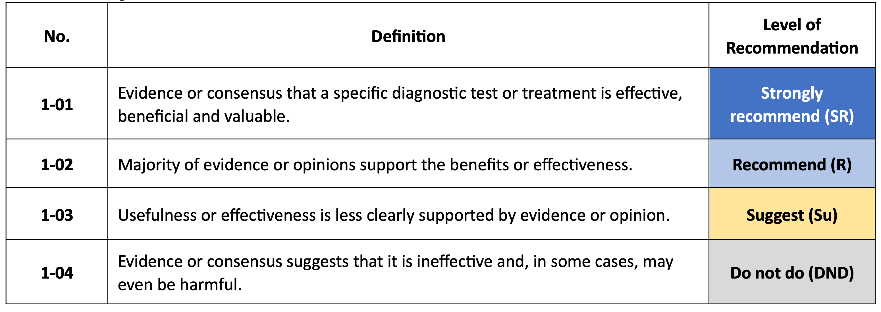
Grading and recommendation
Chopra V, et al. Global Cardiol [Internet]. 2025 Jun. 30 [cited 2025 Aug. 20];3(2). Available from: https://www.globalcardiology.info/site/article/view/70

Slide 5




17 iCARDIO Partner Societies so far
https://icardioalliance.org//partner-societies

Slide 6
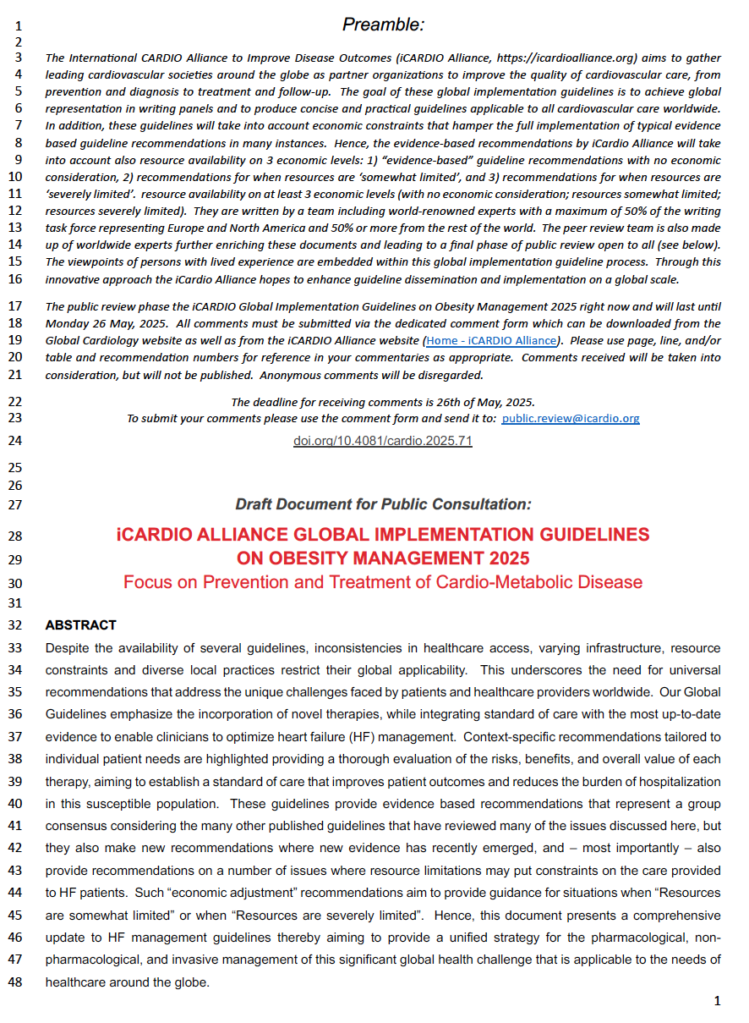
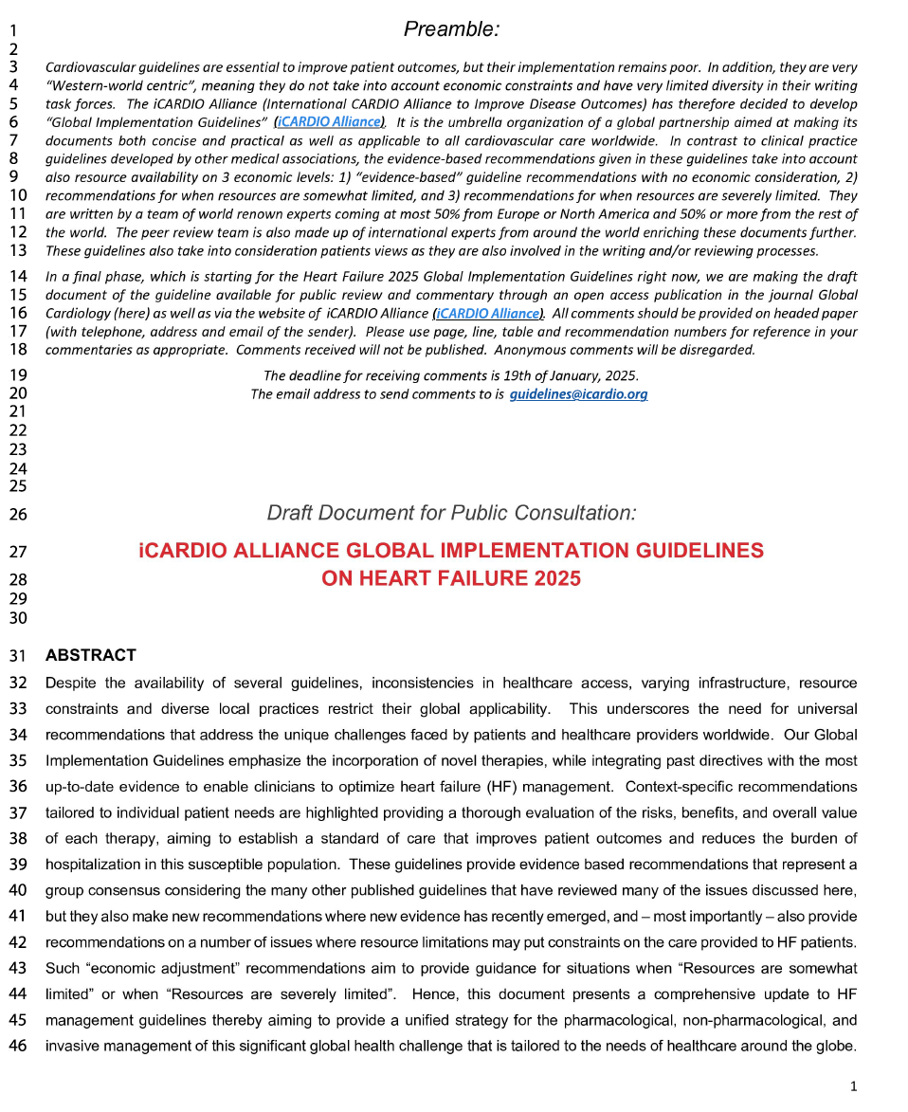
iCARDIO Alliance Global Guidelines Draft for Public Consultation
Published 1st May, 2025
Published 30th Dec, 2024
Draft Heart Failure Global GL within one month
>4000 views
795 downloads
85 comments
https://icardioalliance.org

Slide 7
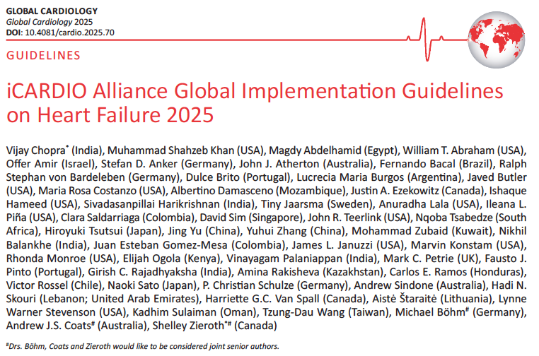

iCARDIO Alliance Global Guidelines Final HF Document
Key Characteristics:
28 Pages
47 references (the document refers to all recent major HF guidelines + references to new data not considered before)
Authors are writing task force members & reviewers
Authors from 27 countries from all continents
Most recent data include is from ACC 2025 (4 weeks before publication)
Chopra V et al. Global Cardiology 2025

Slide 8
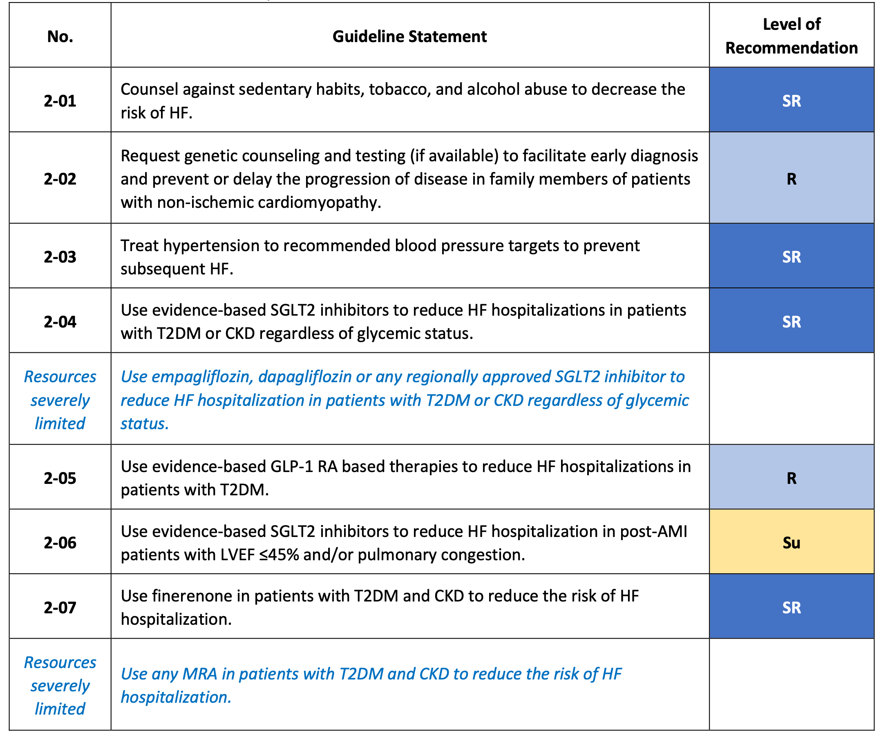
Recommendation for the prevention of HF (1/2)
Chopra V, et al. Global Cardiol [Internet]. 2025 Jun. 30 [cited 2025 Aug. 20];3(2). Available from: https://www.globalcardiology.info/site/article/view/70

Slide 9
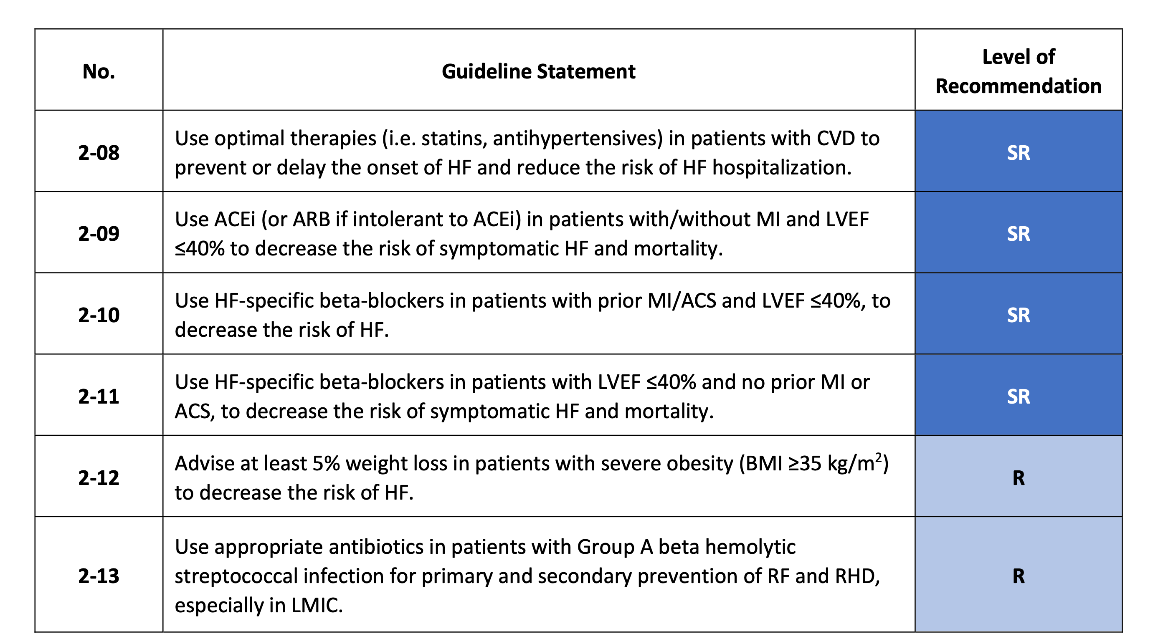
Recommendation for the prevention of HF (2/2)
Chopra V, et al. Global Cardiol [Internet]. 2025 Jun. 30 [cited 2025 Aug. 20];3(2). Available from: https://www.globalcardiology.info/site/article/view/70

Slide 10
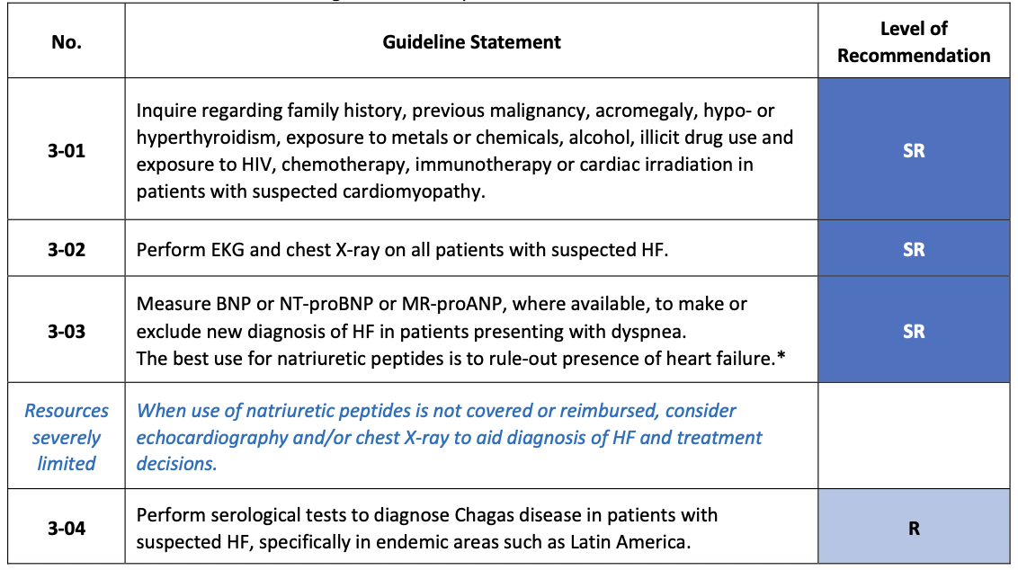
Recommendations for diagnostic tests in HF patients (1/3)
Chopra V, et al. Global Cardiol [Internet]. 2025 Jun. 30 [cited 2025 Aug. 20];3(2). Available from: https://www.globalcardiology.info/site/article/view/70

Slide 11
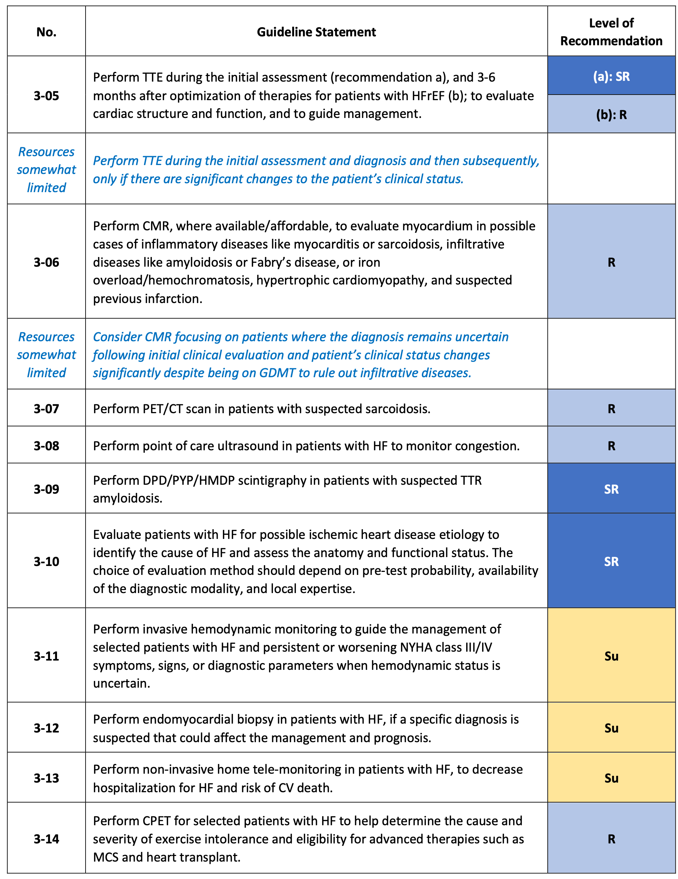
Recommendations for diagnostic tests in HF patients (2/3)
Chopra V, et al. Global Cardiol [Internet]. 2025 Jun. 30 [cited 2025 Aug. 20];3(2). Available from: https://www.globalcardiology.info/site/article/view/70

Slide 12
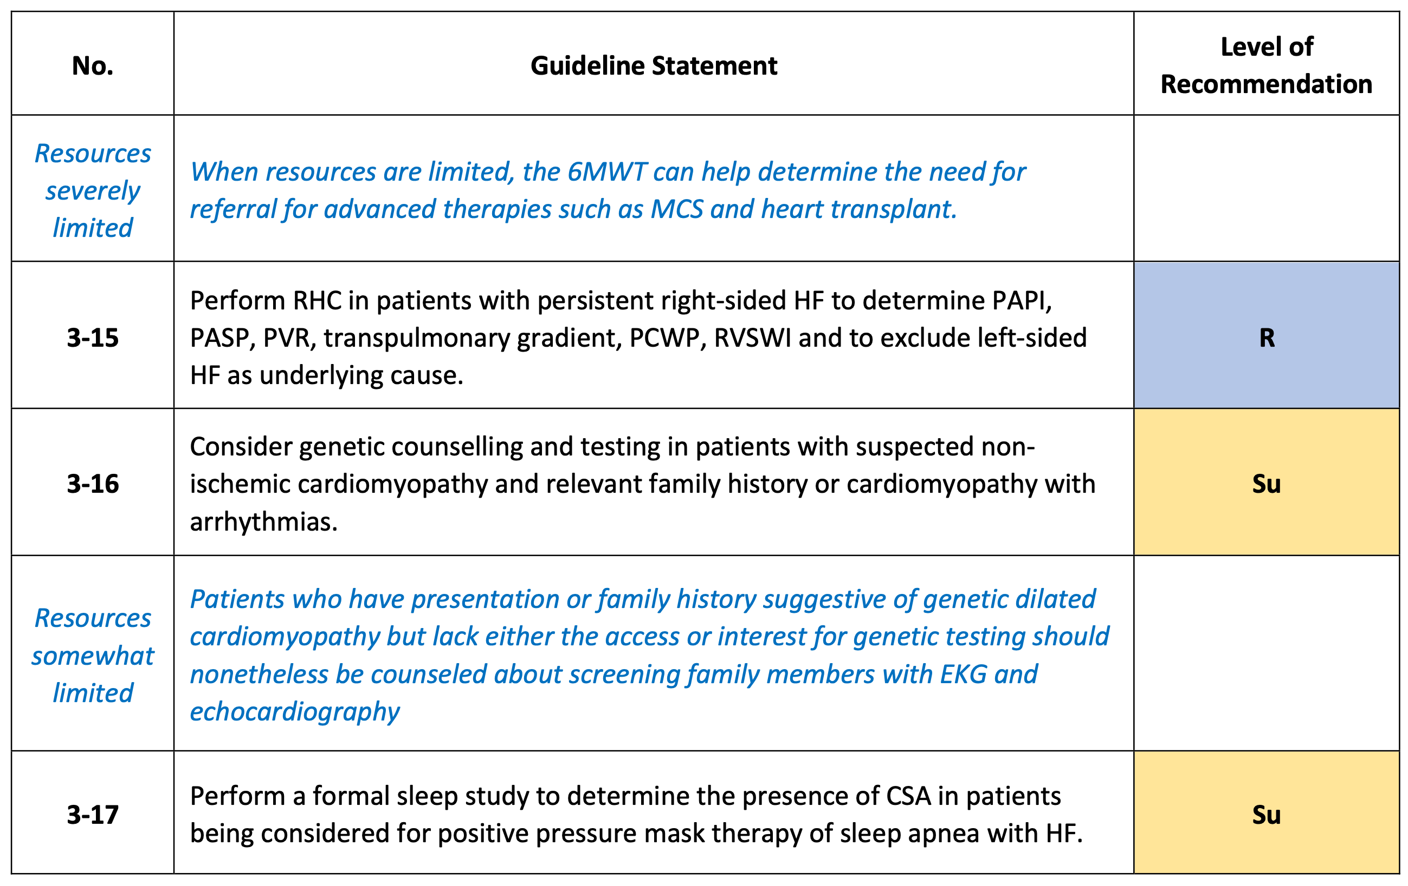
Recommendations for diagnostic tests in HF patients (3/3)
Chopra V, et al. Global Cardiol [Internet]. 2025 Jun. 30 [cited 2025 Aug. 20];3(2). Available from: https://www.globalcardiology.info/site/article/view/70

Slide 13
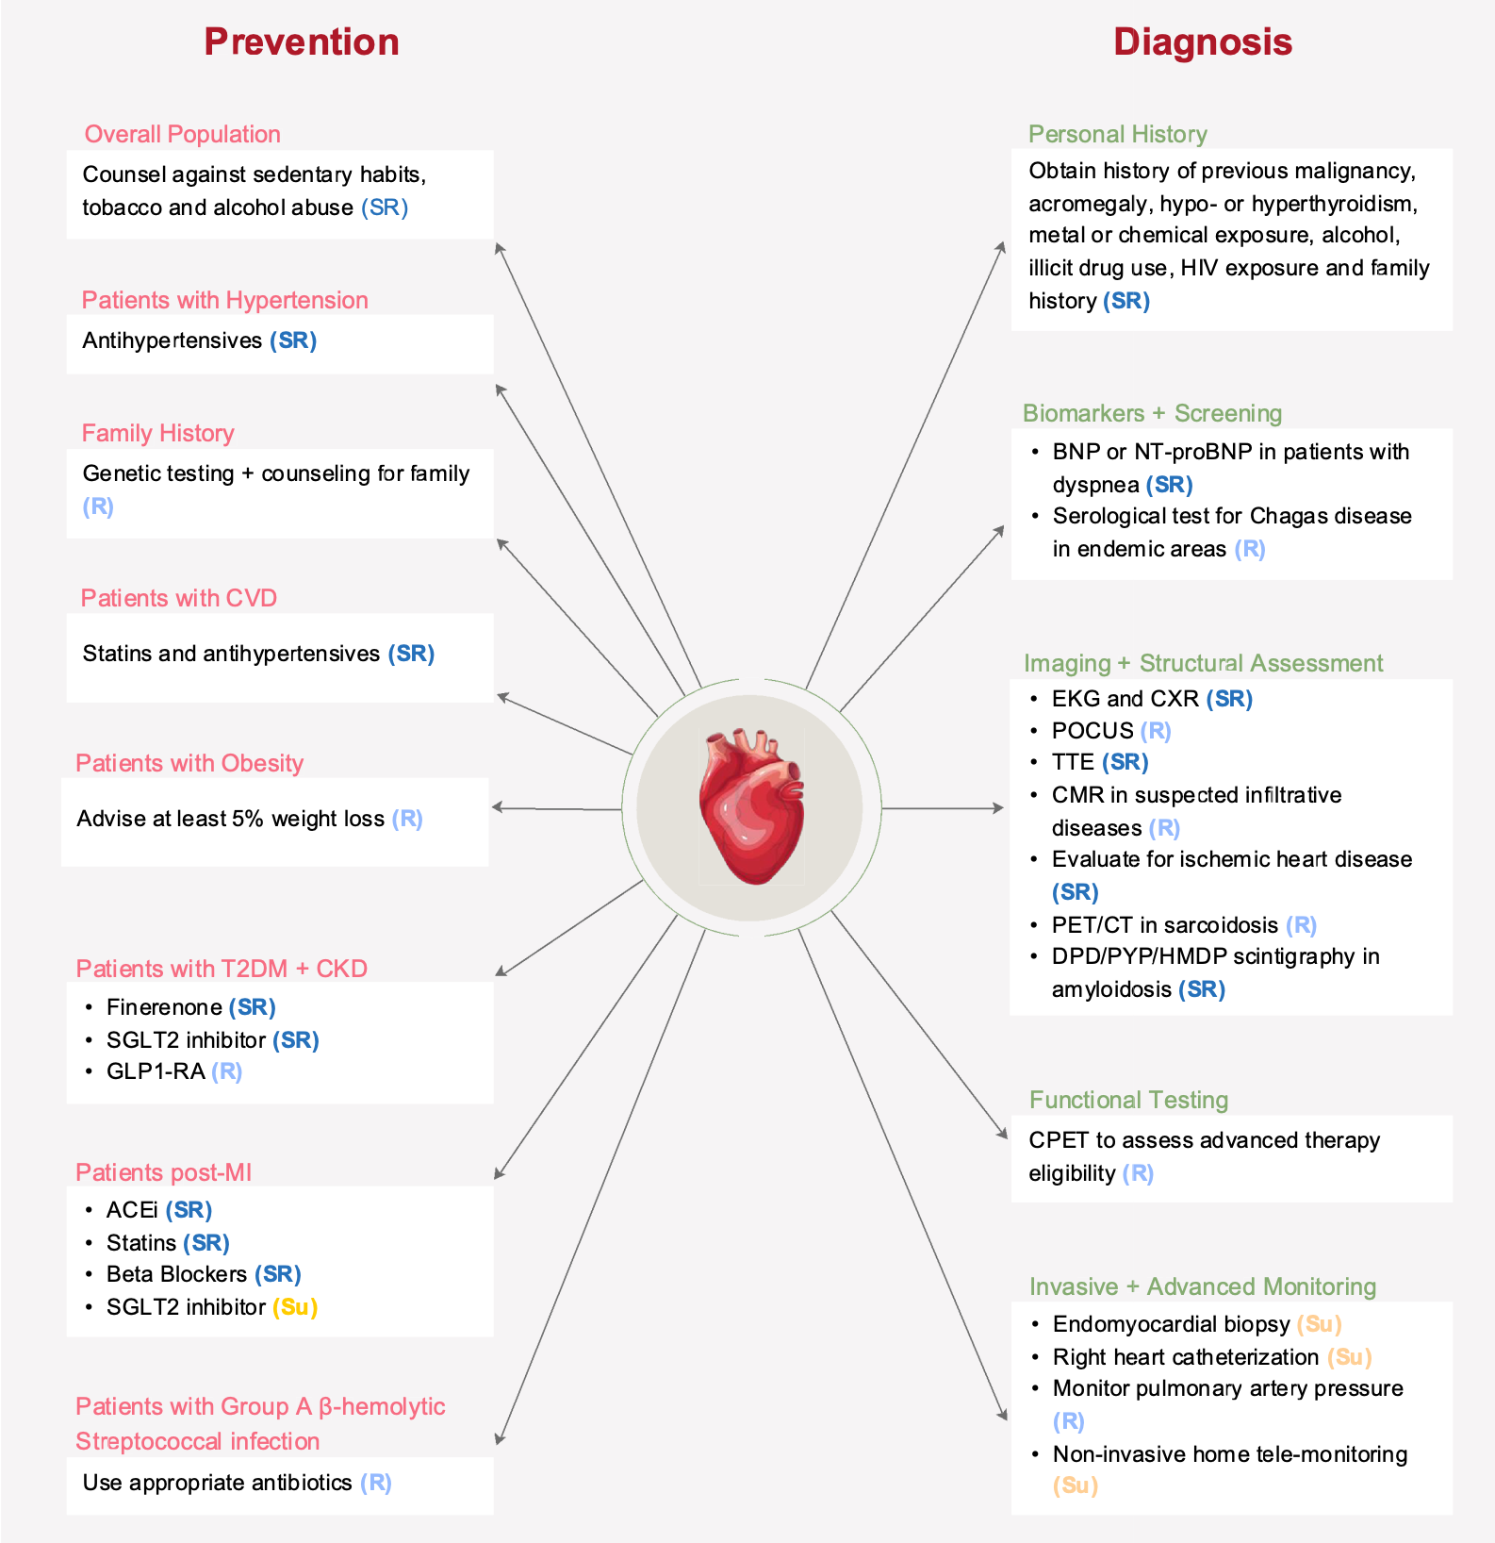
Recommendations for HF prevention and diagnosis
Chopra V, et al. Global Cardiol [Internet]. 2025 Jun. 30 [cited 2025 Aug. 20];3(2). Available from: https://www.globalcardiology.info/site/article/view/70

Slide 14
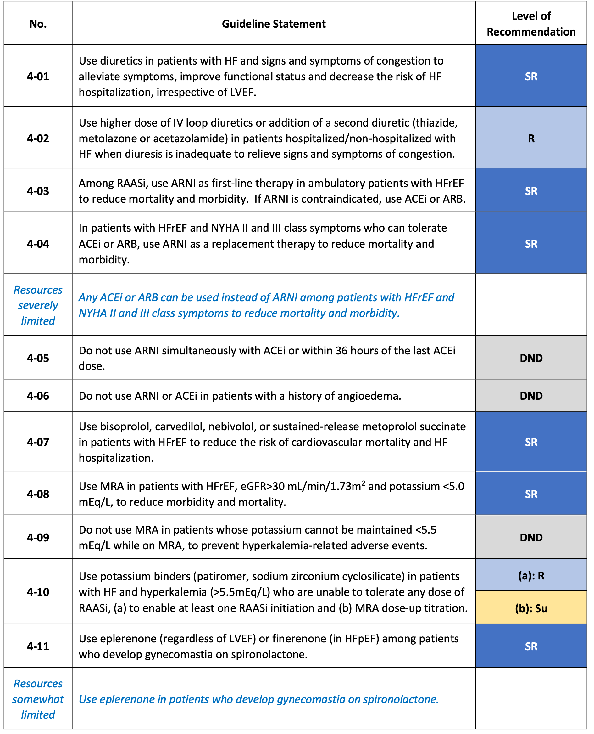
Recommendations for pharmacological therapies in patients with HF (1/4)
Chopra V, et al. Global Cardiol [Internet]. 2025 Jun. 30 [cited 2025 Aug. 20];3(2). Available from: https://www.globalcardiology.info/site/article/view/70

Slide 15
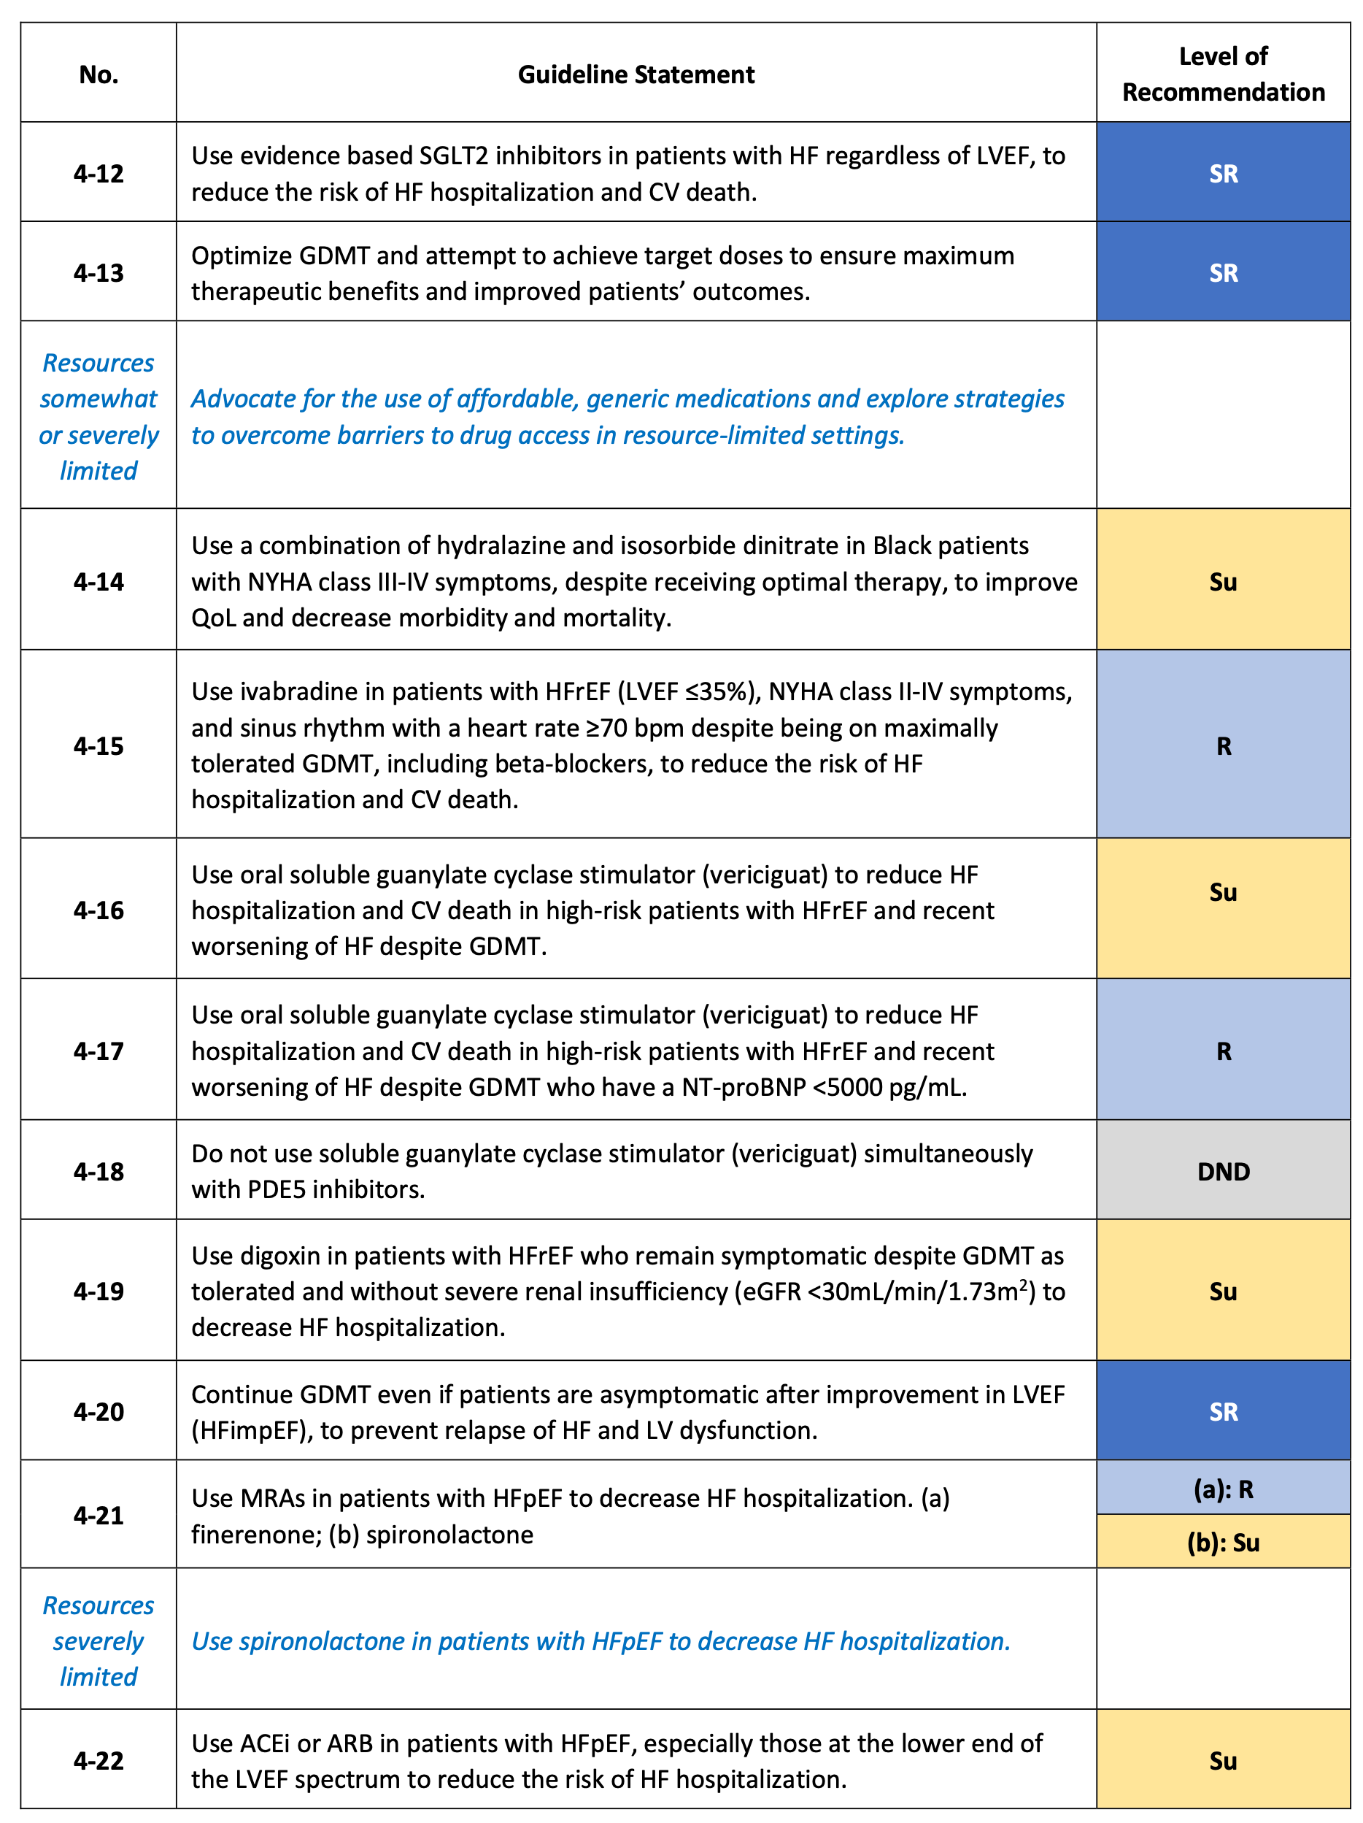
Recommendations for pharmacological therapies in patients with HF (2/4)
Chopra V, et al. Global Cardiol [Internet]. 2025 Jun. 30 [cited 2025 Aug. 20];3(2). Available from: https://www.globalcardiology.info/site/article/view/70

Slide 16
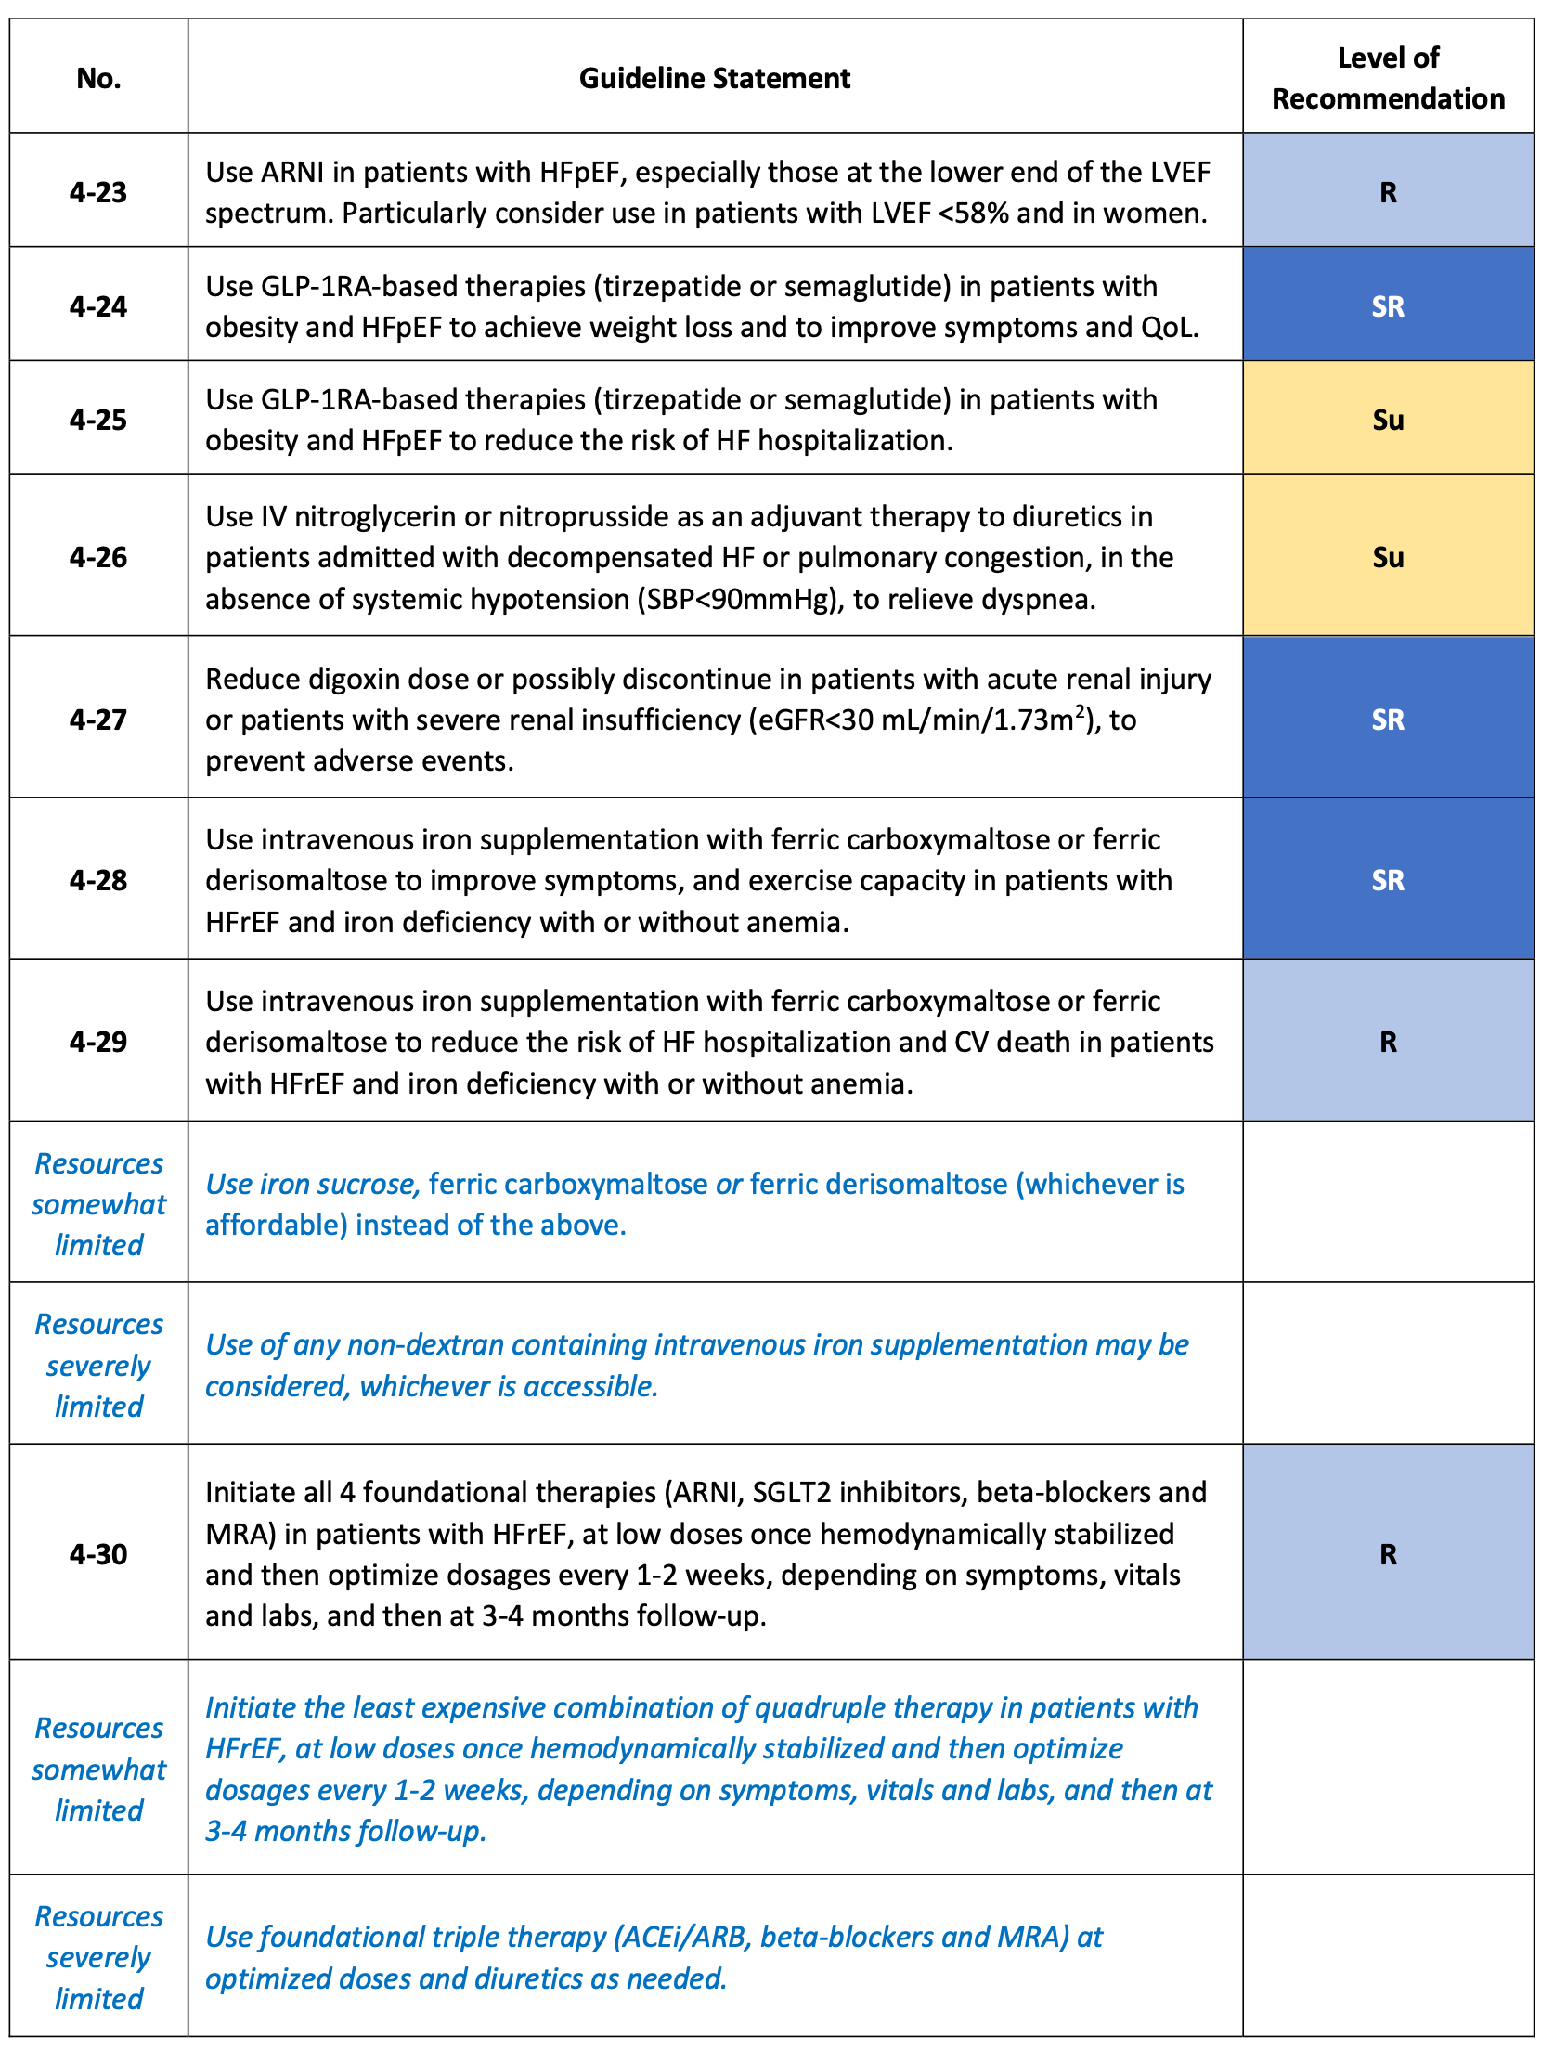
Recommendations for pharmacological therapies in patients with HF (3/4)
Chopra V, et al. Global Cardiol [Internet]. 2025 Jun. 30 [cited 2025 Aug. 20];3(2). Available from: https://www.globalcardiology.info/site/article/view/70

Slide 17
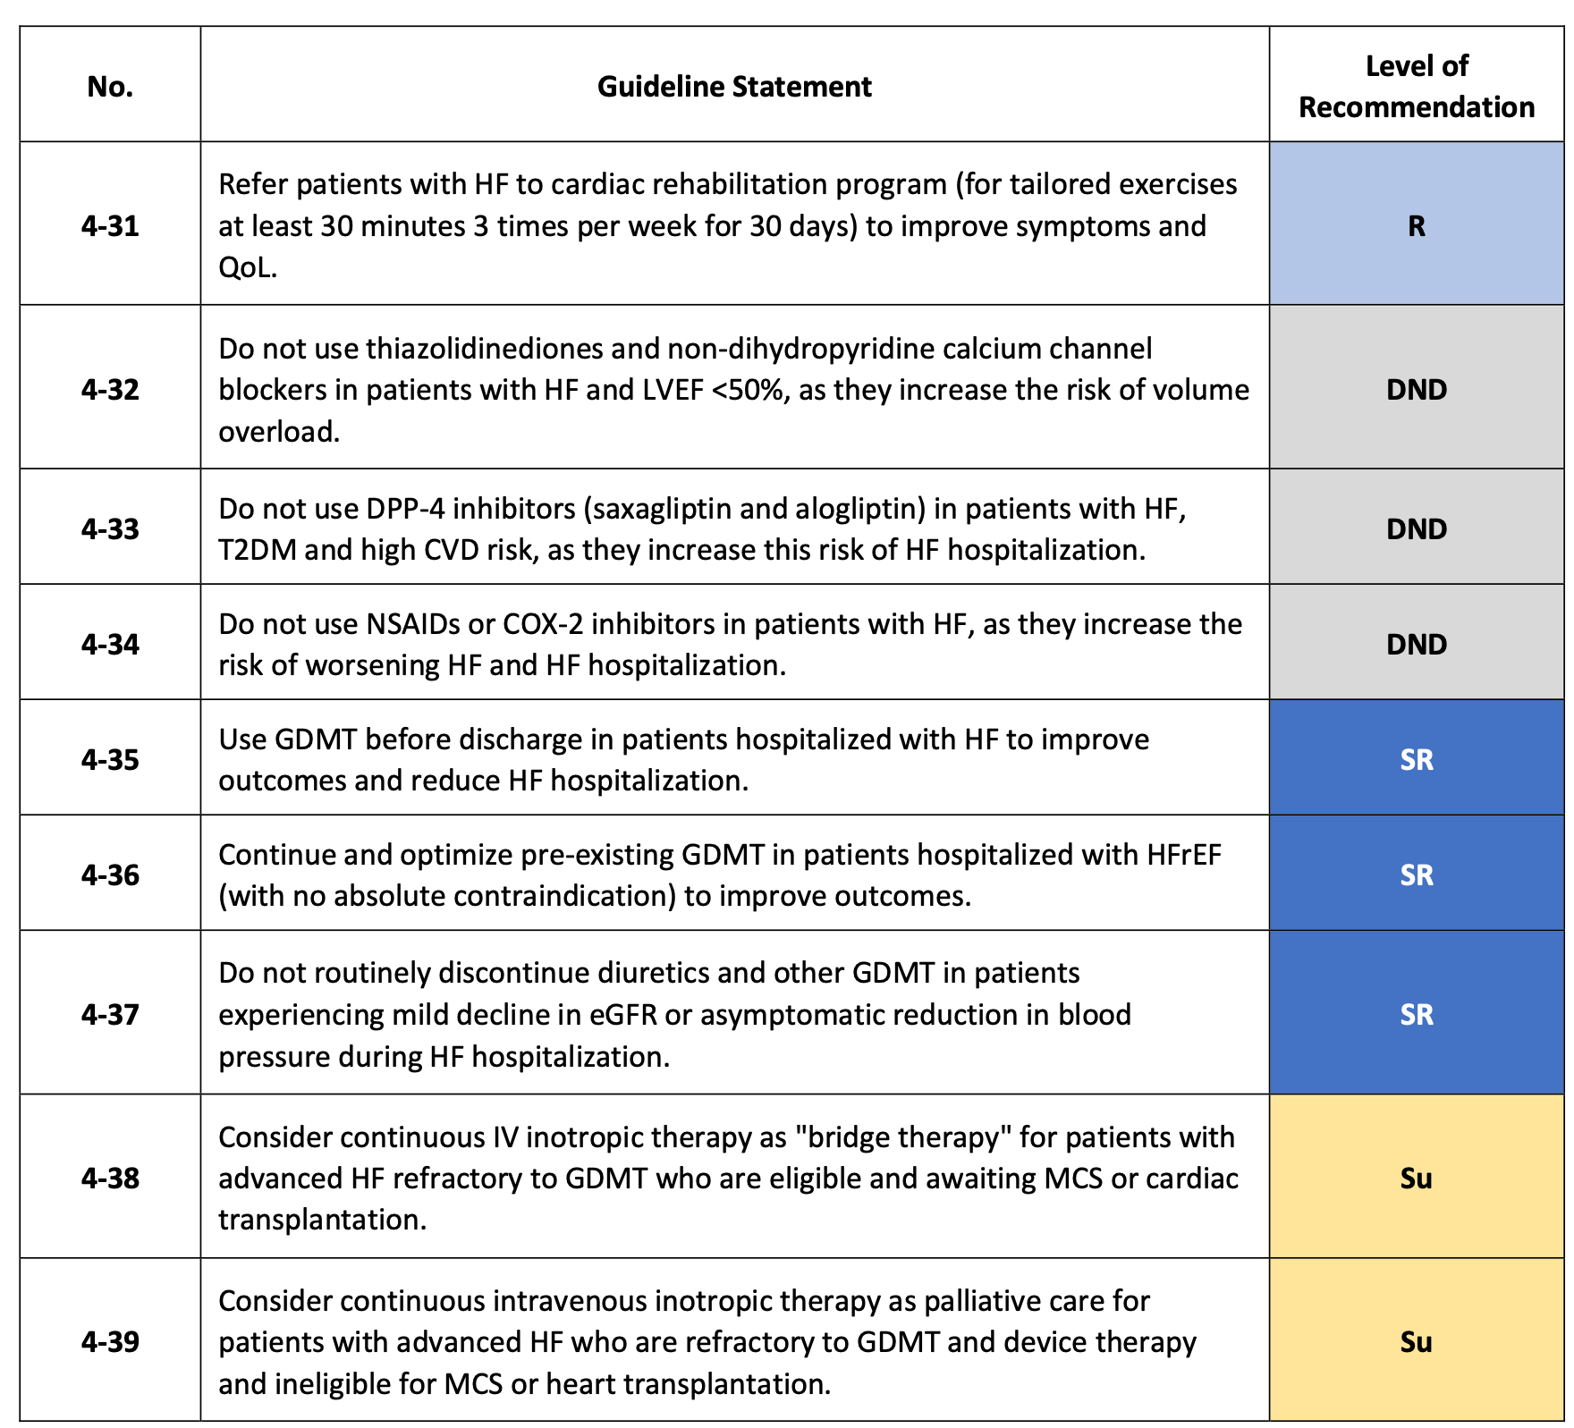
Recommendations for pharmacological therapies in patients with HF (4/4)
Chopra V, et al. Global Cardiol [Internet]. 2025 Jun. 30 [cited 2025 Aug. 20];3(2). Available from: https://www.globalcardiology.info/site/article/view/70

Slide 18
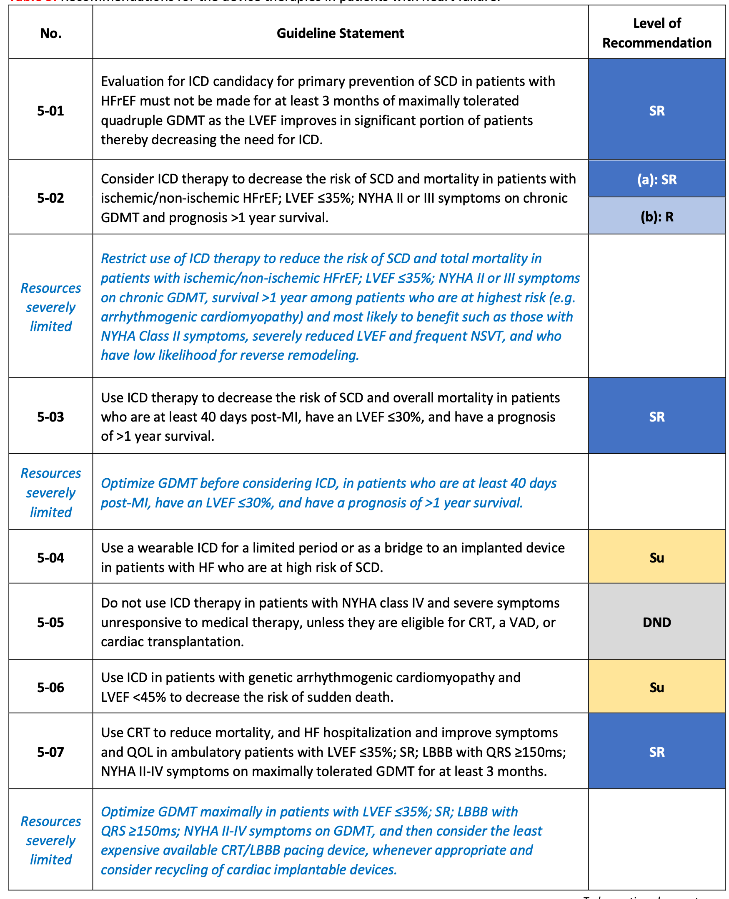
Recommendations for device therapies in HF (1/2)
Chopra V, et al. Global Cardiol [Internet]. 2025 Jun. 30 [cited 2025 Aug. 20];3(2). Available from: https://www.globalcardiology.info/site/article/view/70

Slide 19
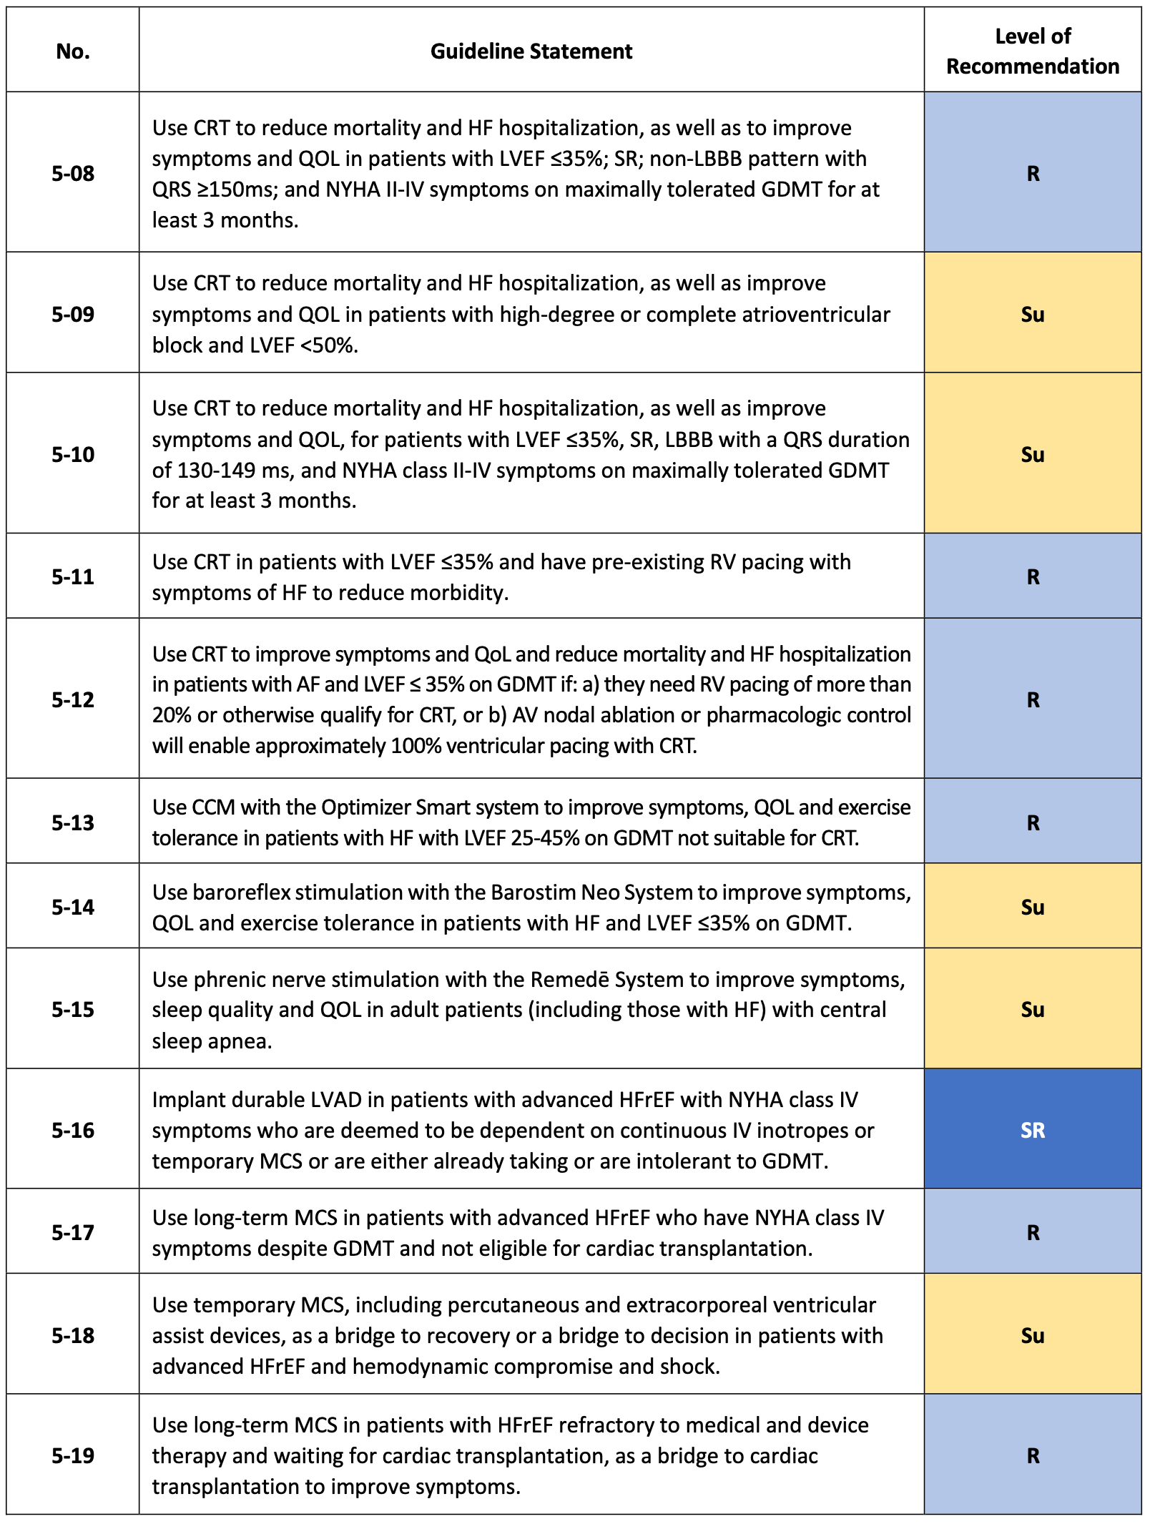
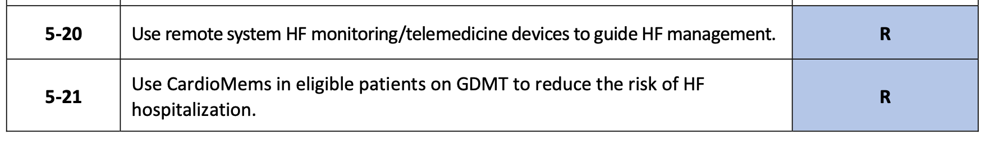
Recommendations for device therapies in HF (2/2)
Chopra V, et al. Global Cardiol [Internet]. 2025 Jun. 30 [cited 2025 Aug. 20];3(2). Available from: https://www.globalcardiology.info/site/article/view/70

Slide 20
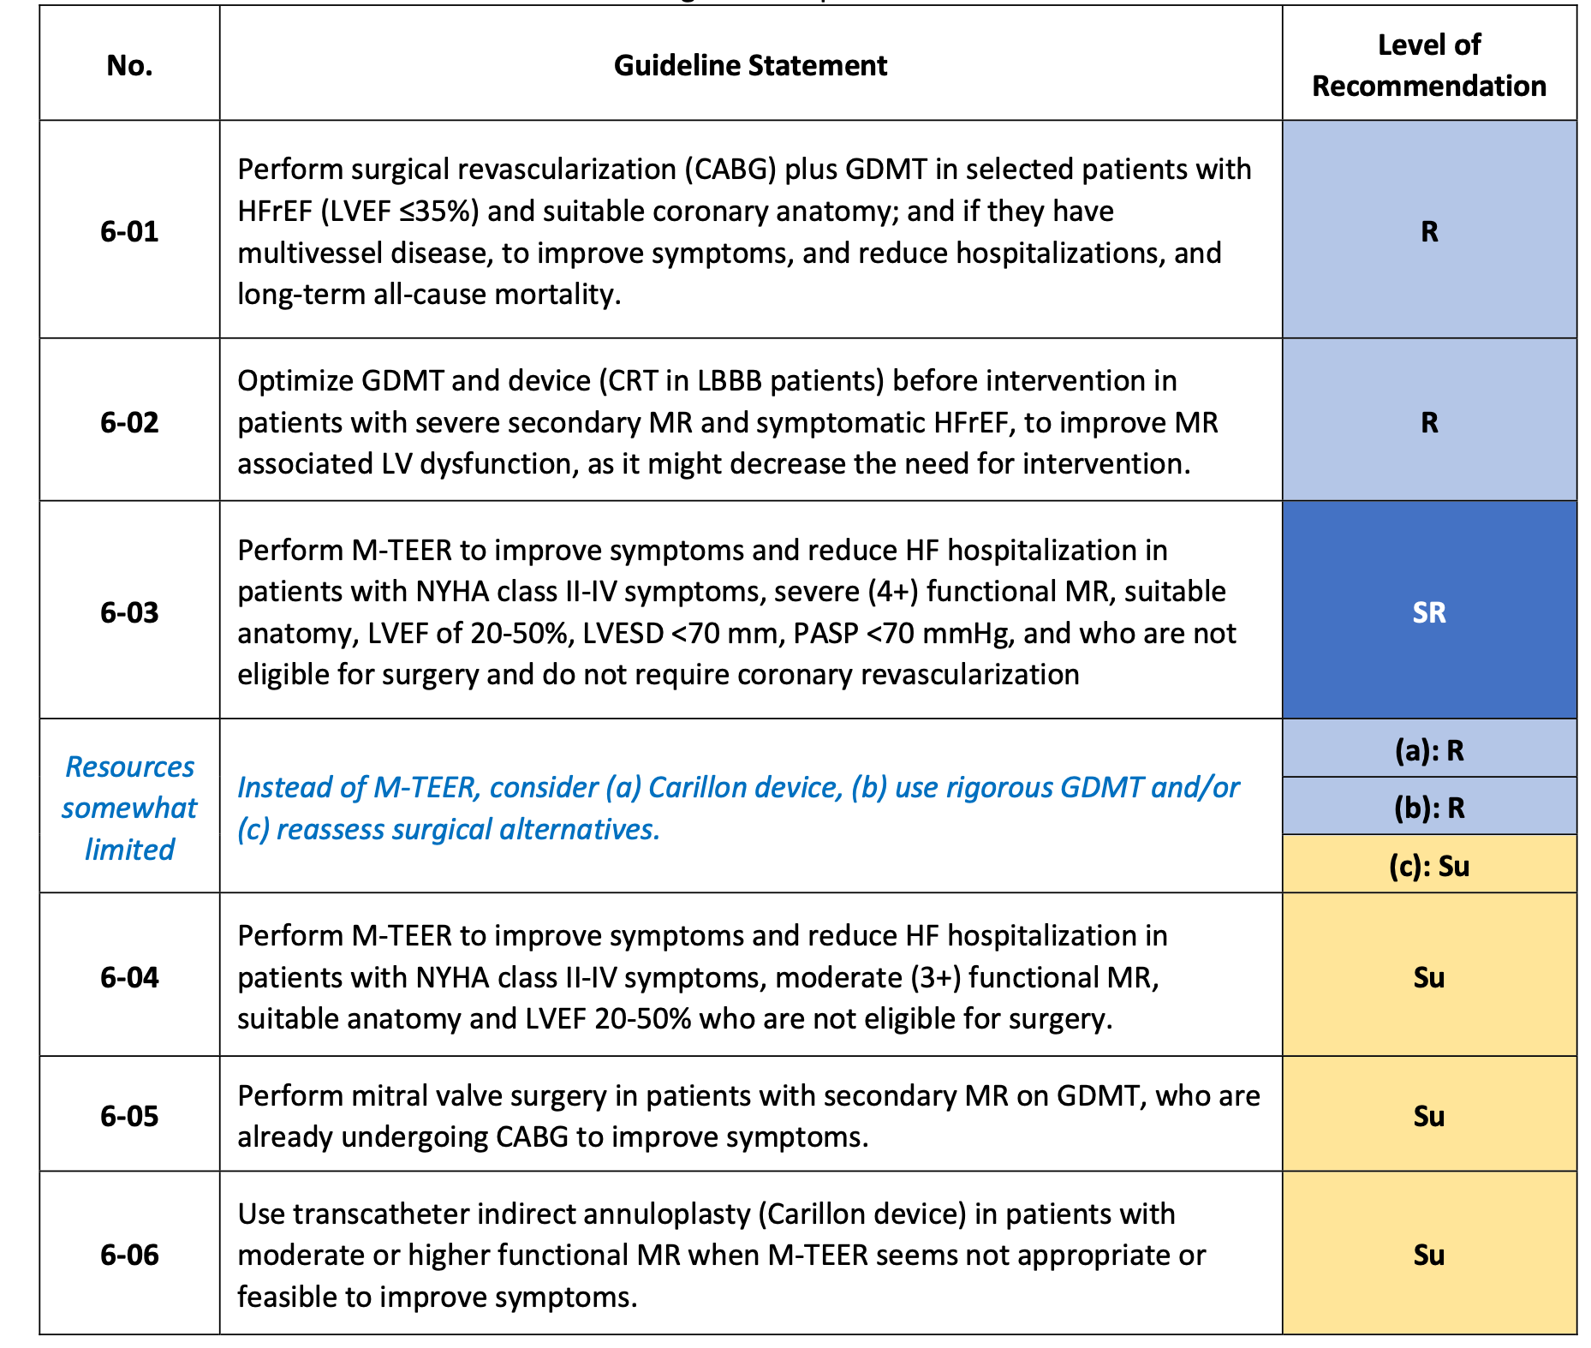
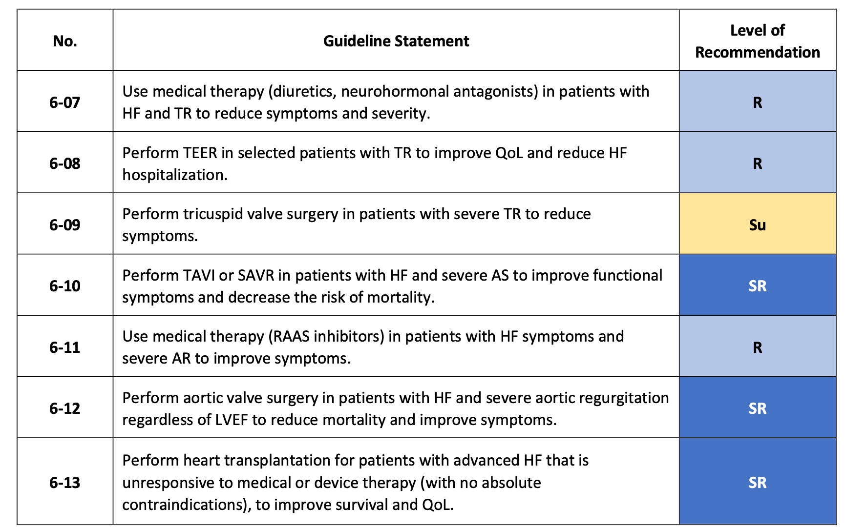
Recommendations for invasive management of HF
Chopra V, et al. Global Cardiol [Internet]. 2025 Jun. 30 [cited 2025 Aug. 20];3(2). Available from: https://www.globalcardiology.info/site/article/view/70

Slide 21
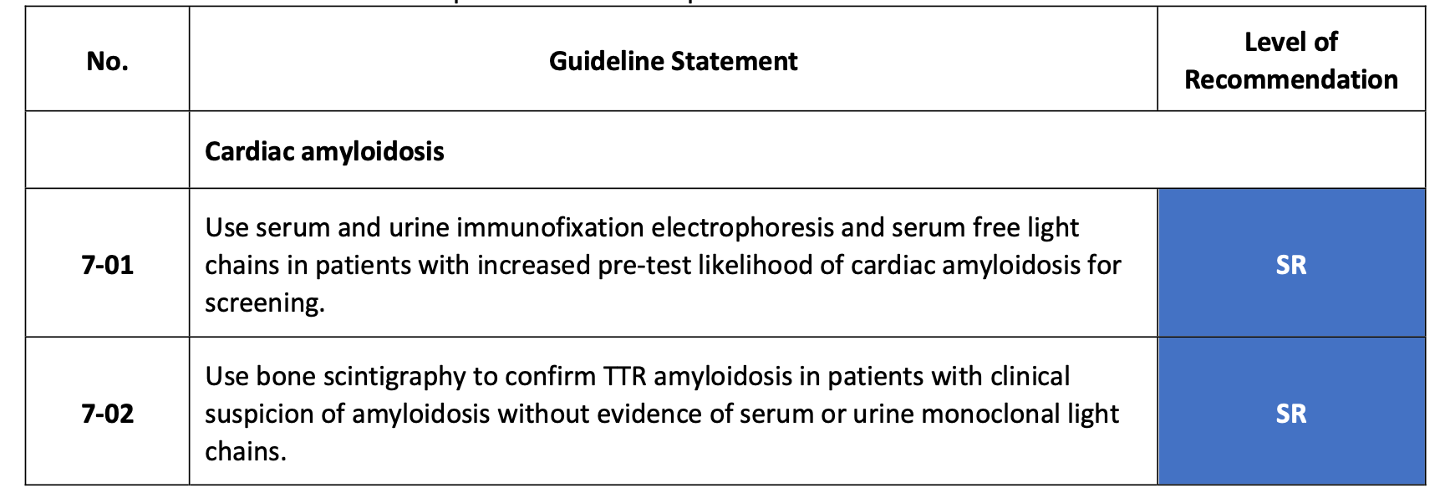
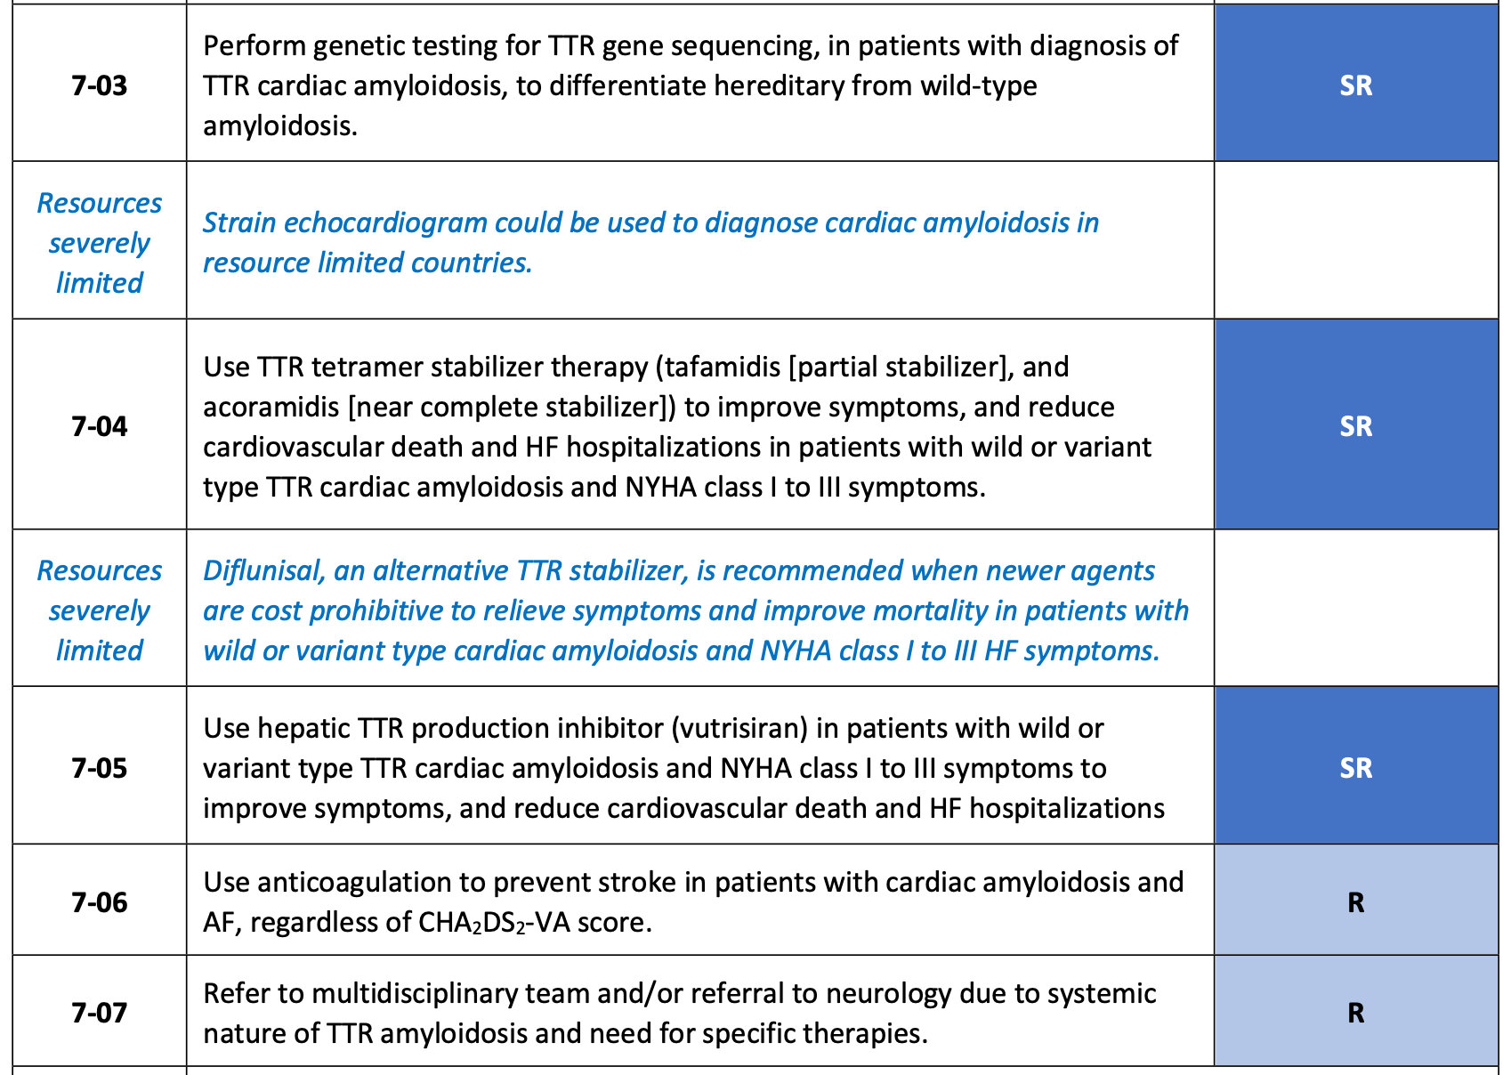
Recommendations for special conditions in HF
Cardiac amyloidosis
Chopra V, et al. Global Cardiol [Internet]. 2025 Jun. 30 [cited 2025 Aug. 20];3(2). Available from: https://www.globalcardiology.info/site/article/view/70

Slide 22
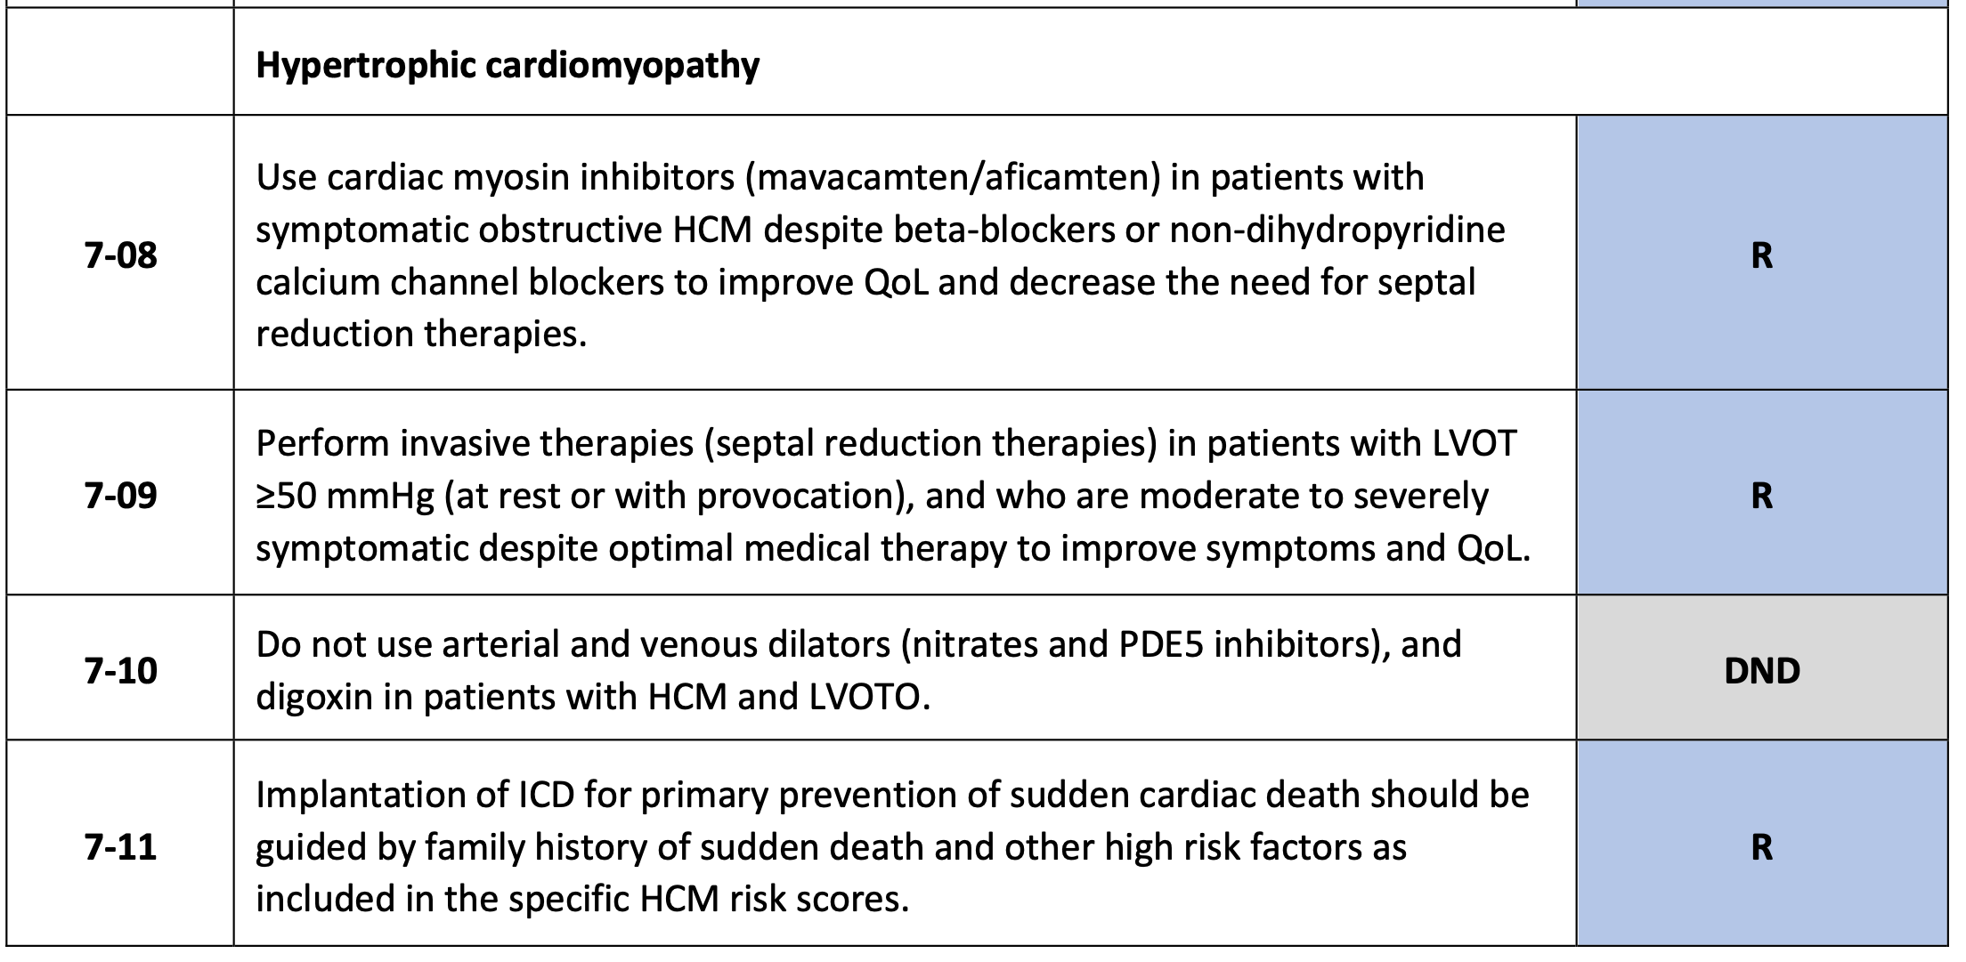
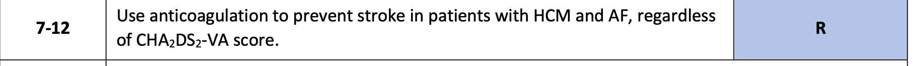
Recommendations for special conditions in HF
Hypertrophic cardiomyopathy
Chopra V, et al. Global Cardiol [Internet]. 2025 Jun. 30 [cited 2025 Aug. 20];3(2). Available from: https://www.globalcardiology.info/site/article/view/70

Slide 23
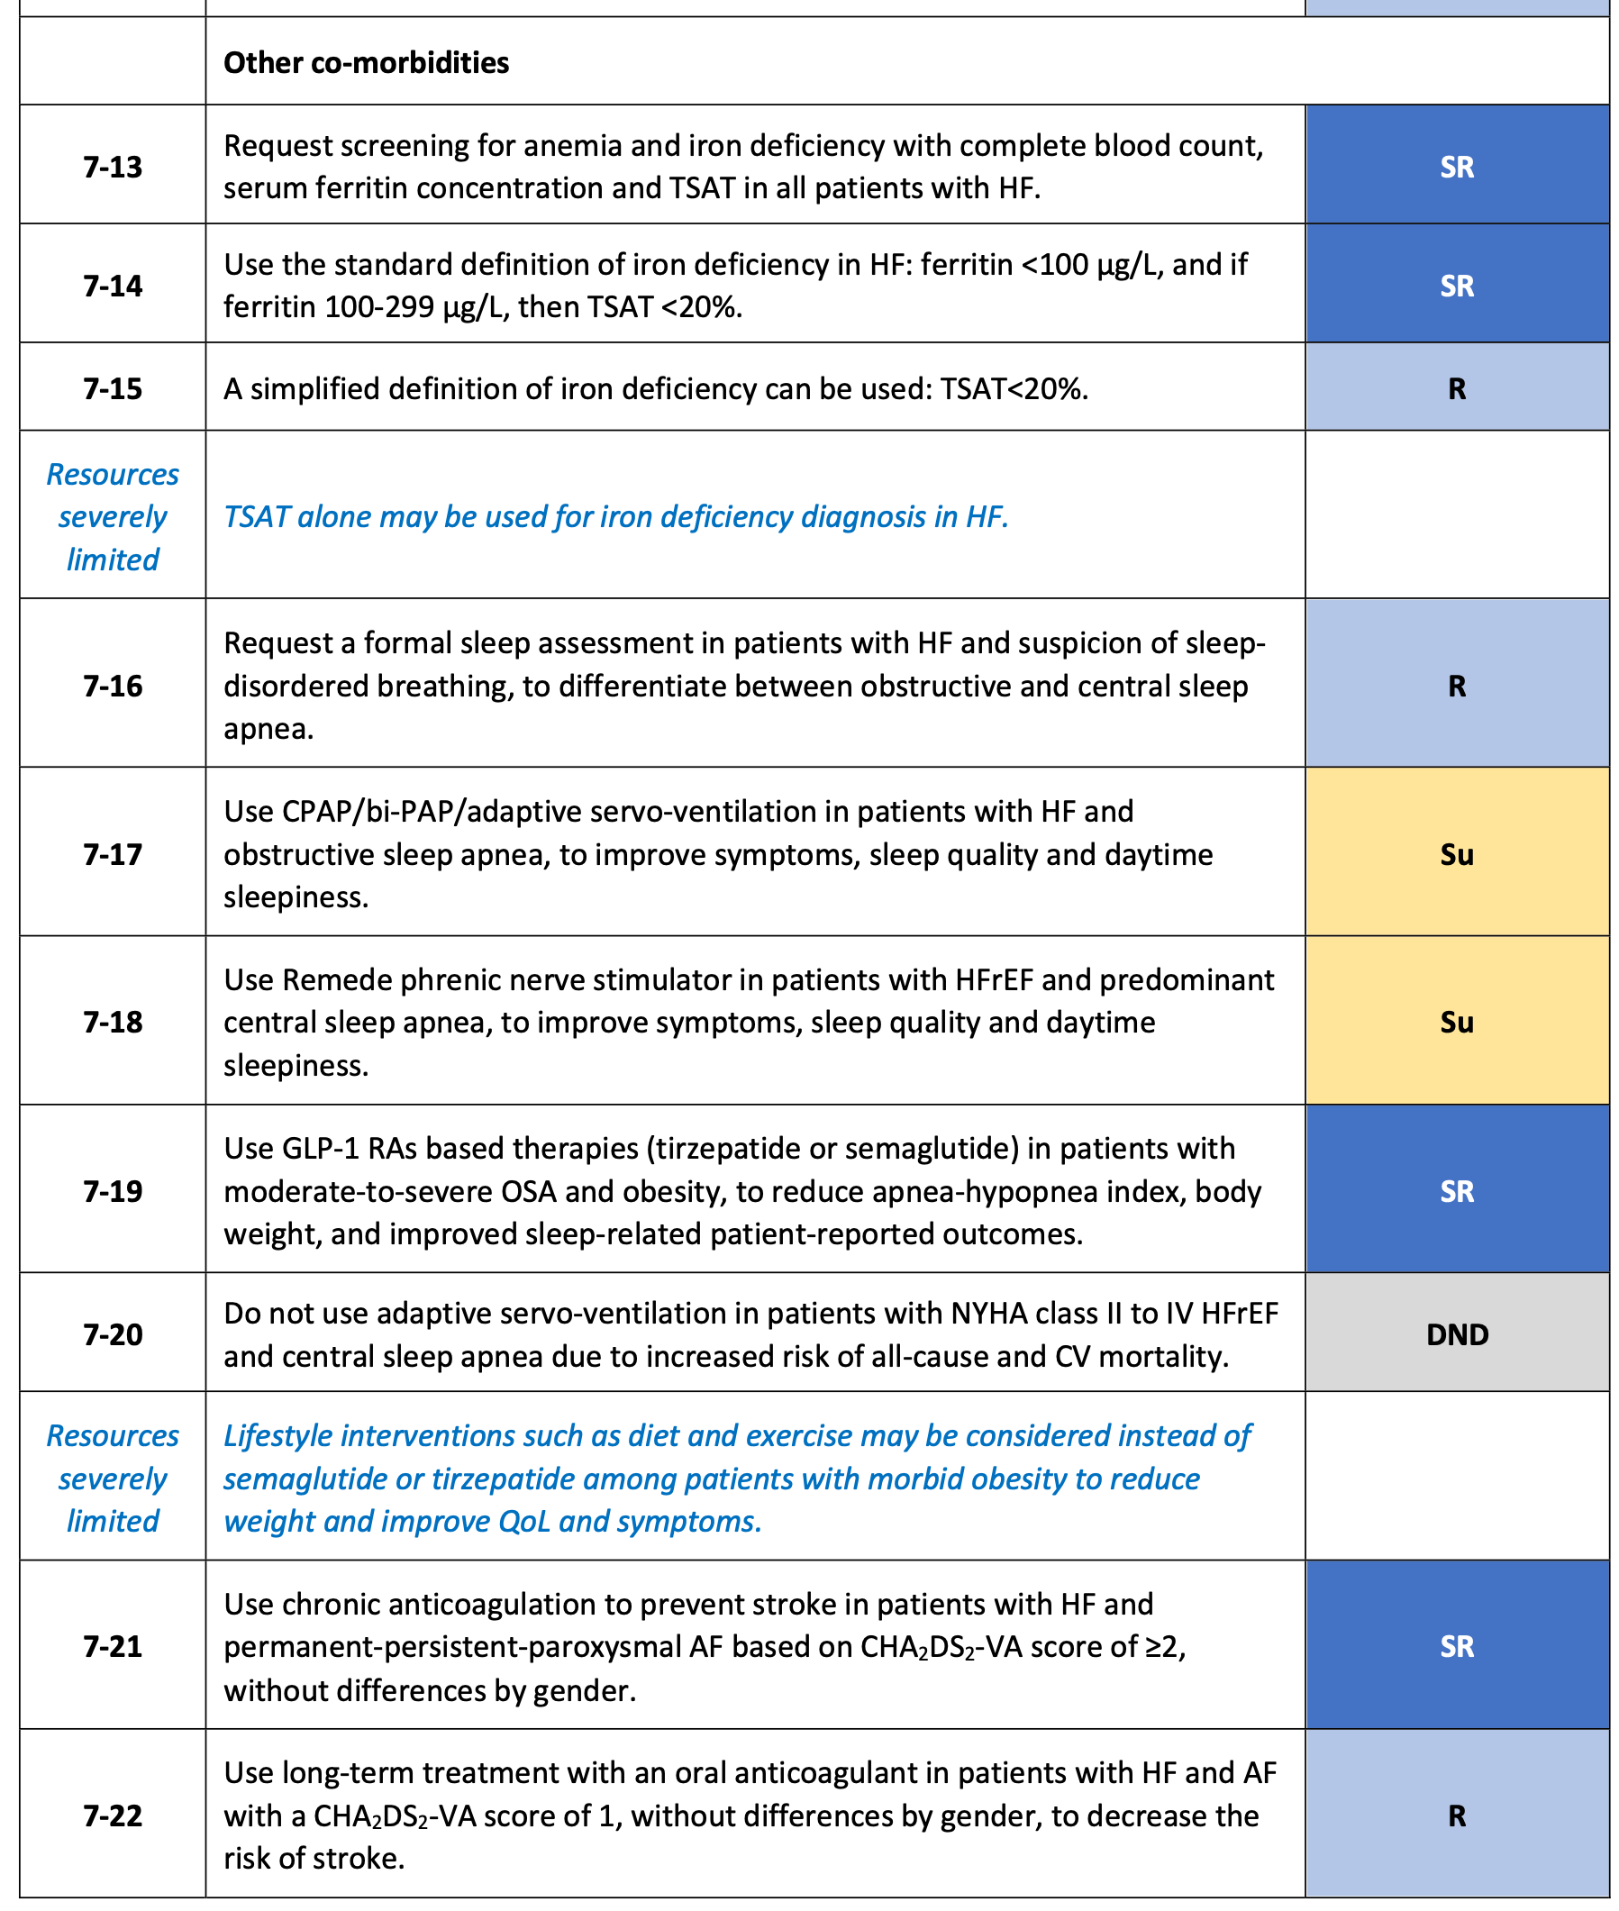
Recommendations for special conditions in HF
Other comorbidities (I/2)
Chopra V, et al. Global Cardiol [Internet]. 2025 Jun. 30 [cited 2025 Aug. 20];3(2). Available from: https://www.globalcardiology.info/site/article/view/70

Slide 24
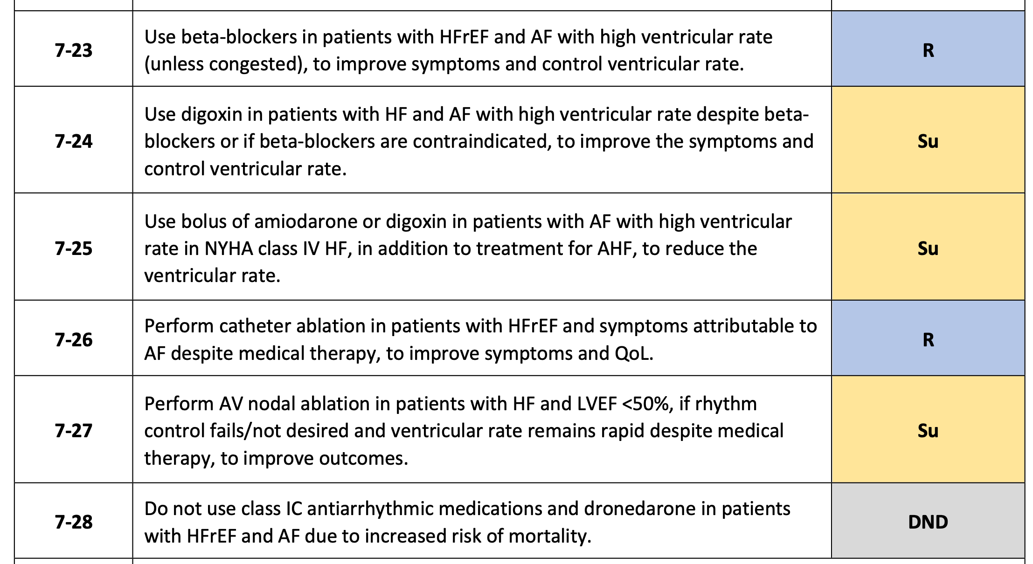
Recommendations for special conditions in HF
Other comorbidities (2/2)
Chopra V, et al. Global Cardiol [Internet]. 2025 Jun. 30 [cited 2025 Aug. 20];3(2). Available from: https://www.globalcardiology.info/site/article/view/70

Slide 25
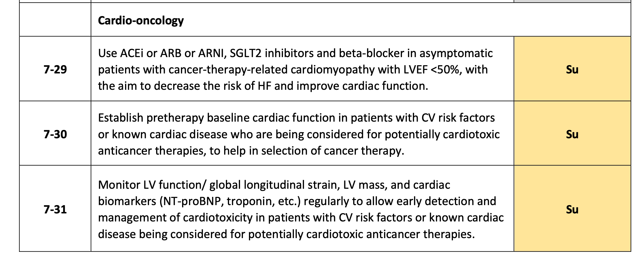
Recommendations for special conditions in HF
Cardio-oncology
Chopra V, et al. Global Cardiol [Internet]. 2025 Jun. 30 [cited 2025 Aug. 20];3(2). Available from: https://www.globalcardiology.info/site/article/view/70

Slide 26
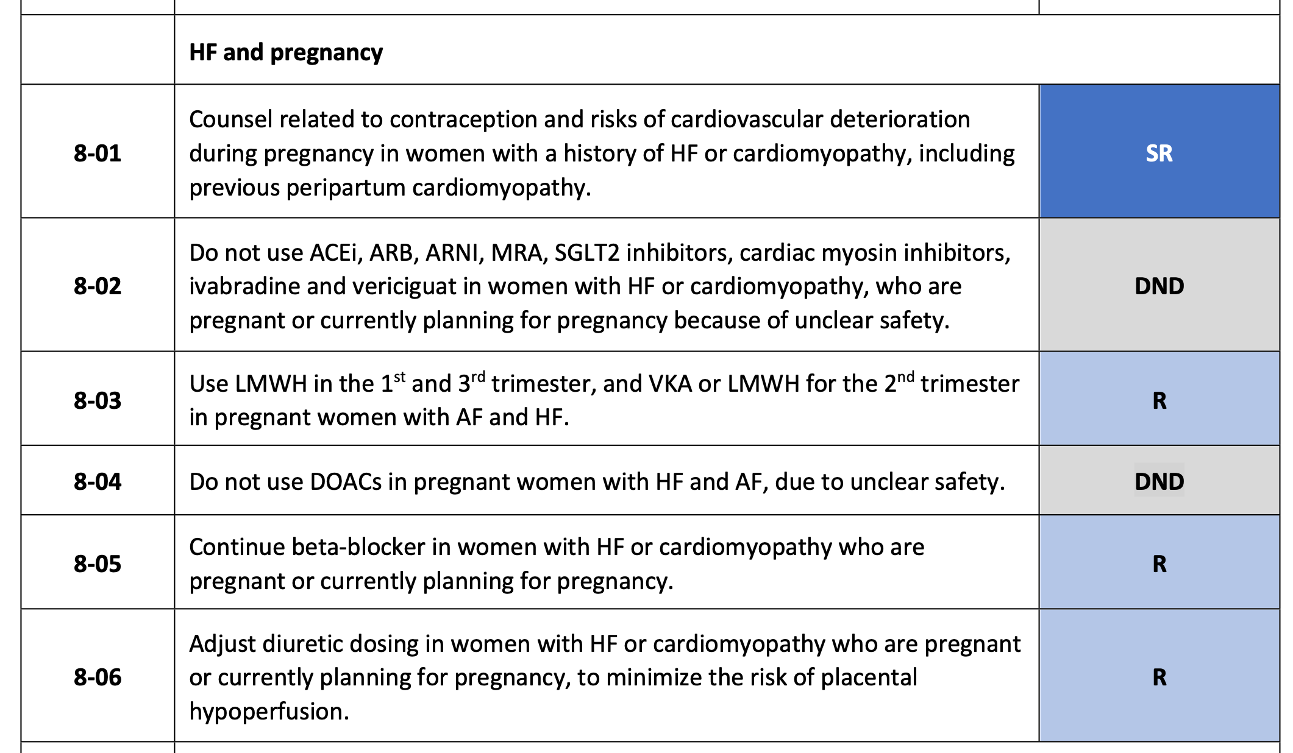
Recommendations for special conditions in HF
HF and pregnancy
Chopra V, et al. Global Cardiol [Internet]. 2025 Jun. 30 [cited 2025 Aug. 20];3(2). Available from: https://www.globalcardiology.info/site/article/view/70

Slide 27
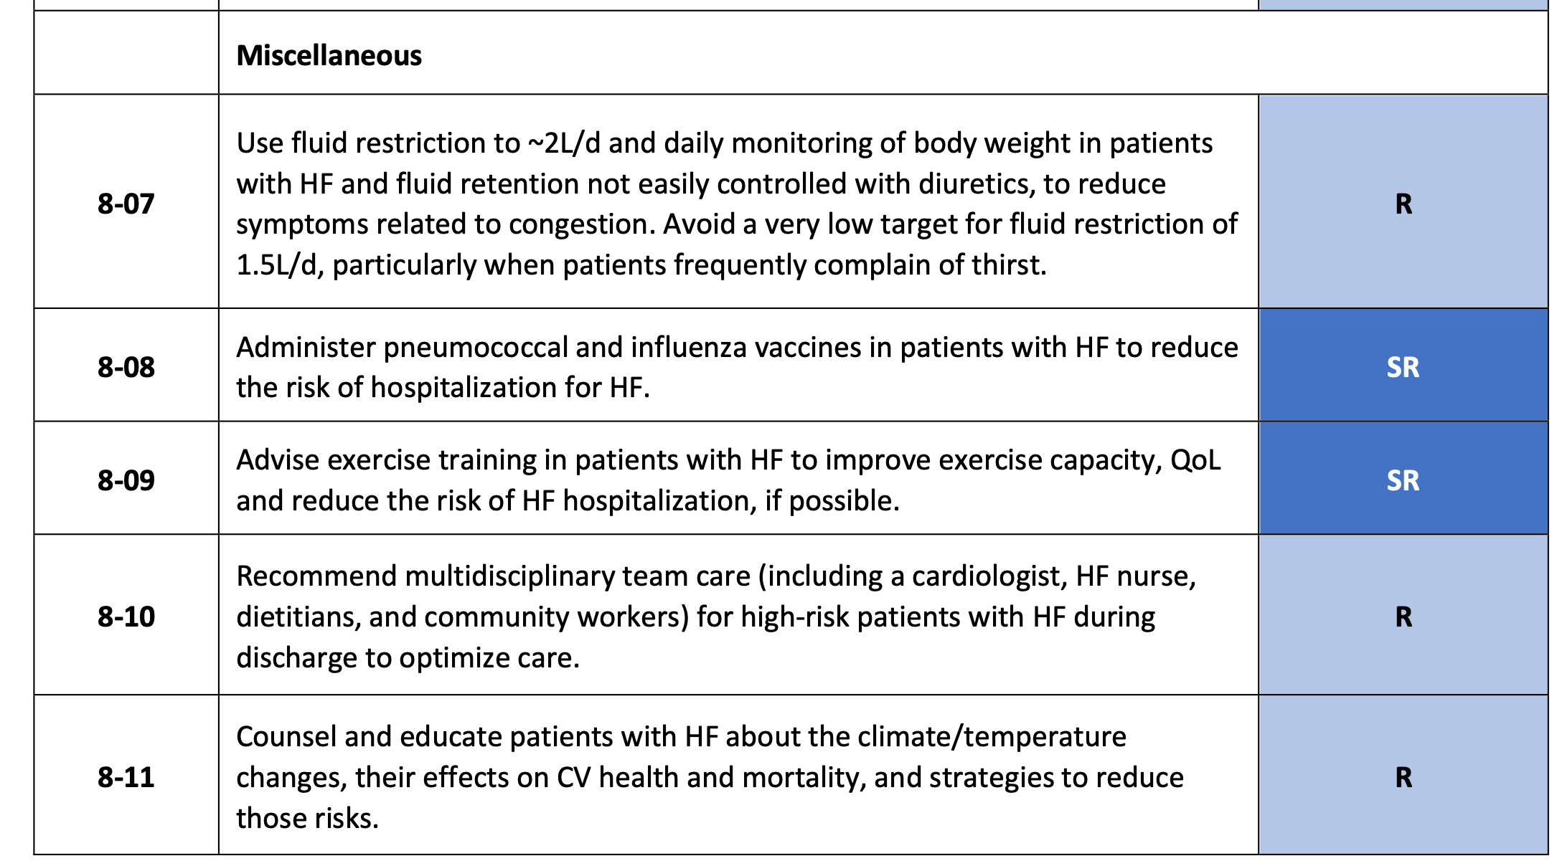
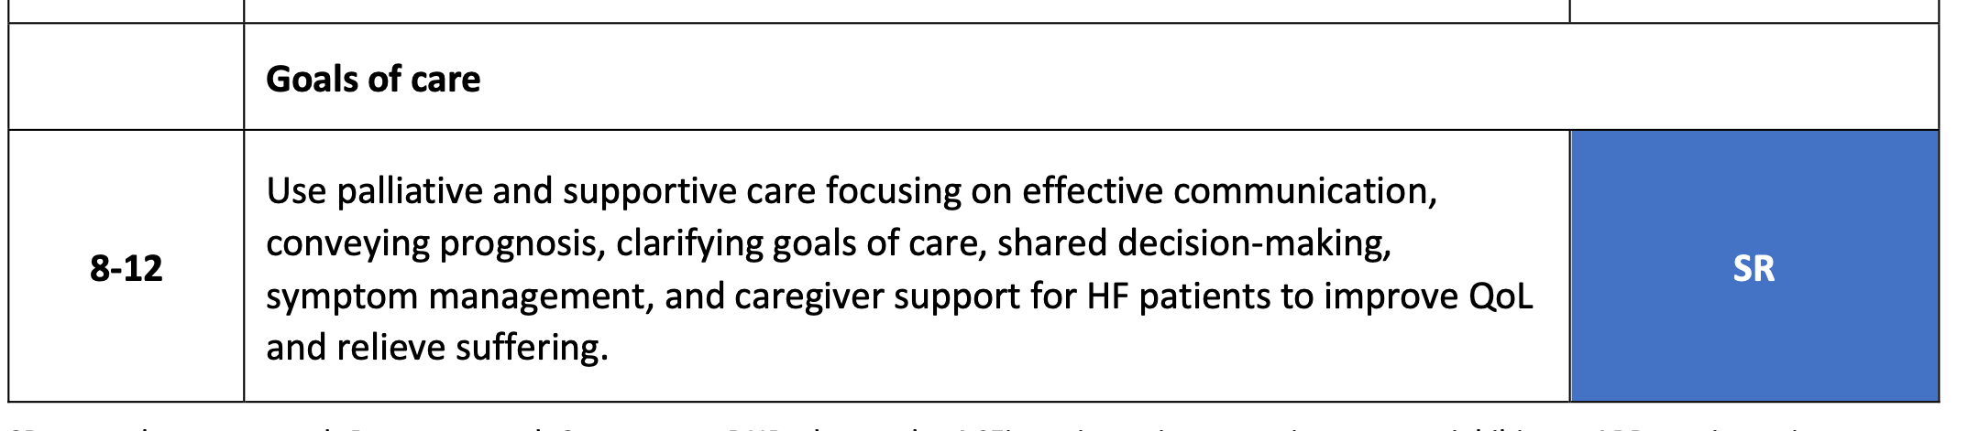
Recommendations for special conditions in HF
Miscellaneous/goals of care
Chopra V, et al. Global Cardiol [Internet]. 2025 Jun. 30 [cited 2025 Aug. 20];3(2). Available from: https://www.globalcardiology.info/site/article/view/70

Slide 28
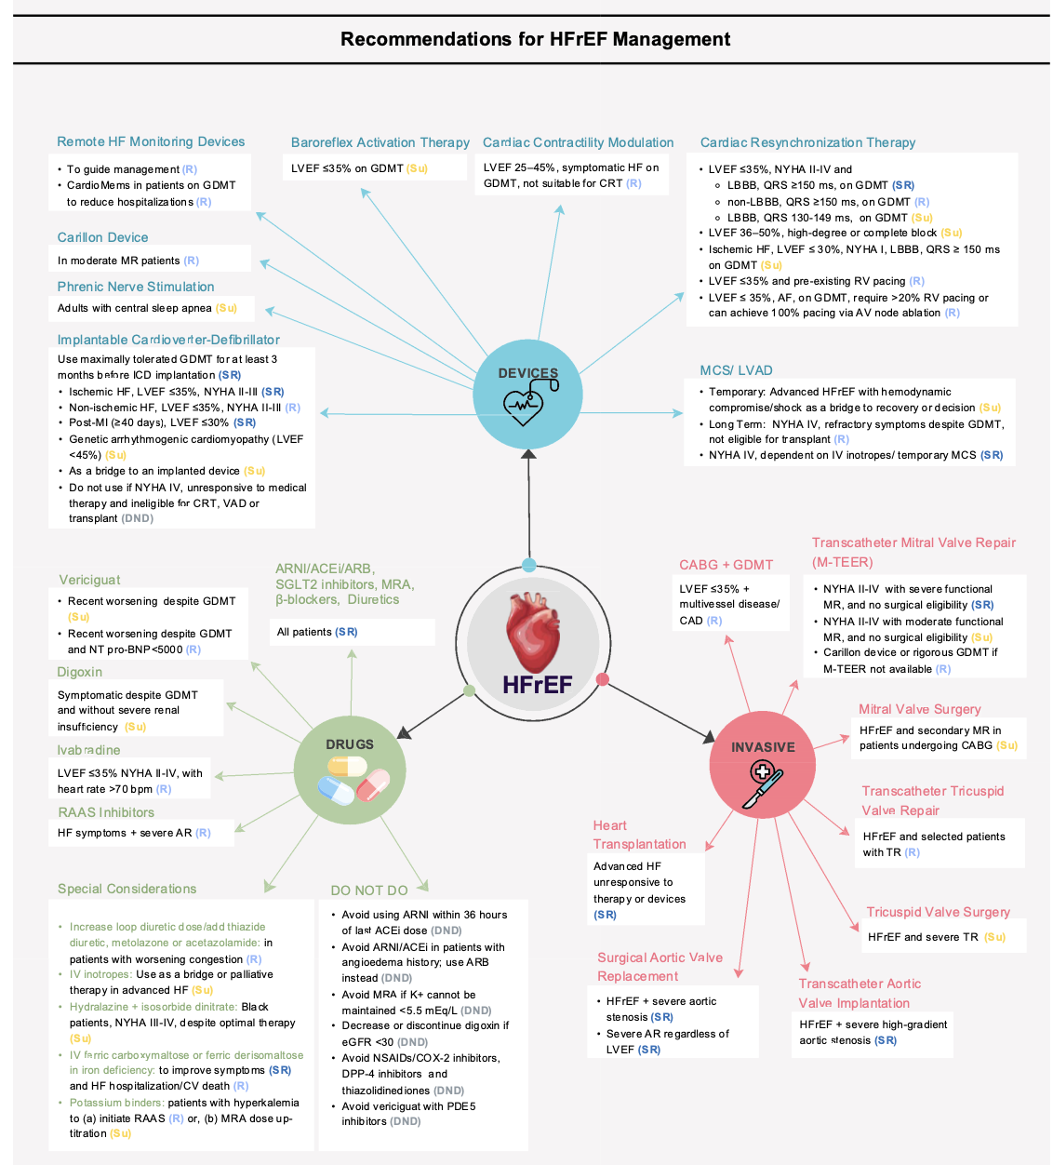
Recommendations for HFrEF management
Chopra V, et al. Global Cardiol [Internet]. 2025 Jun. 30 [cited 2025 Aug. 20];3(2). Available from: https://www.globalcardiology.info/site/article/view/70

Slide 29
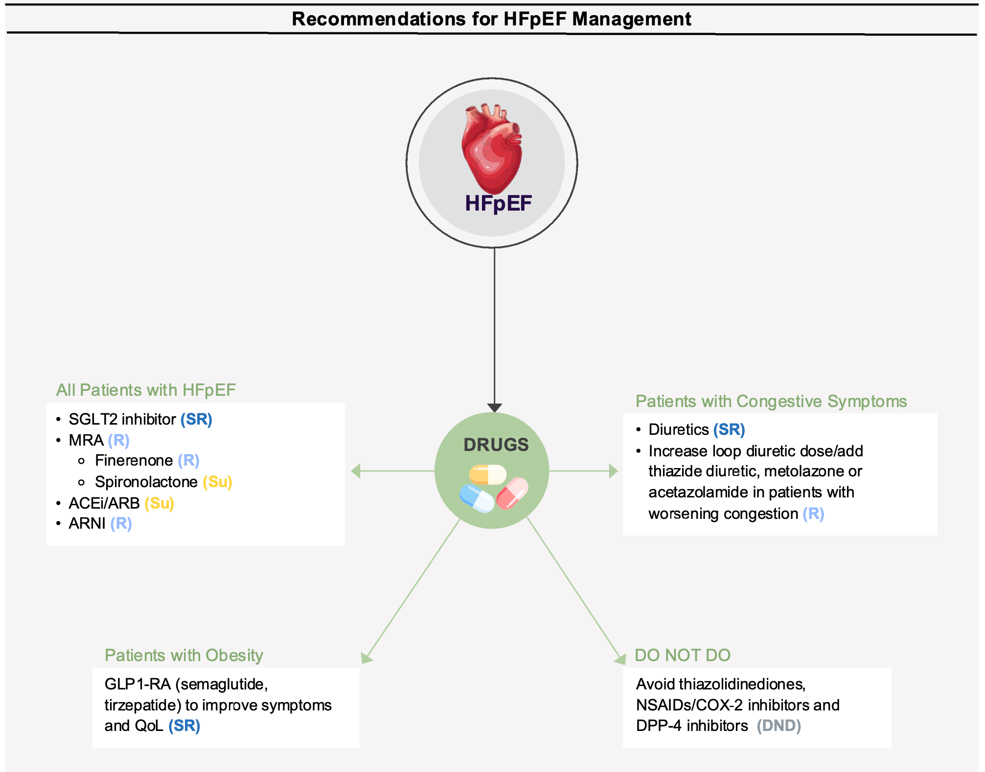
Recommendations for HFpEF management
Chopra V, et al. Global Cardiol [Internet]. 2025 Jun. 30 [cited 2025 Aug. 20];3(2). Available from: https://www.globalcardiology.info/site/article/view/70

Slide 30
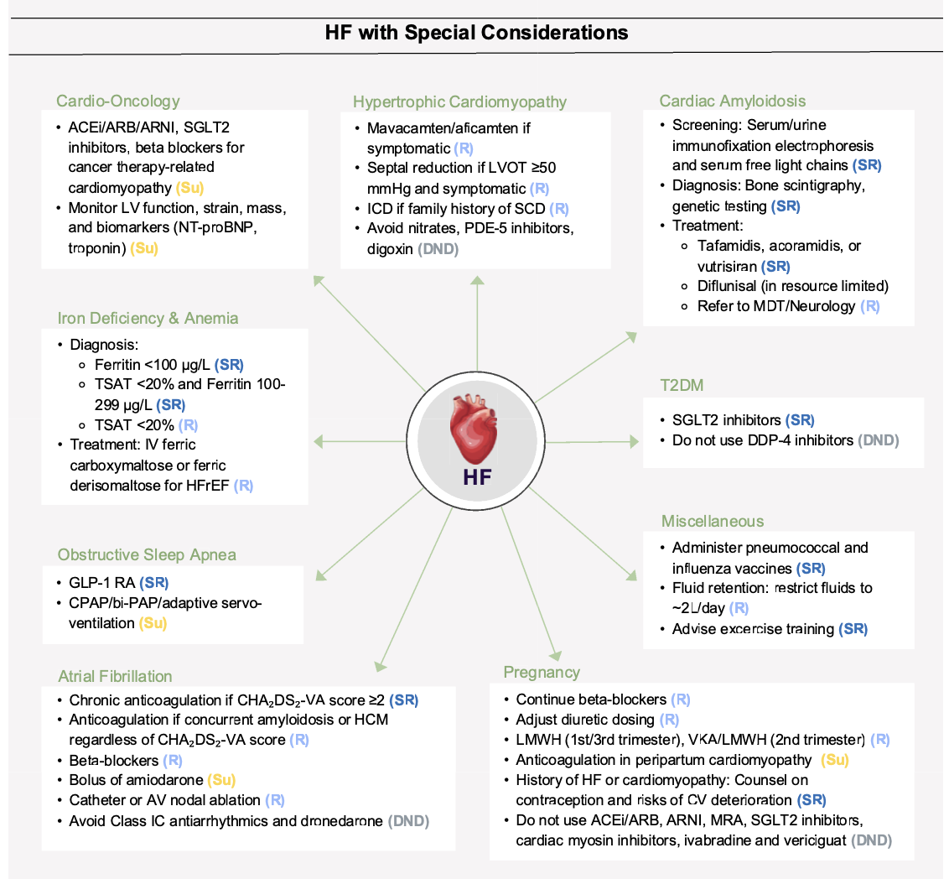
Recommendations with special considerations
Chopra V, et al. Global Cardiol [Internet]. 2025 Jun. 30 [cited 2025 Aug. 20];3(2). Available from: https://www.globalcardiology.info/site/article/view/70

Slide 31
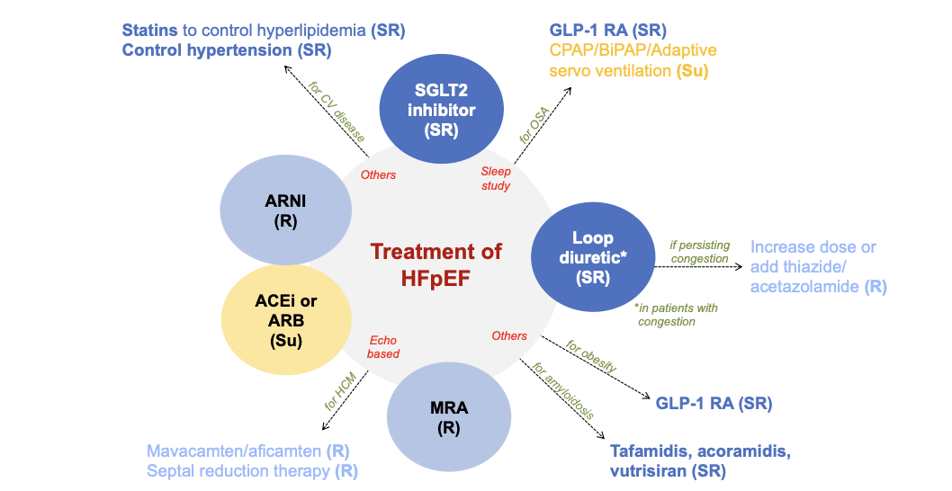
Overview of HFpEF management
Chopra V, et al. Global Cardiol [Internet]. 2025 Jun. 30 [cited 2025 Aug. 20];3(2). Available from: https://www.globalcardiology.info/site/article/view/70

Slide 32
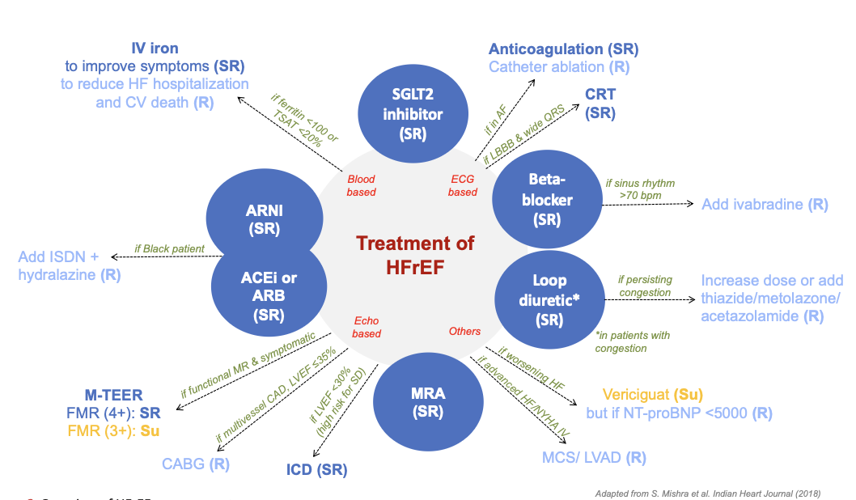
Overview of HFrEF management
Adapted from Mishra S. et al. Indian Heart J. 2018
Chopra V, et al. Global Cardiol [Internet]. 2025 Jun. 30 [cited 2025 Aug. 20];3(2). Available from: https://www.globalcardiology.info/site/article/view/70

Slide 33
iCARDIO Guidelines Development
summarize intl guidelines into short, concise, implementable documents
50% of authors in writing task force from outside Europe & NA
suggest task force members and all partner societies propose reviewers therefore guidelines peer reviewed by worldwide experts
public review period open to all
publication in 4-5 international journals (lead: Global Cardiology)
publicly and freely available with open access.

Slide 34
iCARDIO Alliance Global Guidelines
GLs statements considering 3 economic levels:
a) evidence-based only
b) resources somewhat limited
c )resources severely limited
50% of authors in writing task force from outside Europe & NA
all partner societies propose reviewers (and suggest task force members)
public review period
open access publication in 4-5 international journals (lead: Global Cardiology)
https://icardioalliance.org/partner-societies/

