Slide 1


The iCARDIO Alliance
Global Implementation Guidelines
iCARDIO Alliance Global Implementation
Guidelines on Ischemic Heart disease 2026
Pinto FJ et al. Global Cardiology 2026;4:139-164
Home - iCARDIO Alliance
Notes:
Title slide.

Slide 2

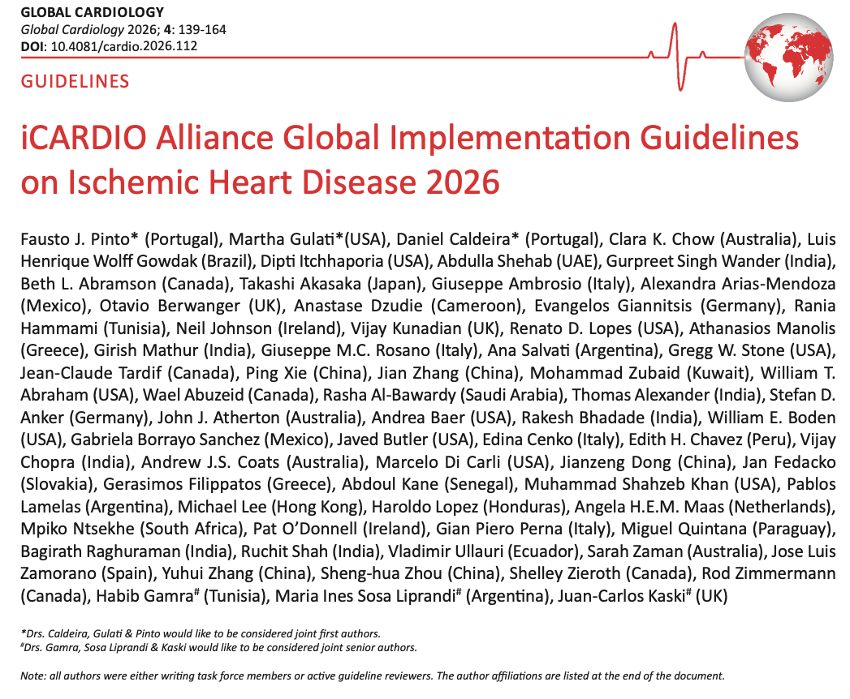

Pinto FJ et al. Global Cardiology 2026;4:139-164
Home - iCARDIO Alliance
Notes:
The published guideline in Global Cardiology.

Slide 3
iCARDIO ALLIANCE GLOBAL GUIDELINES
Aim of the iCARDIO Alliance Global Guidelines
01
Build a truly global alliance by bringing together leading cardiovascular societies worldwide to improve the full continuum of care — from prevention and diagnosis to treatment.
04
Guarantee global representation & credibility with writing panels composed of world-renowned experts (≥50% from outside Europe & North America), and an international peer-review. We also perform an open public review. All partner societies contribute to the process.
02
Design guidelines for real-world use, producing concise, practical, and actionable recommendations applicable across diverse healthcare systems and clinical settings.
05
Open access & global reach: Guidelines are published open access in up to 4 to 5 international journals (lead: Global Cardiology), maximizing worldwide dissemination.
03
Ensure equity through resource-stratified guidance, with recommendations adapted to three levels of resource availability: with no economic consideration, resources somewhat limited, resources severely limited.
Pinto FJ et al. Global Cardiology 2026;4:139-164
Home - iCARDIO Alliance
Notes:
Five aims of the alliance guidelines.

Slide 4
What makes iCARDIO different
Not another guideline body - a faster, simpler, farther-reaching way to bring evidence to every patient
1
SPEED
2
ACCESSIBILITY
3
IMPACT
Agile by design - we go faster
Made to be read - and used
Built to land, everywhere
A flexible entity, matched to the hectic pace of evidence
Synthetic format: shorter, simpler, digestible, implementable
Awareness & dissemination powered by our 25 Partner societies
Living updates in months, not five-year cycles like other guidelines producers
Economic tiers - equity for LMICs, adapted to local resources
Local implementation through Partner societies on five continents
So much happened between the first HF guidelines (2025) and today - and we kept up!
Guidance clinicians can act on at the point of care
The iCARDIO App carries living guidance into clinicians’ hands
Speed. Accessibility. Impact.Our approach to implementation.
Notes:
Speed, accessibility, impact - our approach to implementation.

Slide 5
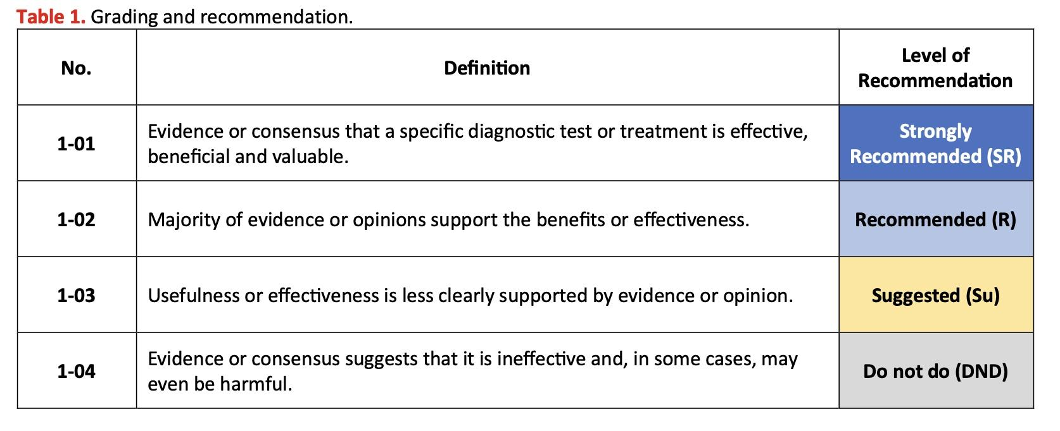
METHODOLOGY
iCARDIO Alliance Global Guidelines grading of recommendations
Home - iCARDIO Alliance
Notes:
How recommendations are graded: SR, R, Su, DND.

Slide 6
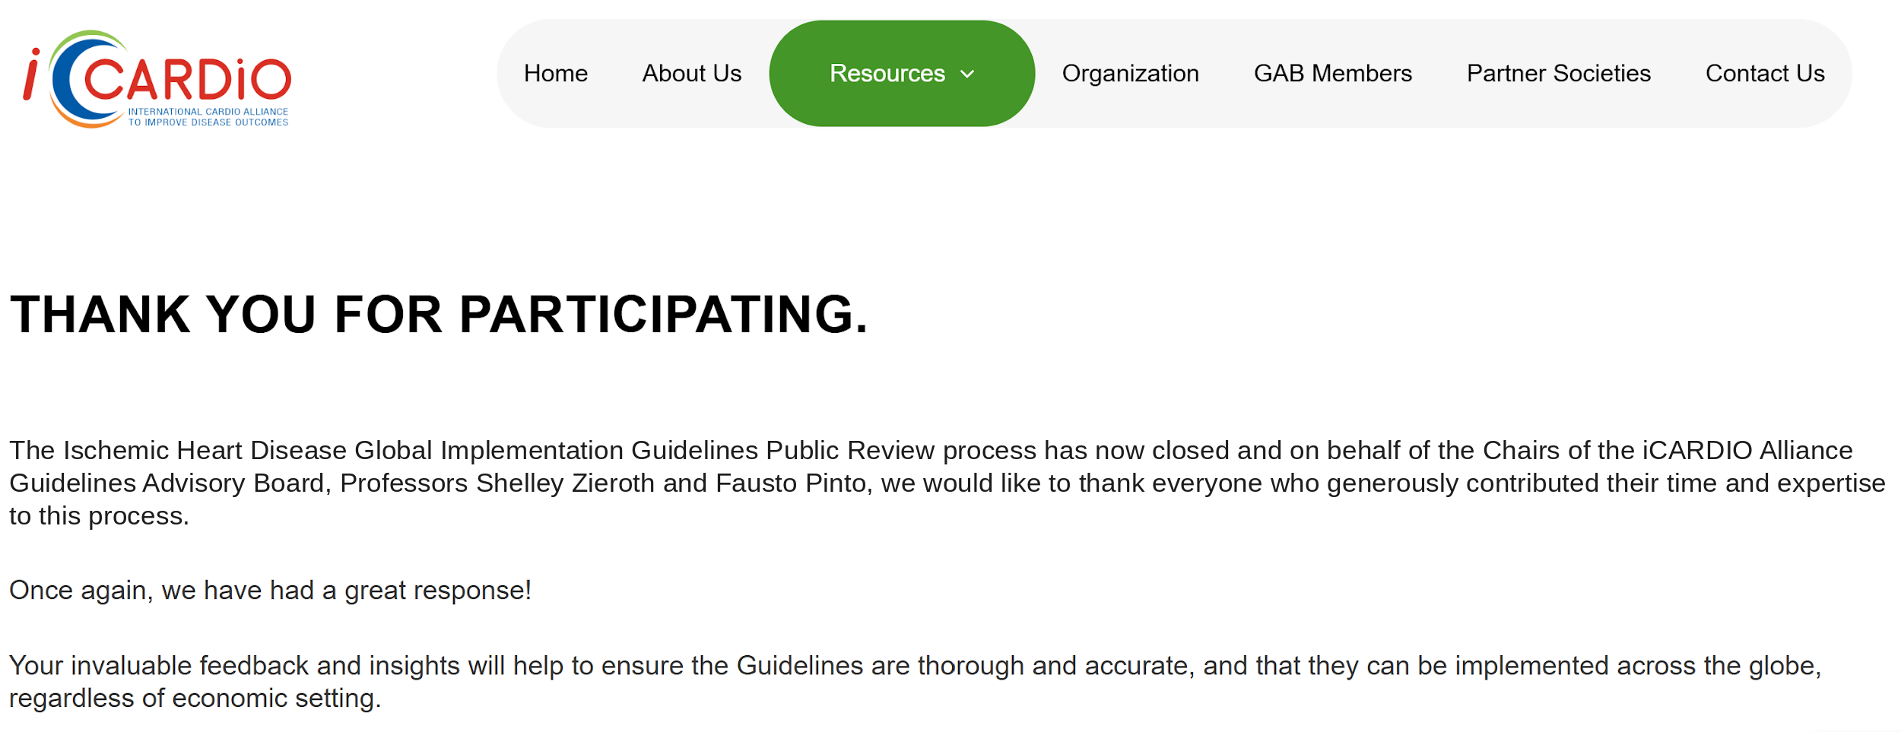
METHODOLOGY
iCARDIO Alliance Global Guidelines on IHD Public Consultation following the Peer Review
Open Public Review lasted one month March 2026
with comments from 50 spontaneous reviewers
Pinto FJ et al. Global Cardiology 2026;4:139-164
Home - iCARDIO Alliance
Notes:
Open public review, March 2026, 50 spontaneous reviewers.

Slide 7
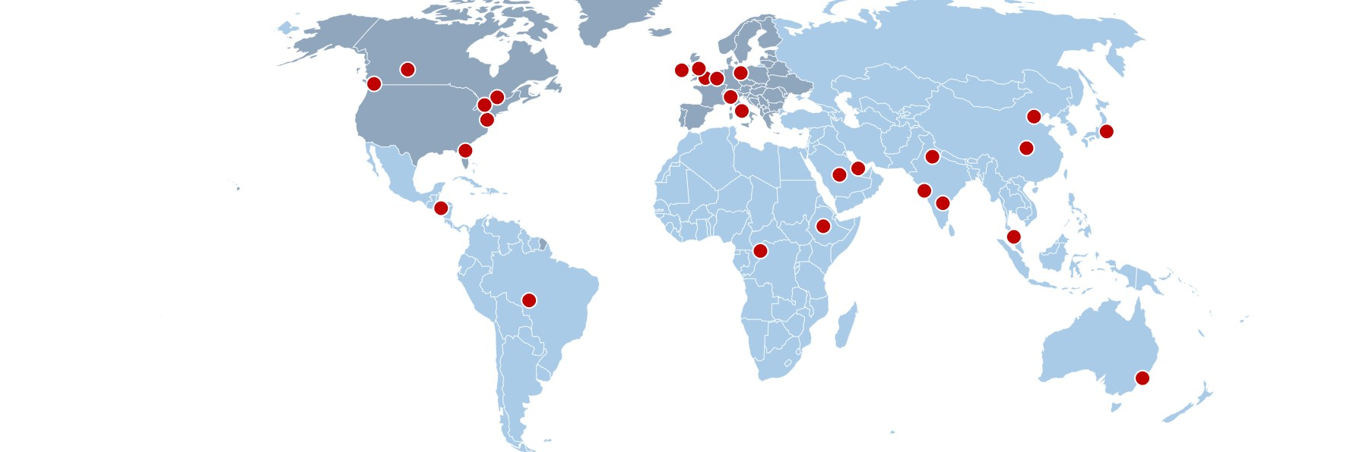

2026 iCARDIO GLOBAL IMPLEMENTATION GUIDELINES ON ISCHEMIC HEART DISEASE
Metrics
27 iCARDIO Partner Societies
TF ORIGIN
North America / Europe
Rest of world
CONTRIBUTORS
Each dot = one contributor
Countries
involved outside of public reviewers’ countries
27
TF Members
41
Peer Reviewers
50
Public Reviewers
14 from North America/Europe
13 from ROW
18 from North America/Europe
23 from ROW
Pinto FJ et al. Global Cardiology 2026;4:139-164
Home - iCARDIO Alliance
Notes:
Panel composition and review metrics. Map shows all 27 iCARDIO partner societies.

Slide 8

iCARDIO ALLIANCE GLOBAL GUIDELINES ON ISCHEMIC HEART DISEASE
Key Characteristics
25 pages
87 references
Authors are writing Task Force Members & Peer Reviewers
Authors from 22 countries from all continents
Published on 30th August, 2026
Pinto FJ et al. Global Cardiology 2026;4:139-164
Home - iCARDIO Alliance
Notes:
Key characteristics of the published guideline.

Slide 9
2026 iCARDIO GLOBAL IMPLEMENTATION GUIDELINES ON ISCHEMIC HEART DISEASE
Why were these guidelines needed?
01
Inconsistencies in healthcare access, varying infrastructure, resource constraints and diverse local practices restrict global applicability of conventional guidelines.
03
Provide recommendations on several issues where resource limitations may put constraints on the evaluation and treatments provided to patients with IHD.
02
Need for universal recommendations that address the unique challenges faced by patients and healthcare providers in different settings.
04
Provide a unified strategy for the management of IHD that is applicable to all cardiovascular care worldwide.
Pinto FJ et al. Global Cardiology 2026;4:139-164
Home - iCARDIO Alliance
Notes:
Why these guidelines were needed.

Slide 10
2026 iCARDIO ALLIANCE GLOBAL GUIDELINES ON ISCHEMIC HEART DISEASE
Recommendations
Pinto FJ et al. Global Cardiology 2026;4:139-164
Home - iCARDIO Alliance
Notes:
Section: Recommendations.

Slide 11
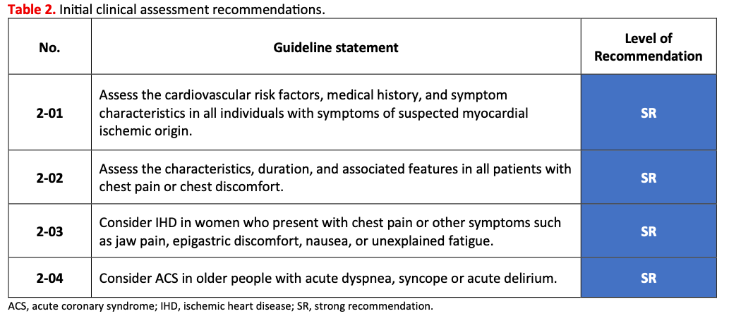
RECOMMENDATIONS
Initial clinical assessment recommendations in IHD
Pinto FJ et al. Global Cardiology 2026;4:139-164
Home - iCARDIO Alliance
Notes:
Initial clinical assessment recommendations in IHD.

Slide 12
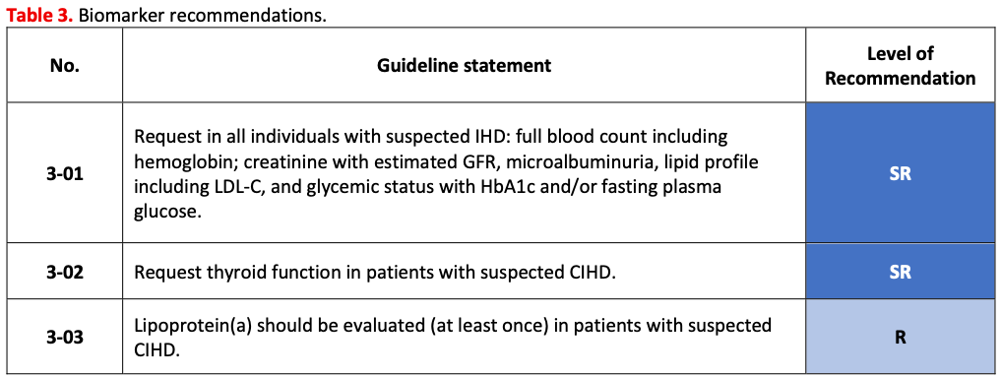
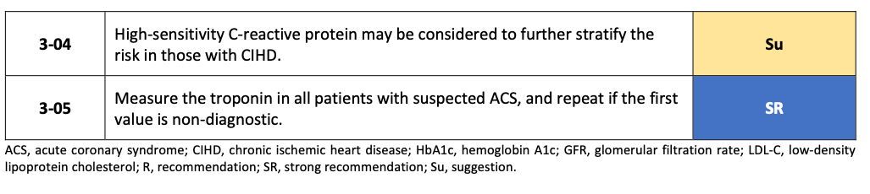
RECOMMENDATIONS
Recommendations for the biomarkers in patients with IHD
Pinto FJ et al. Global Cardiology 2026;4:139-164
Home - iCARDIO Alliance
Notes:
Recommendations for the biomarkers in patients with IHD.

Slide 13
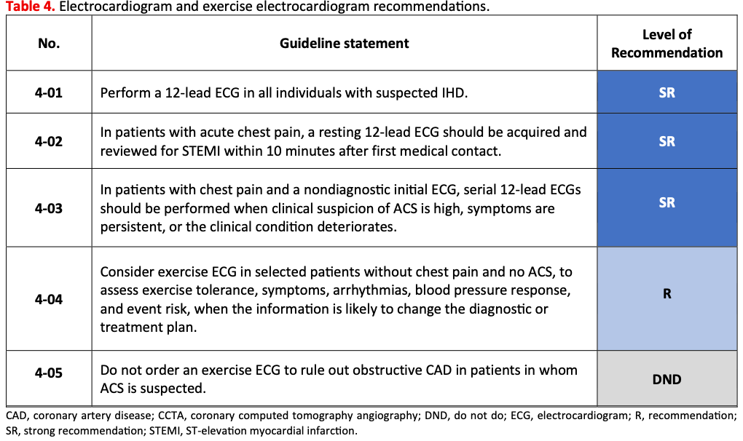
RECOMMENDATIONS
EKG and exercice EKG recommendations in IHD
Pinto FJ et al. Global Cardiology 2026;4:139-164
Home - iCARDIO Alliance
Notes:
EKG and exercice EKG recommendations in IHD.

Slide 14
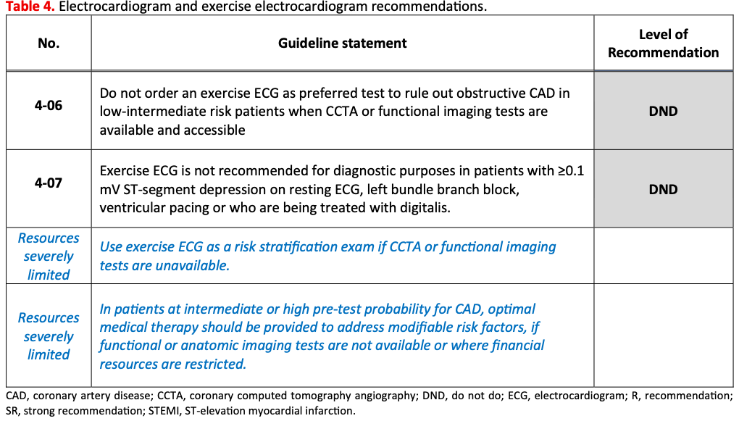
RECOMMENDATIONS
EKG and exercice EKG recommendations in IHD (cont’d)
Pinto FJ et al. Global Cardiology 2026;4:139-164
Home - iCARDIO Alliance
Notes:
EKG and exercice EKG recommendations in IHD (cont’d).

Slide 15
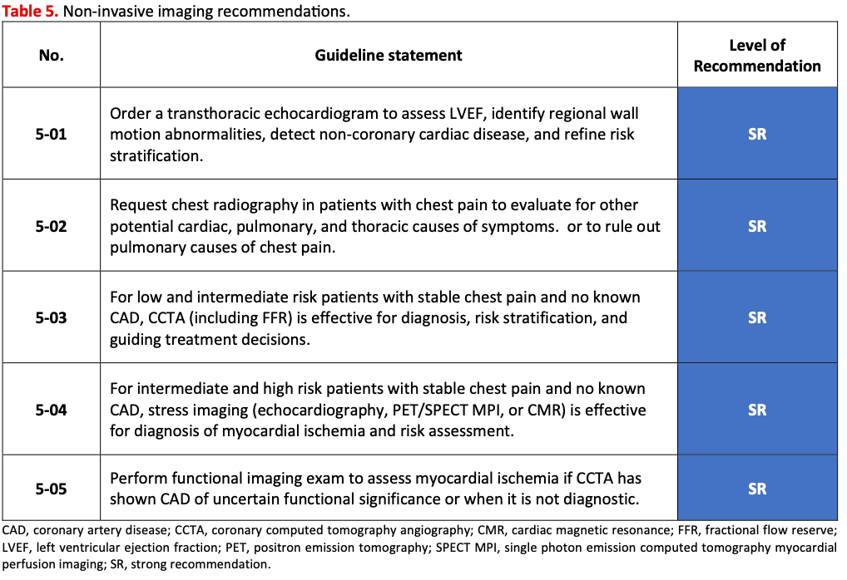
RECOMMENDATIONS
Recommendations for non-invasive imaging in IHD
Pinto FJ et al. Global Cardiology 2026;4:139-164
Home - iCARDIO Alliance
Notes:
Recommendations for non-invasive imaging in IHD.

Slide 16
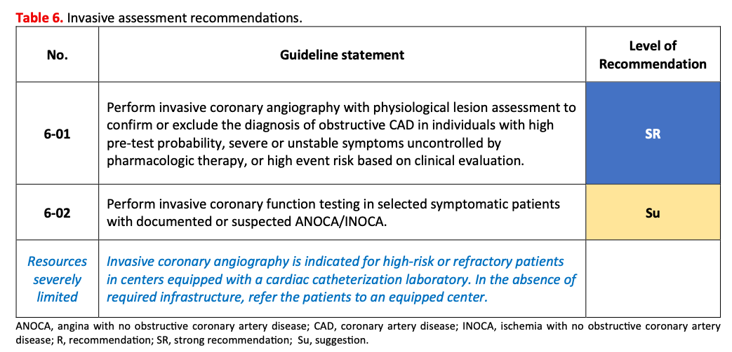
RECOMMENDATIONS
Recommendations for invasive assessment in IHD
Pinto FJ et al. Global Cardiology 2026;4:139-164
Home - iCARDIO Alliance
Notes:
Recommendations for invasive assessment in IHD.

Slide 17
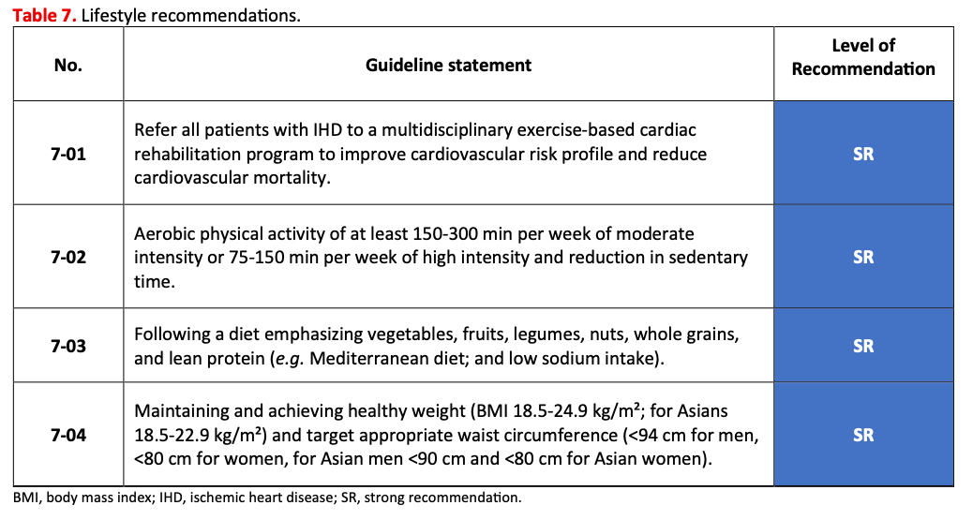
RECOMMENDATIONS
Lifestyle recommendations in IHD
Pinto FJ et al. Global Cardiology 2026;4:139-164
Home - iCARDIO Alliance
Notes:
Lifestyle recommendations in IHD.

Slide 18
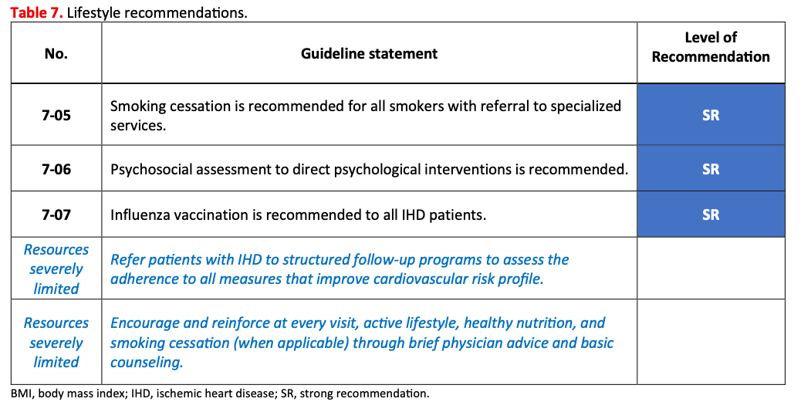
RECOMMENDATIONS
Lifestyle recommendations in IHD (cont’d)
Pinto FJ et al. Global Cardiology 2026;4:139-164
Home - iCARDIO Alliance
Notes:
Lifestyle recommendations in IHD (cont’d).

Slide 19
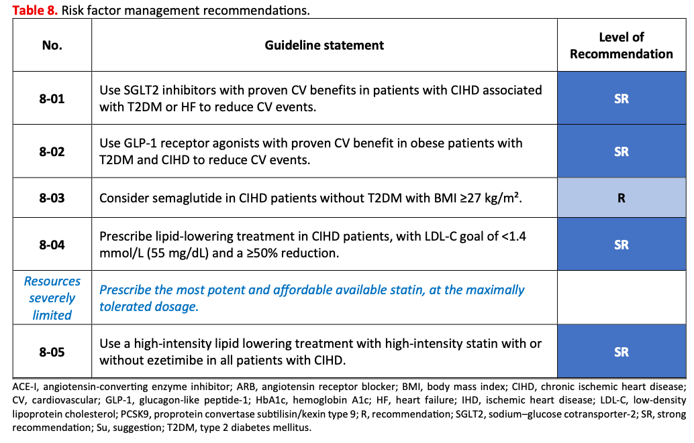
RECOMMENDATIONS
Recommendations for risk factor management in patients with IHD
Pinto FJ et al. Global Cardiology 2026;4:139-164
Home - iCARDIO Alliance
Notes:
Recommendations for risk factor management in patients with IHD.

Slide 20
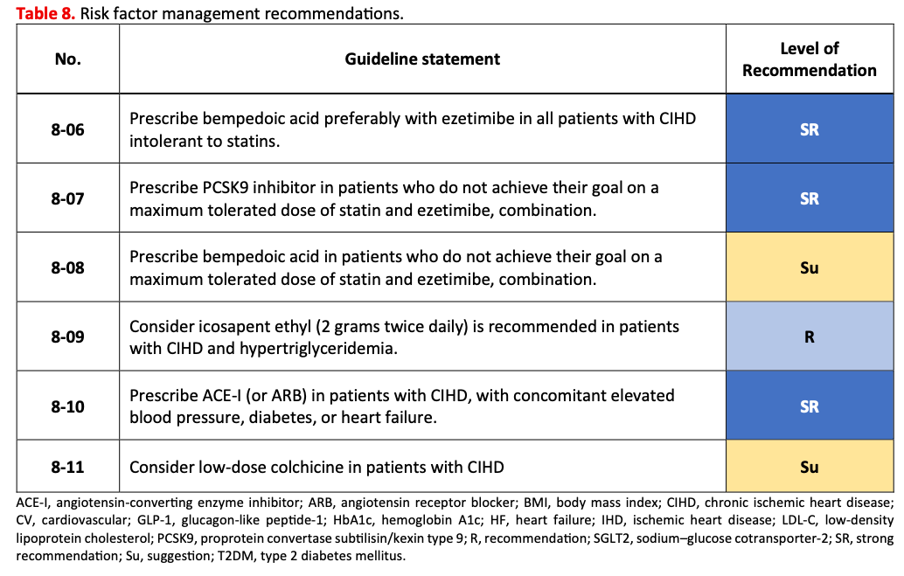
RECOMMENDATIONS
Recommendations for risk factor management in patients with IHD (cont’d)
Pinto FJ et al. Global Cardiology 2026;4:139-164
Home - iCARDIO Alliance
Notes:
Recommendations for risk factor management in patients with IHD (cont’d).

Slide 21
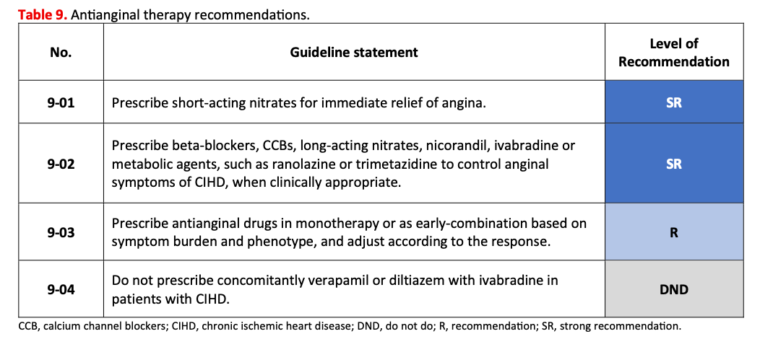
RECOMMENDATIONS
Recommendations for antianginal therapy in patients with IHD
Pinto FJ et al. Global Cardiology 2026;4:139-164
Home - iCARDIO Alliance
Notes:
Recommendations for antianginal therapy in patients with IHD.

Slide 22
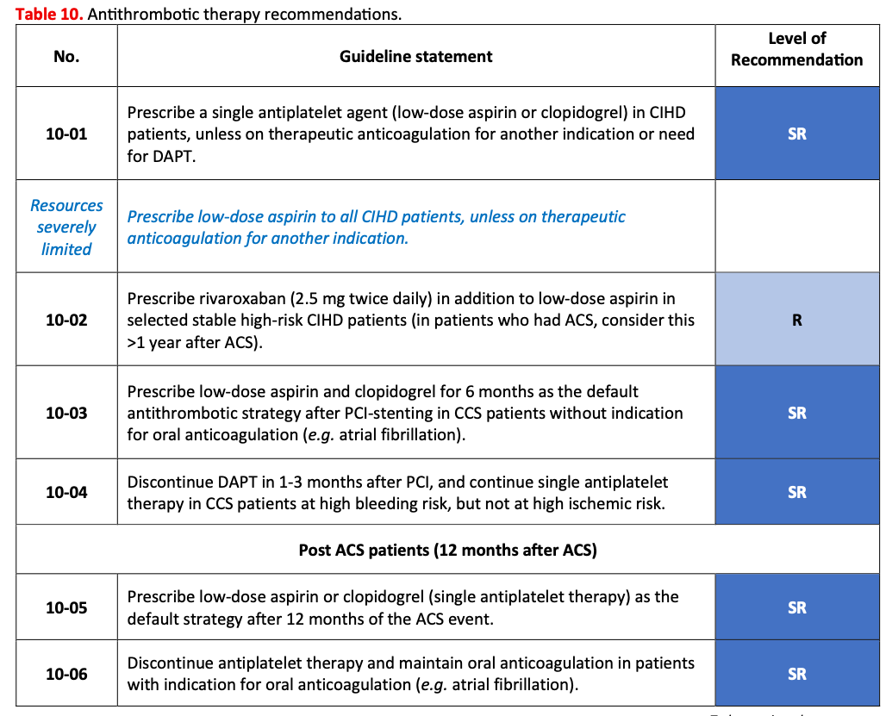
RECOMMENDATIONS
Recommendations for antithrombotic therapy in IHD
Pinto FJ et al. Global Cardiology 2026;4:139-164
Home - iCARDIO Alliance
Notes:
Recommendations for antithrombotic therapy in IHD.

Slide 23
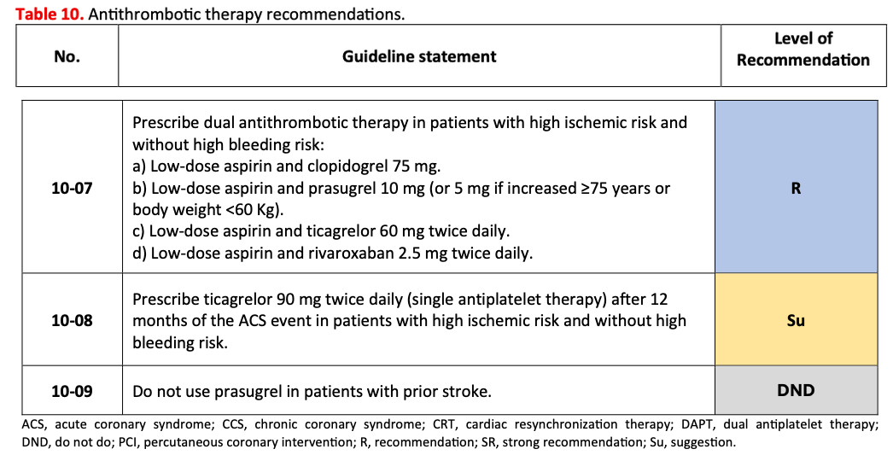
RECOMMENDATIONS
Recommendations for antithrombotic therapy in IHD (cont’d)
Pinto FJ et al. Global Cardiology 2026;4:139-164
Home - iCARDIO Alliance
Notes:
Recommendations for antithrombotic therapy in IHD (cont’d).

Slide 24
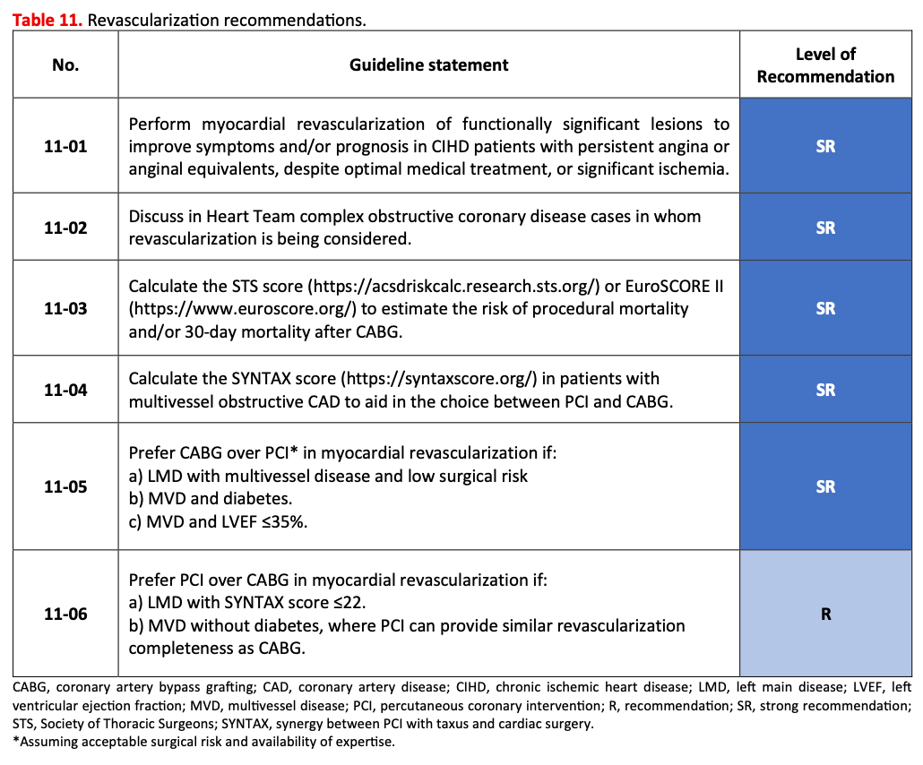
RECOMMENDATIONS
Recommendations for revascularisation in IHD
Pinto FJ et al. Global Cardiology 2026;4:139-164
Home - iCARDIO Alliance
Notes:
Recommendations for revascularisation in IHD.

Slide 25
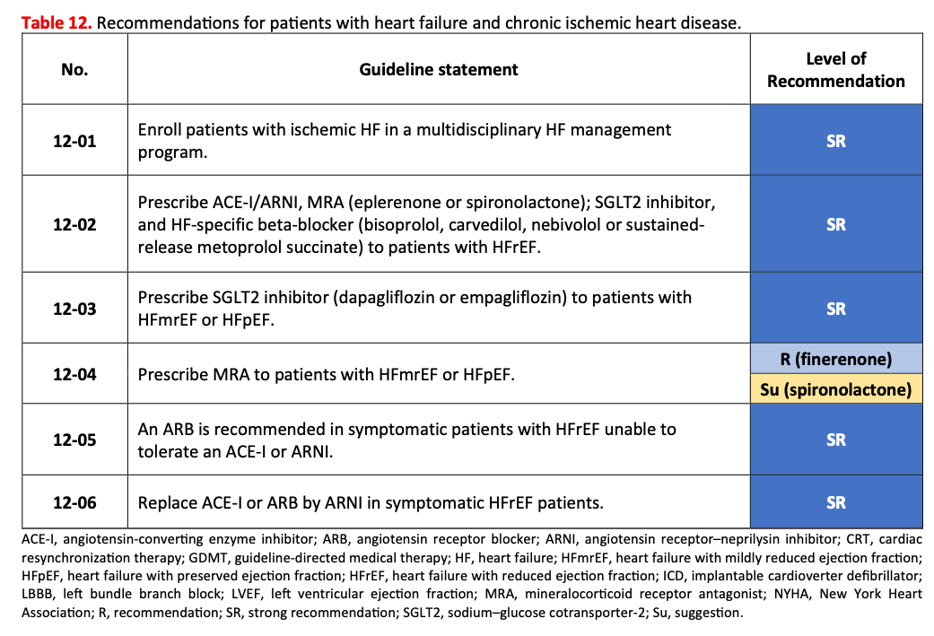
RECOMMENDATIONS
Recommendations for patients with HF and chronic ischemic heart disease
Pinto FJ et al. Global Cardiology 2026;4:139-164
Home - iCARDIO Alliance
Notes:
Recommendations for patients with HF and chronic ischemic heart disease.

Slide 26
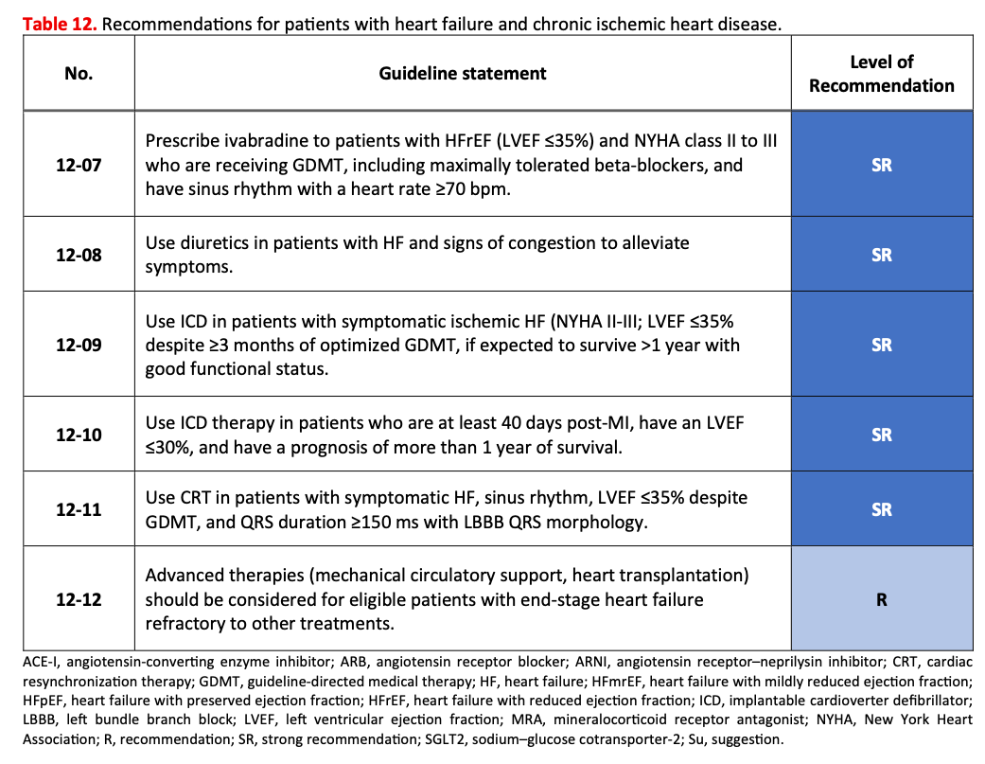
RECOMMENDATIONS
Recommendations for patients with HF and chronic ischemic heart disease (cont’d)
Pinto FJ et al. Global Cardiology 2026;4:139-164
Home - iCARDIO Alliance
Notes:
Recommendations for patients with HF and chronic ischemic heart disease (cont’d).

Slide 27
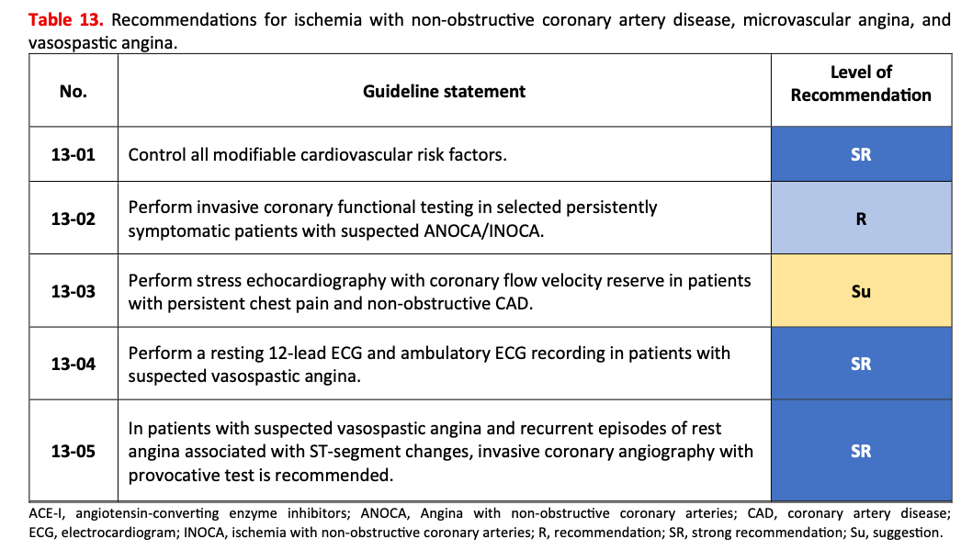
RECOMMENDATIONS
Recommendations for ischemia with non obstructive CAD, microvascular angina and vasospastic angina
Pinto FJ et al. Global Cardiology 2026;4:139-164
Home - iCARDIO Alliance
Notes:
Recommendations for ischemia with non obstructive CAD, microvascular angina and vasospastic angina.

Slide 28
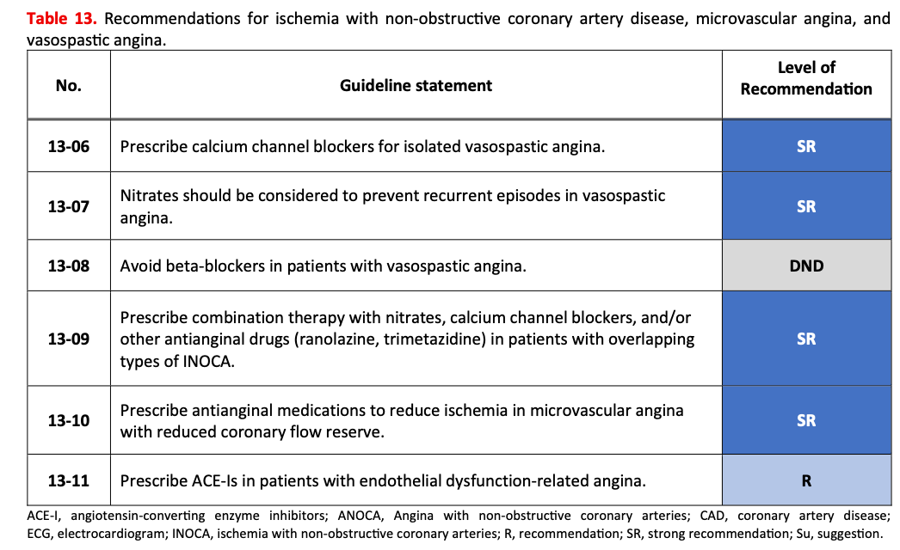
RECOMMENDATIONS
Recommendations for ischemia with non obstructive CAD, microvascular angina and vasospastic angina (cont’d)
Pinto FJ et al. Global Cardiology 2026;4:139-164
Home - iCARDIO Alliance
Notes:
Recommendations for ischemia with non obstructive CAD, microvascular angina and vasospastic angina (cont’d).

Slide 29
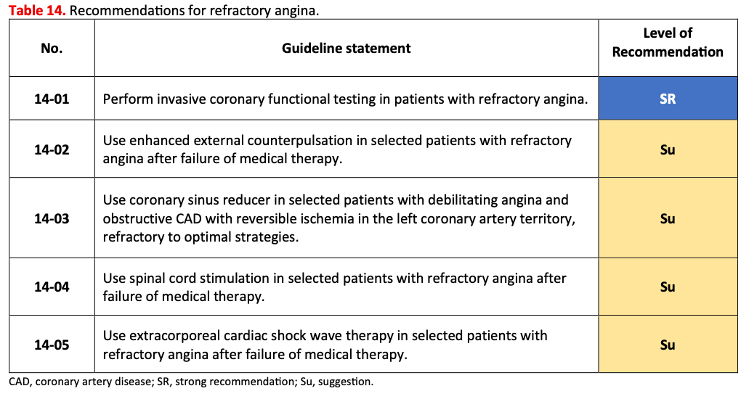
RECOMMENDATIONS
Recommendations for refractory angina in IHD
Pinto FJ et al. Global Cardiology 2026;4:139-164
Home - iCARDIO Alliance
Notes:
Recommendations for refractory angina in IHD.

Slide 30
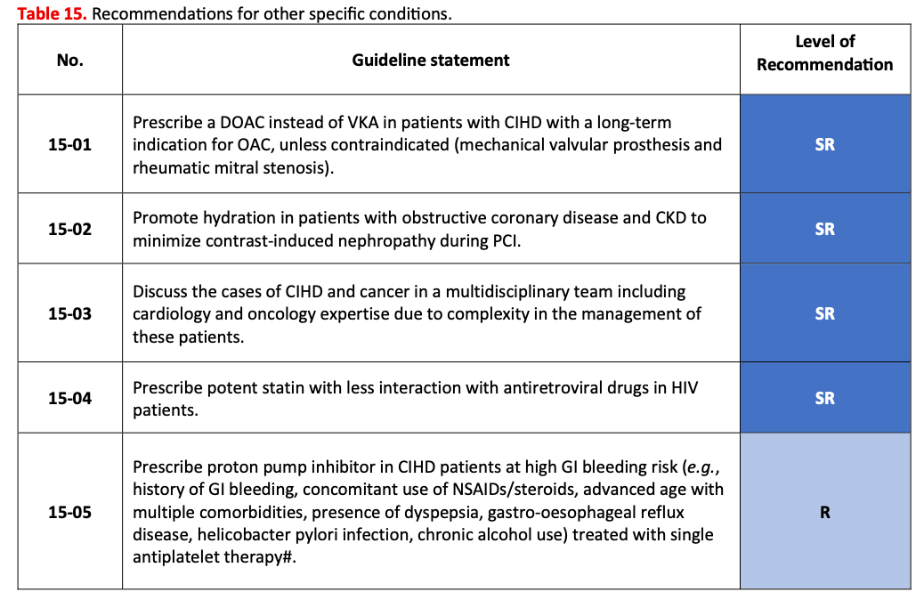
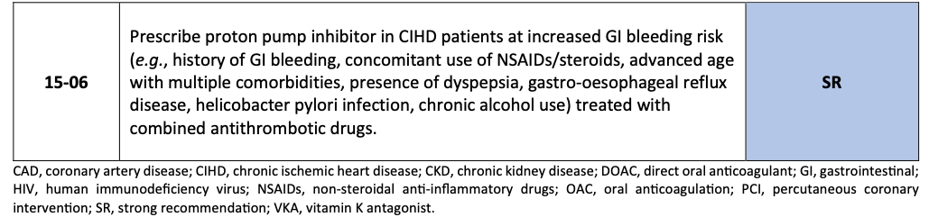
RECOMMENDATIONS
Recommendations for other specific conditions in IHD
Pinto FJ et al. Global Cardiology 2026;4:139-164
Home - iCARDIO Alliance
Notes:
Recommendations for other specific conditions in IHD.

Slide 31
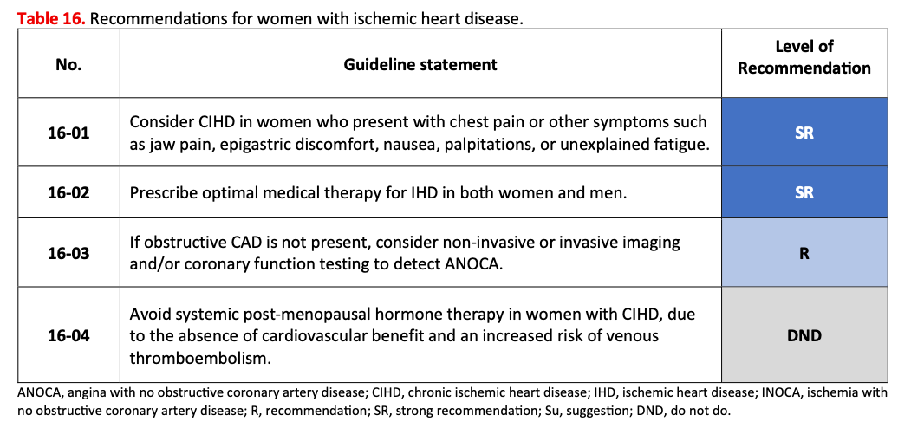
RECOMMENDATIONS
Recommendations for women with IHD
Pinto FJ et al. Global Cardiology 2026;4:139-164
Home - iCARDIO Alliance
Notes:
Recommendations for women with IHD.

Slide 32
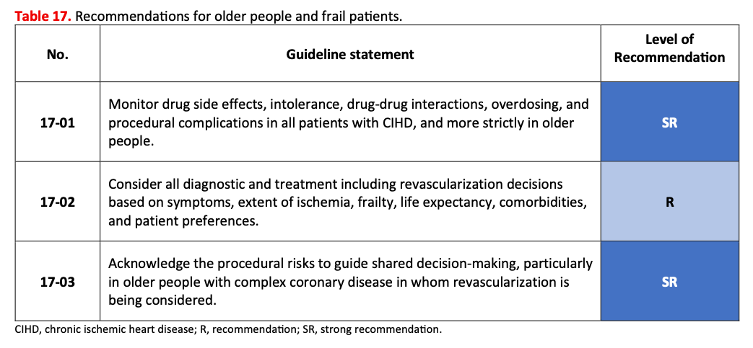
RECOMMENDATIONS
Recommendations for older and frail people with IHD
Pinto FJ et al. Global Cardiology 2026;4:139-164
Home - iCARDIO Alliance
Notes:
Recommendations for older and frail people with IHD.

Slide 33
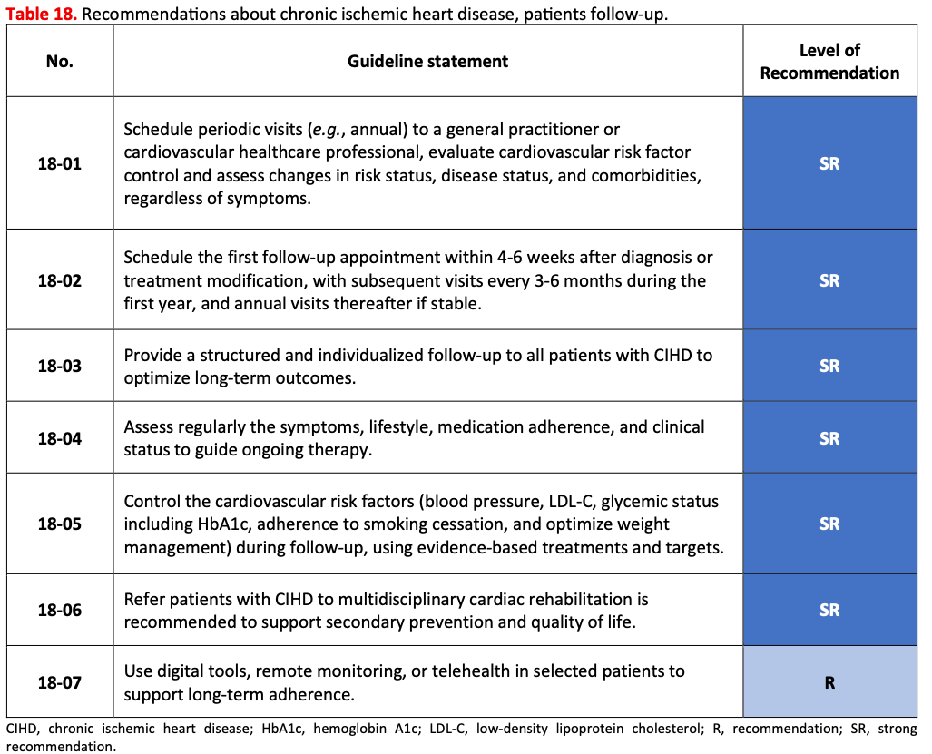
RECOMMENDATIONS
Recommendations for patient follow-up in IHD
Pinto FJ et al. Global Cardiology 2026;4:139-164
Home - iCARDIO Alliance
Notes:
Recommendations for patient follow-up in IHD.

Slide 34
2026 iCARDIO ALLIANCE GLOBAL GUIDELINES ON ISCHEMIC HEART DISEASE
Overview
Pinto FJ et al. Global Cardiology 2026;4:139-164
Home - iCARDIO Alliance
Notes:
Section: Overview figures.

Slide 35
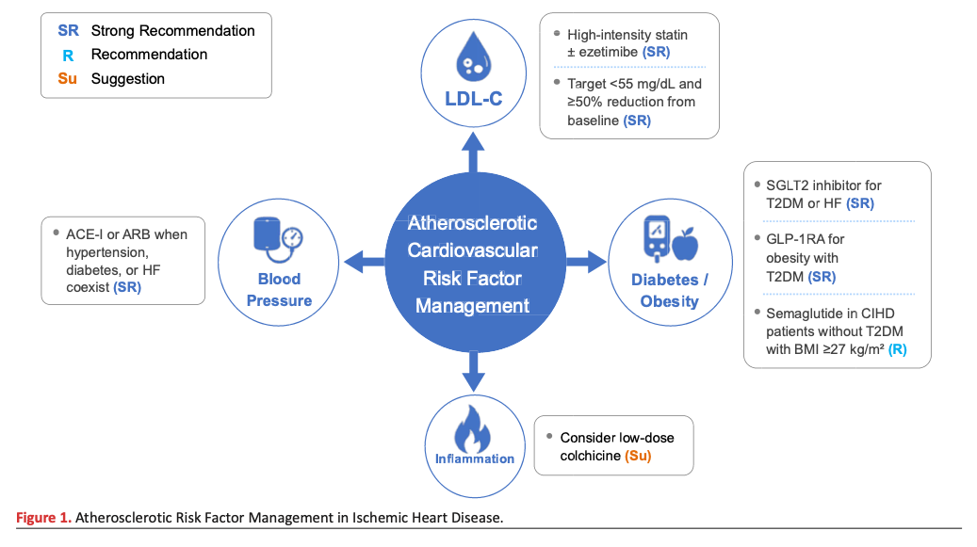
Atherosclerotic risk factor management in IHD
OVERVIEW
Pinto FJ et al. Global Cardiology 2026;4:139-164
Home - iCARDIO Alliance
Notes:
Atherosclerotic risk factor management in IHD.

Slide 36
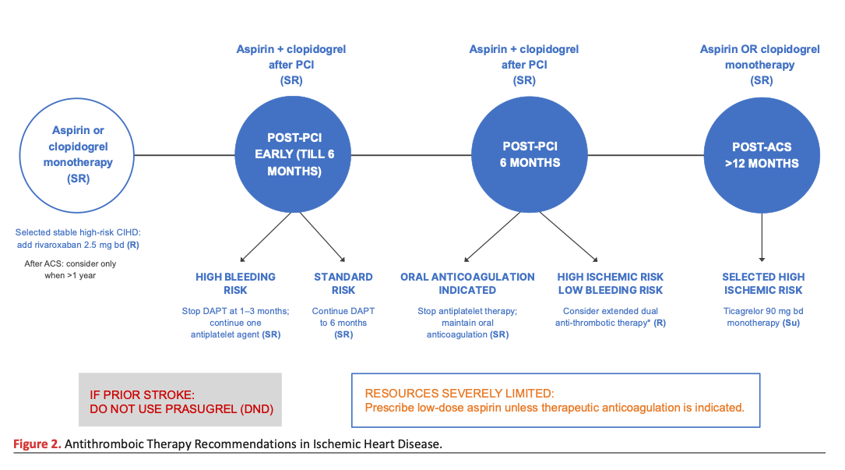
Antithrombotic therapy recommendations in IHD
OVERVIEW
Pinto FJ et al. Global Cardiology 2026;4:139-164
Home - iCARDIO Alliance
Notes:
Antithrombotic therapy recommendations in IHD.

Slide 37
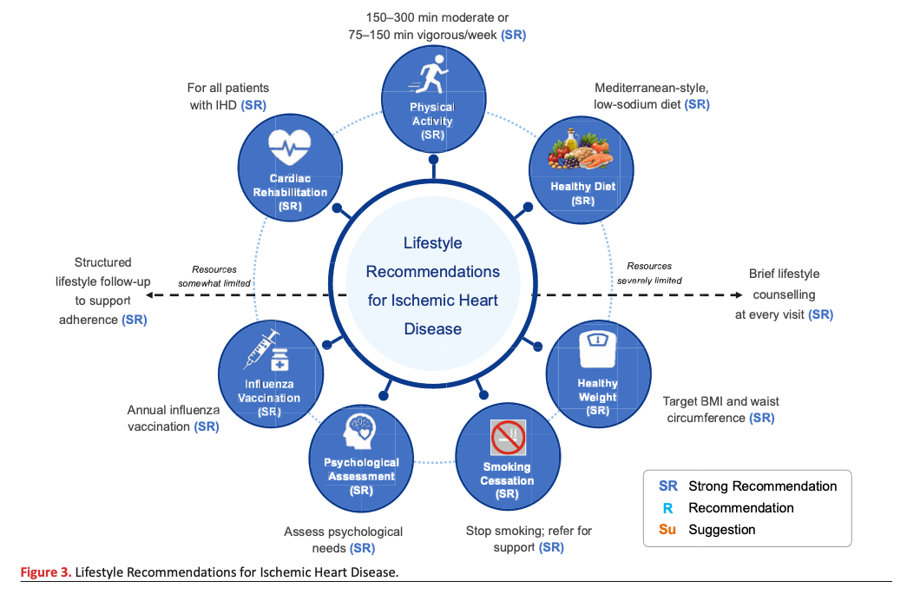
Lifestyle recommendations in IHD
OVERVIEW
Pinto FJ et al. Global Cardiology 2026;4:139-164
Home - iCARDIO Alliance
Notes:
Lifestyle recommendations in IHD.

Slide 38




iCARDIO ALLIANCE
Contacts
Veronica Dean
Christine Gans
Guidelines Development Manager
Administrative Officer
Phone : +33 685 543 219
Phone : +33 660 035 726
vdean@tmacademy.org
christine.gans@tmacademy.org
www.icardioalliance.org
www.icardioalliance.org
Translational Medicine Academy TMA Foundation - Headquarter: Picassoplatz 8, 4052 Basel, Switzerland
Notes:
Contacts.

