Slide 1


The iCARDIO Alliance
Global Implementation Guidelines
2026 iCARDIO Alliance Global Implementation
Guidelines on Heart Failure
Chopra V et al. Global Cardiology 2026;4:165-196
Home - iCARDIO Alliance
Notes:
Title slide.

Slide 2

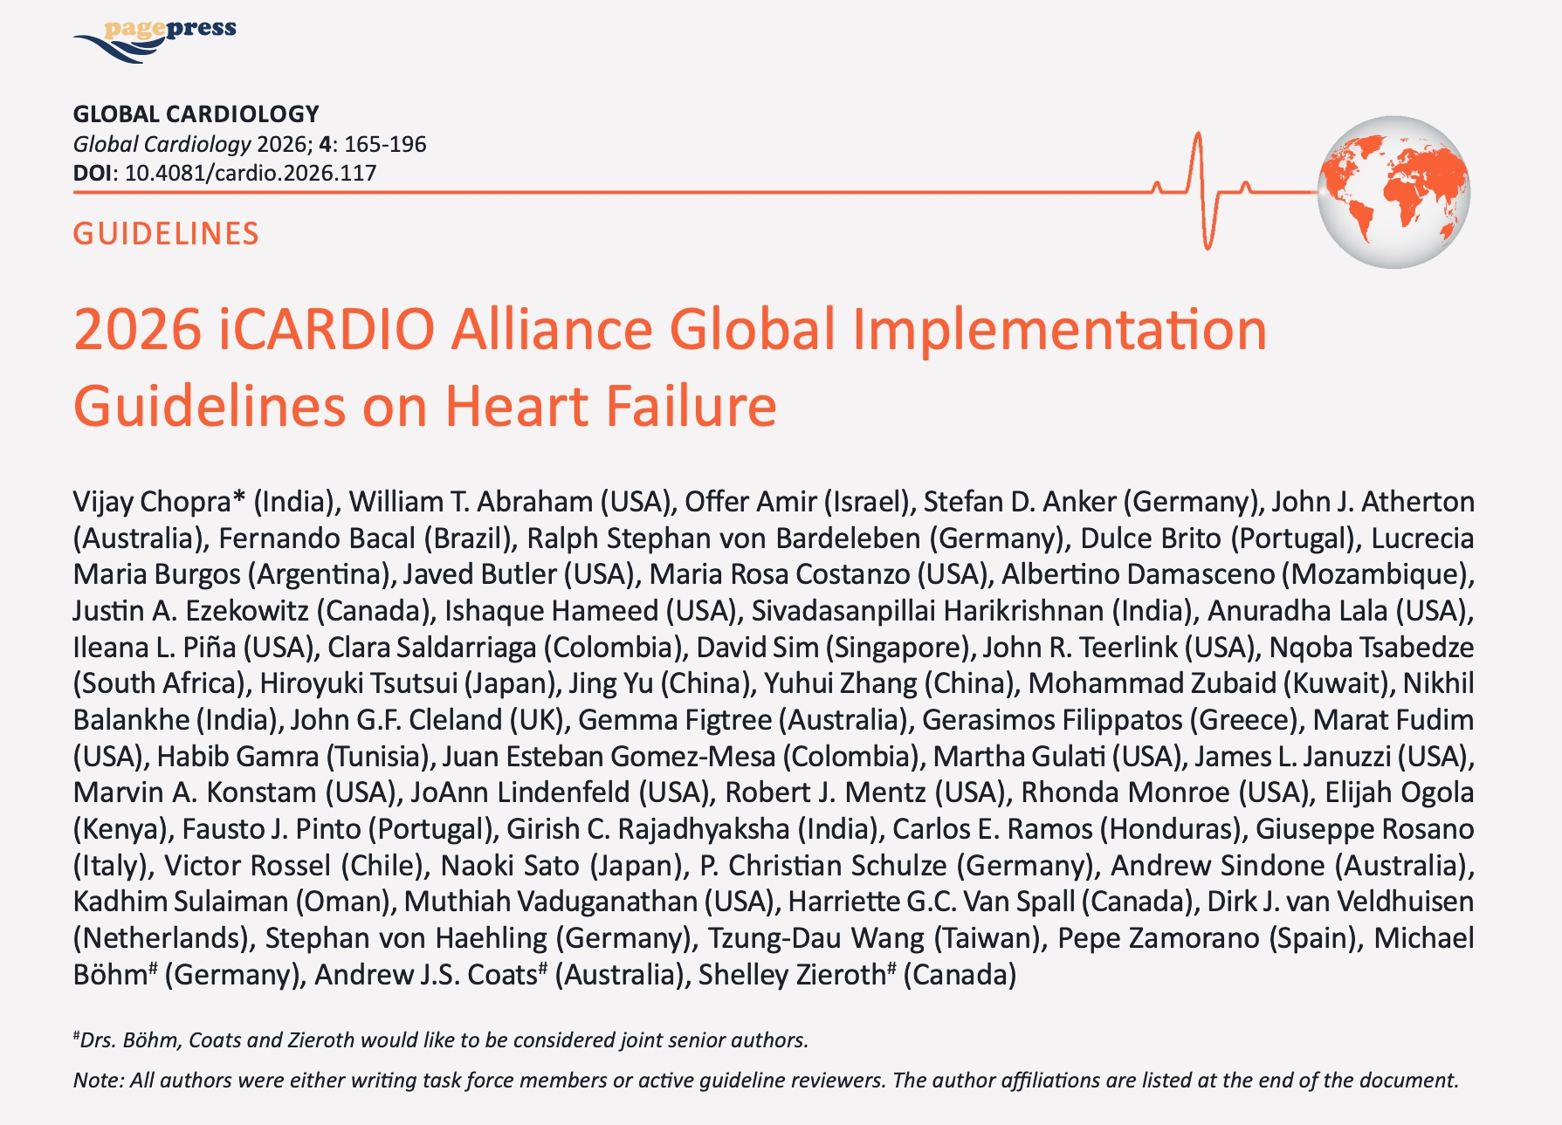

Chopra V et al. Global Cardiology 2026;4:165-196
Home - iCARDIO Alliance
Notes:
The published guideline in Global Cardiology.

Slide 3
iCARDIO ALLIANCE GLOBAL GUIDELINES
Aim of the iCARDIO Alliance Global Guidelines
01
Build a truly global alliance by bringing together leading cardiovascular societies worldwide to improve the full continuum of care — from prevention and diagnosis to treatment.
04
Guarantee global representation & credibility with writing panels composed of world-renowned experts (≥50% from outside Europe & North America), and an international peer-review. We also perform an open public review. All partner societies contribute to the process.
02
Design guidelines for real-world use , producing concise, practical, and actionable recommendations applicable across diverse healthcare systems and clinical settings.
05
Open access & global reach: Guidelines are published open access in up to 4 to 5 international journals (lead: Global Cardiology), maximizing worldwide dissemination.
03
Ensure equity through resource-stratified guidance , with recommendations adapted to three levels of resource availability: with no economic consideration, resources somewhat limited, resources severely limited.
Chopra V et al. Global Cardiology 2026;4:165-196
Home - iCARDIO Alliance
Notes:
Five aims of the alliance guidelines.

Slide 4
What makes iCARDIO different
Not another guideline body - a faster, simpler, farther-reaching way to bring evidence to every patient
1
SPEED
2
ACCESSIBILITY
3
IMPACT
Agile by design - we go faster
Made to be read - and used
Built to land, everywhere
A flexible entity, matched to the hectic pace of evidence
Synthetic format: shorter, simpler, digestible, implementable
Awareness & dissemination powered by our 25 Partner societies
Living updates in months, not five-year cycles like other guidelines producers
Economic tiers - equity for LMICs, adapted to local resources
Local implementation through Partner societies on five continents
So much happened between the first HF guidelines (2025) and today - and we kept up!
Guidance clinicians can act on at the point of care
The iCARDIO App carries living guidance into clinicians’ hands
Speed. Accessibility. Impact.Our approach to implementation.
Notes:
Speed, accessibility, impact - our approach to implementation.

Slide 5
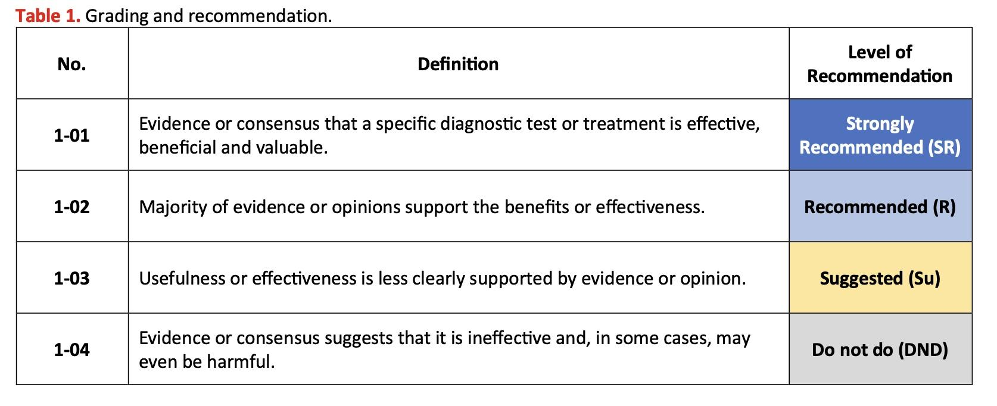
METHODOLOGY
iCARDIO Alliance Global Guidelines grading of recommendations
Home - iCARDIO Alliance
Notes:
How recommendations are graded: SR, R, Su, DND.

Slide 6
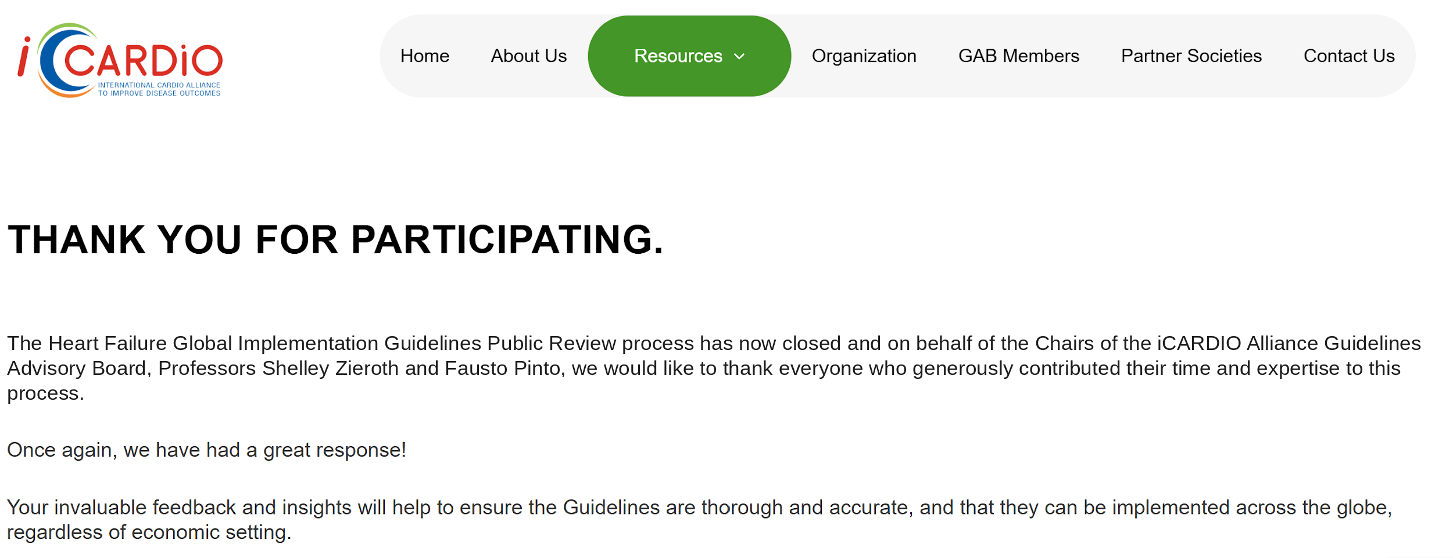
METHODOLOGY
2026 iCARDIO Alliance Global Guidelines on HF Public Consultation following the Peer Review
Open Public Review lasted one month June 2026
with comments from 41 spontaneous reviewers
Chopra V et al. Global Cardiology 2026;4:165-196
Home - iCARDIO Alliance
Notes:
Open public review, June 2026, 41 spontaneous reviewers.

Slide 7
iCARDIO ALLIANCE GLOBAL GUIDELINES ON HEART FAILURE
Key Characteristics
31 pages
62 references
Authors are writing Task Force Members & Peer Reviewers
Authors from 22 countries from all continents
Published on 30th August, 2026
Chopra V et al. Global Cardiology 2026;4:165-196
Home - iCARDIO Alliance
Notes:
Key characteristics of the published guideline.

Slide 8
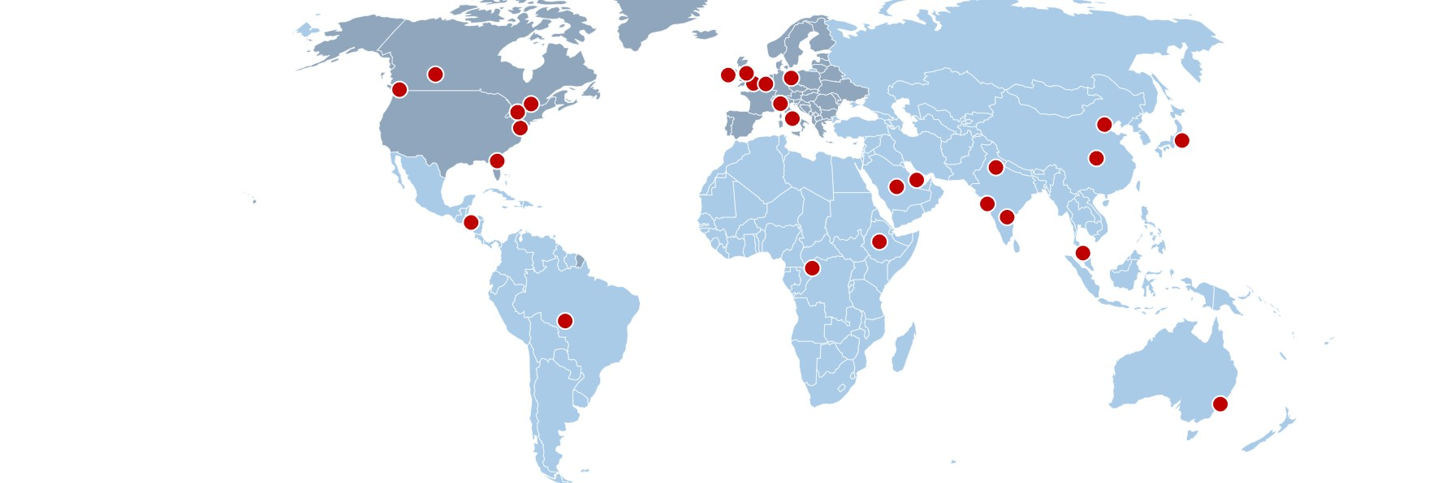

2026 iCARDIO GLOBAL IMPLEMENTATION GUIDELINES ON HEART FAILURE
Metrics
27 iCARDIO Partner Societies
TF ORIGIN
North America / Europe
Rest of world
CONTRIBUTORS
Each dot = one contributor
Countries
involved outside of public reviewers’ countries
26
TF Members
30
Peer Reviewers
41
Public Reviewers
12 from North America/Europe
14 from ROW
Chopra V et al. Global Cardiology 2026;4:165-196
Home - iCARDIO Alliance
Notes:
Panel composition and review metrics. Map shows all 27 iCARDIO partner societies.

Slide 9
2026 iCARDIO GLOBAL IMPLEMENTATION GUIDELINES ON HEART FAILURE
Classification
Heart failure now classified into two categories: HFrEF (LVEF <50%) and HFpEF (LVEF ≥50%)
Update builds on the 2025 Guidelines and includes new evidence released as recently as June 2026.
HFrEF
HFpEF
LVEF <50%
LVEF ≥50%
Practical, implementation-focused recommendations – considering clinical evidence and the realities of healthcare delivery in resource-variable settings.
Patients traditionally classified as “mildly reduced” ejection fraction often benefit from the same therapies used in HFrEF.
Chopra V et al. Global Cardiology 2026;4:165-196
Home - iCARDIO Alliance
Notes:
Two categories: HFrEF and HFpEF.

Slide 10
2026 iCARDIO GLOBAL IMPLEMENTATION GUIDELINES ON HEART FAILURE
Drug therapy
NEW
STRENGTHENED
New recommendations on digoxin, finerenone and vericiguat in patients with HFrEF
Cardiac glycosides (digitoxin and digoxin): strengthened and clarified recommendations
New evidence demonstrates benefits across a broader range of patients than previously recognized.
For patients who remain symptomatic despite guideline-directed medical therapy.
Chopra V et al. Global Cardiology 2026;4:165-196
Home - iCARDIO Alliance
Notes:
New and strengthened pharmacological recommendations.

Slide 11
2026 iCARDIO GLOBAL IMPLEMENTATION GUIDELINES ON HEART FAILURE
Beyond HFrEF
01
02
03
Cardiac myosin inhibitors: stronger recommendations in symptomatic obstructive hypertrophic cardiomyopathy.
Updated preventive vaccination strategies: influenza, pneumococcal, COVID-19, herpes zoster and RSV vaccines.
GLP-1 receptor agonists in HFpEF and obesity: continued support, refined to reflect ongoing discussions on patient-reported outcomes and the need for additional long-term data.
Chopra V et al. Global Cardiology 2026;4:165-196
Home - iCARDIO Alliance
Notes:
Myosin inhibitors, vaccination, GLP-1 receptor agonists.

Slide 12
2026 iCARDIO ALLIANCE GLOBAL GUIDELINES ON HEART FAILURE
Recommendations
Chopra V et al. Global Cardiology 2026;4:165-196
Home - iCARDIO Alliance
Notes:
Title slide.

Slide 13
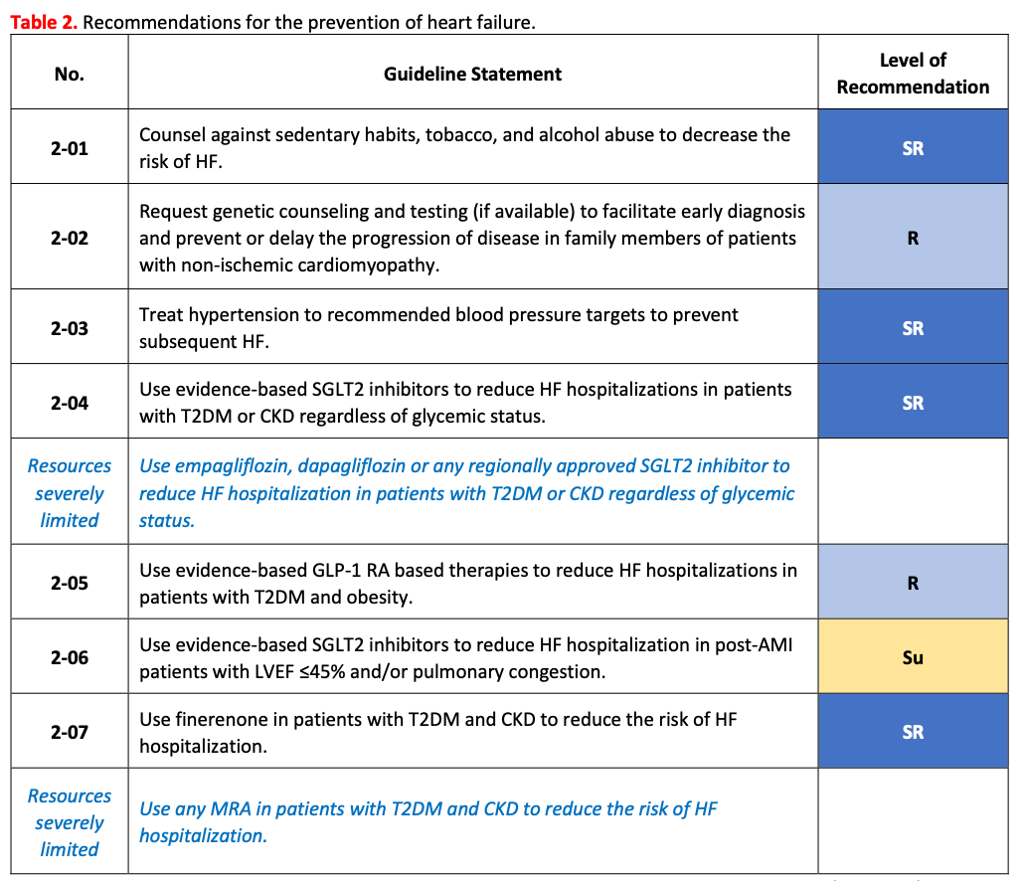
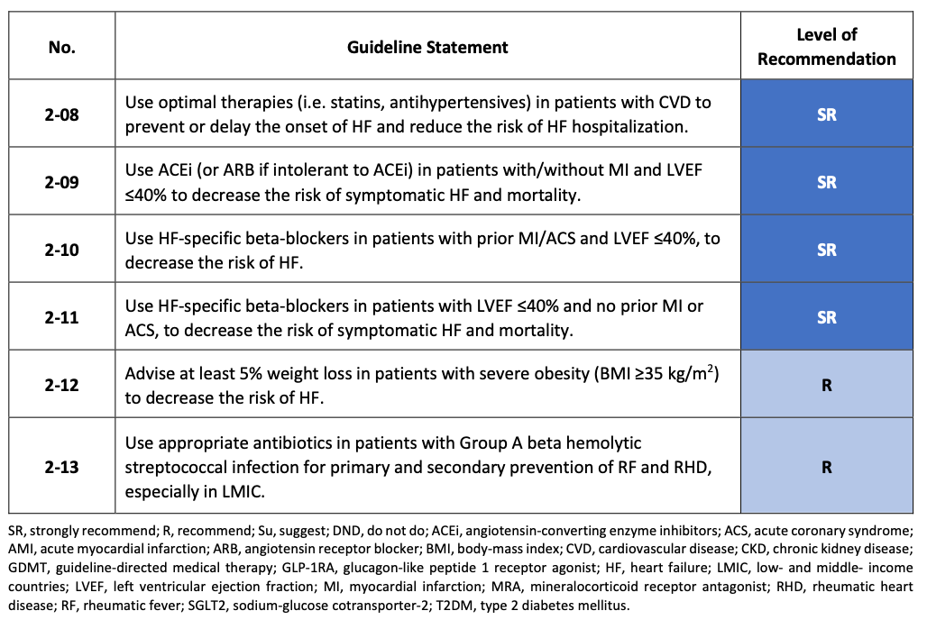
RECOMMENDATIONS
Recommendations for the prevention of HF
Chopra V et al. Global Cardiology 2026;4:165-196
Home - iCARDIO Alliance
Notes:
Recommendations for the prevention of heart failure.

Slide 14
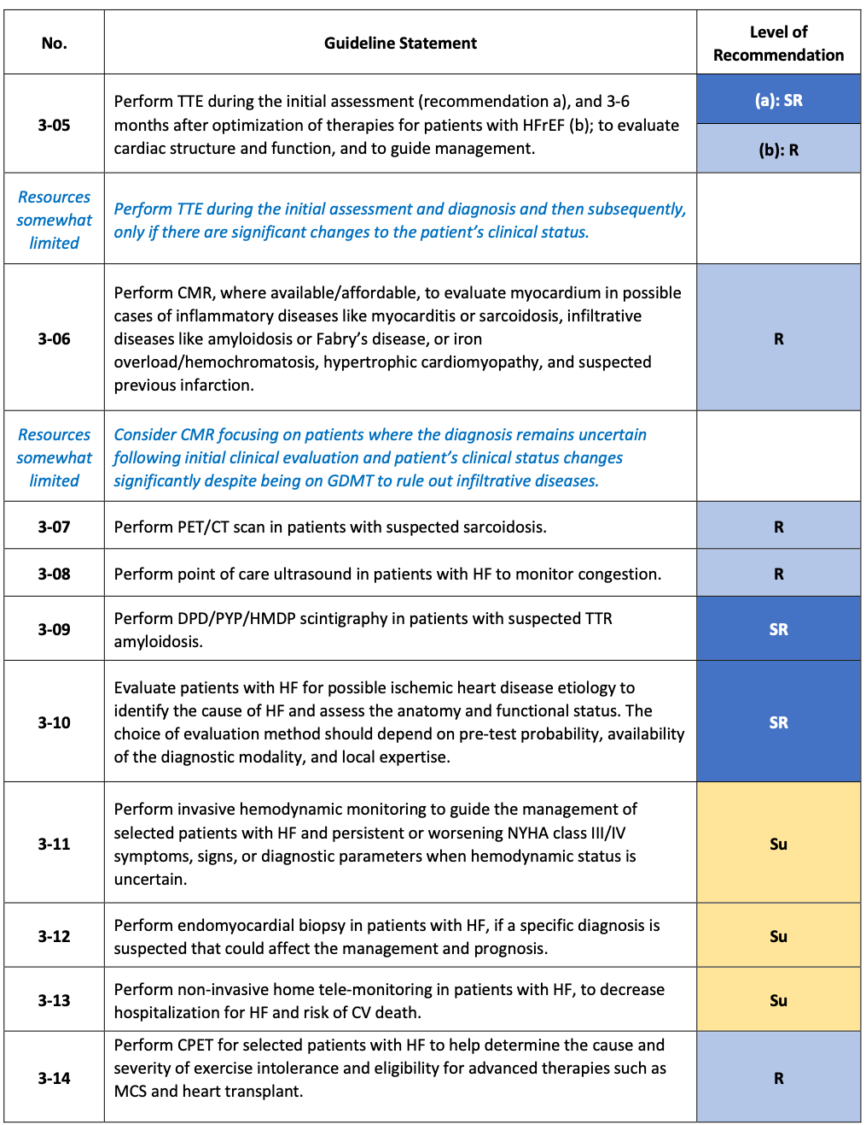
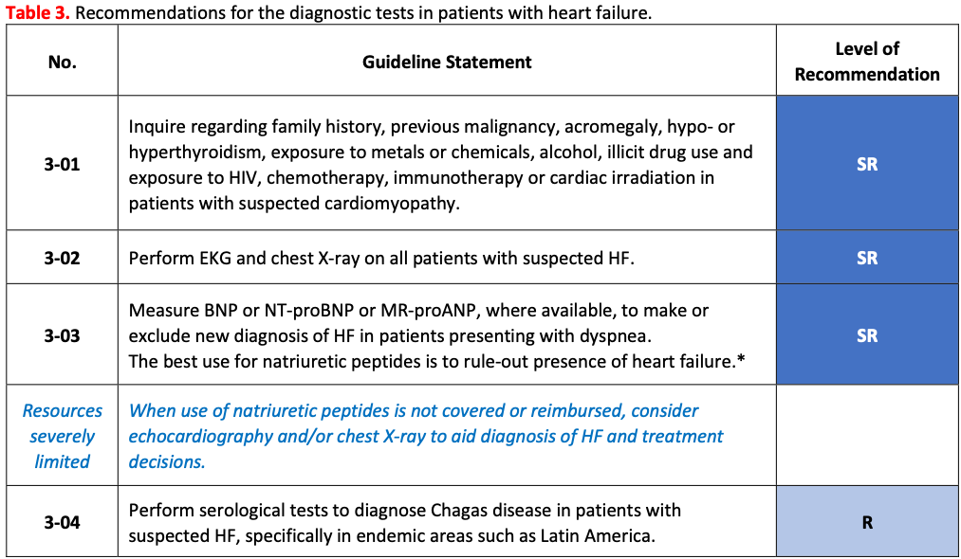
RECOMMENDATIONS
Recommendations for the diagnostic tests in patients with HF
Chopra V et al. Global Cardiology 2026;4:165-196
Home - iCARDIO Alliance
Notes:
Diagnostic tests in patients with HF.

Slide 15
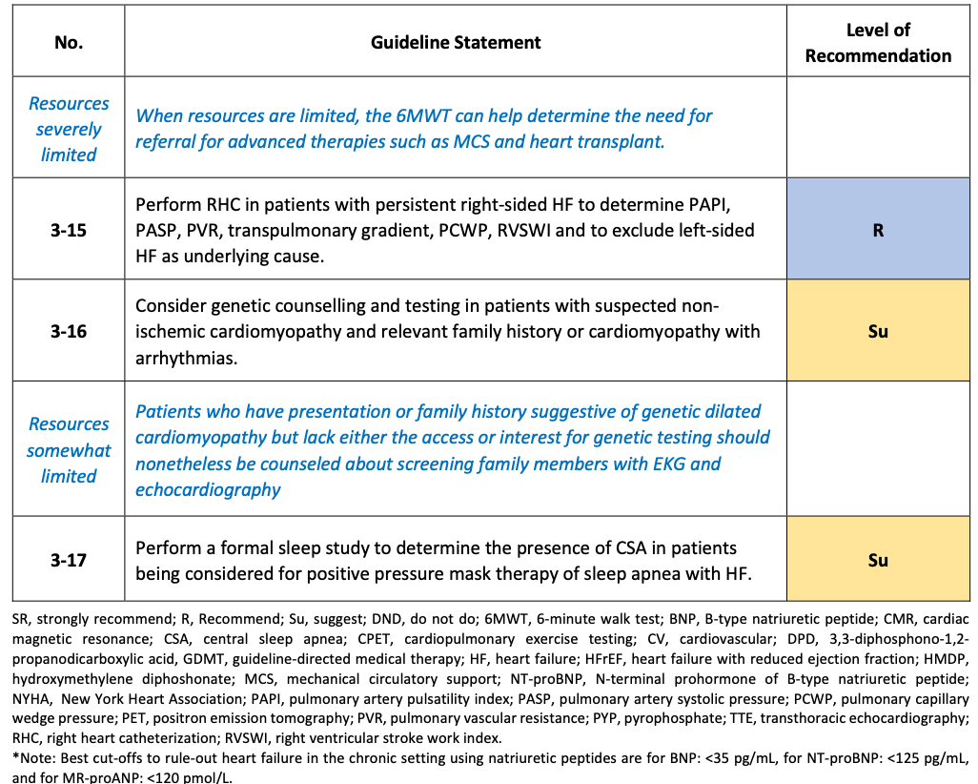
RECOMMENDATIONS
Recommendations for the diagnostic tests in patients with HF (cont’d)
Chopra V et al. Global Cardiology 2026;4:165-196
Home - iCARDIO Alliance
Notes:
Diagnostic tests, continued.

Slide 16
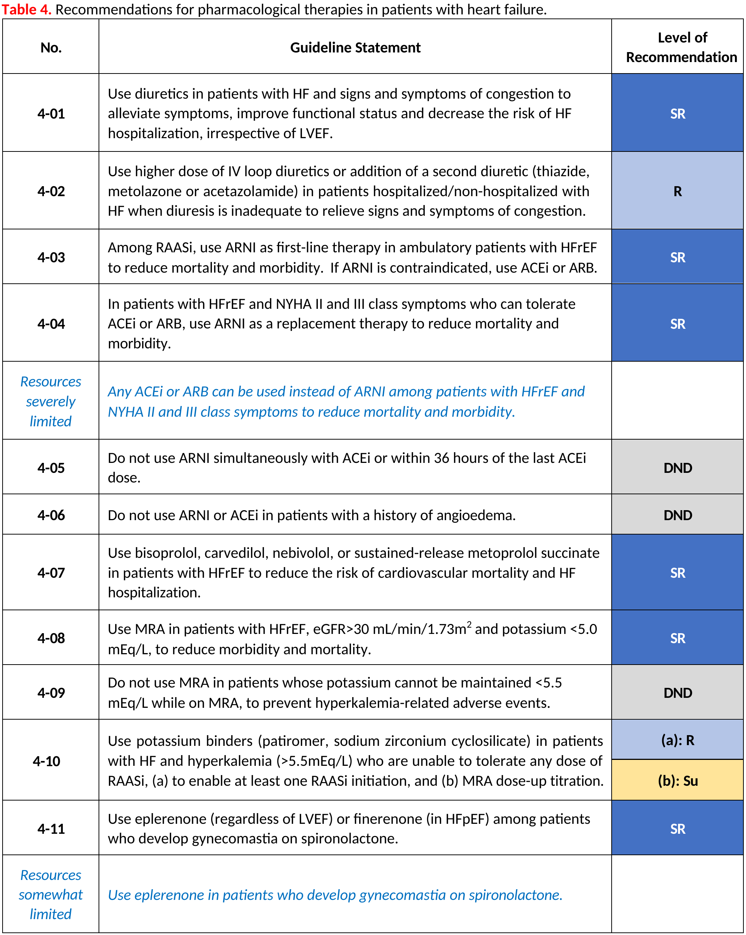
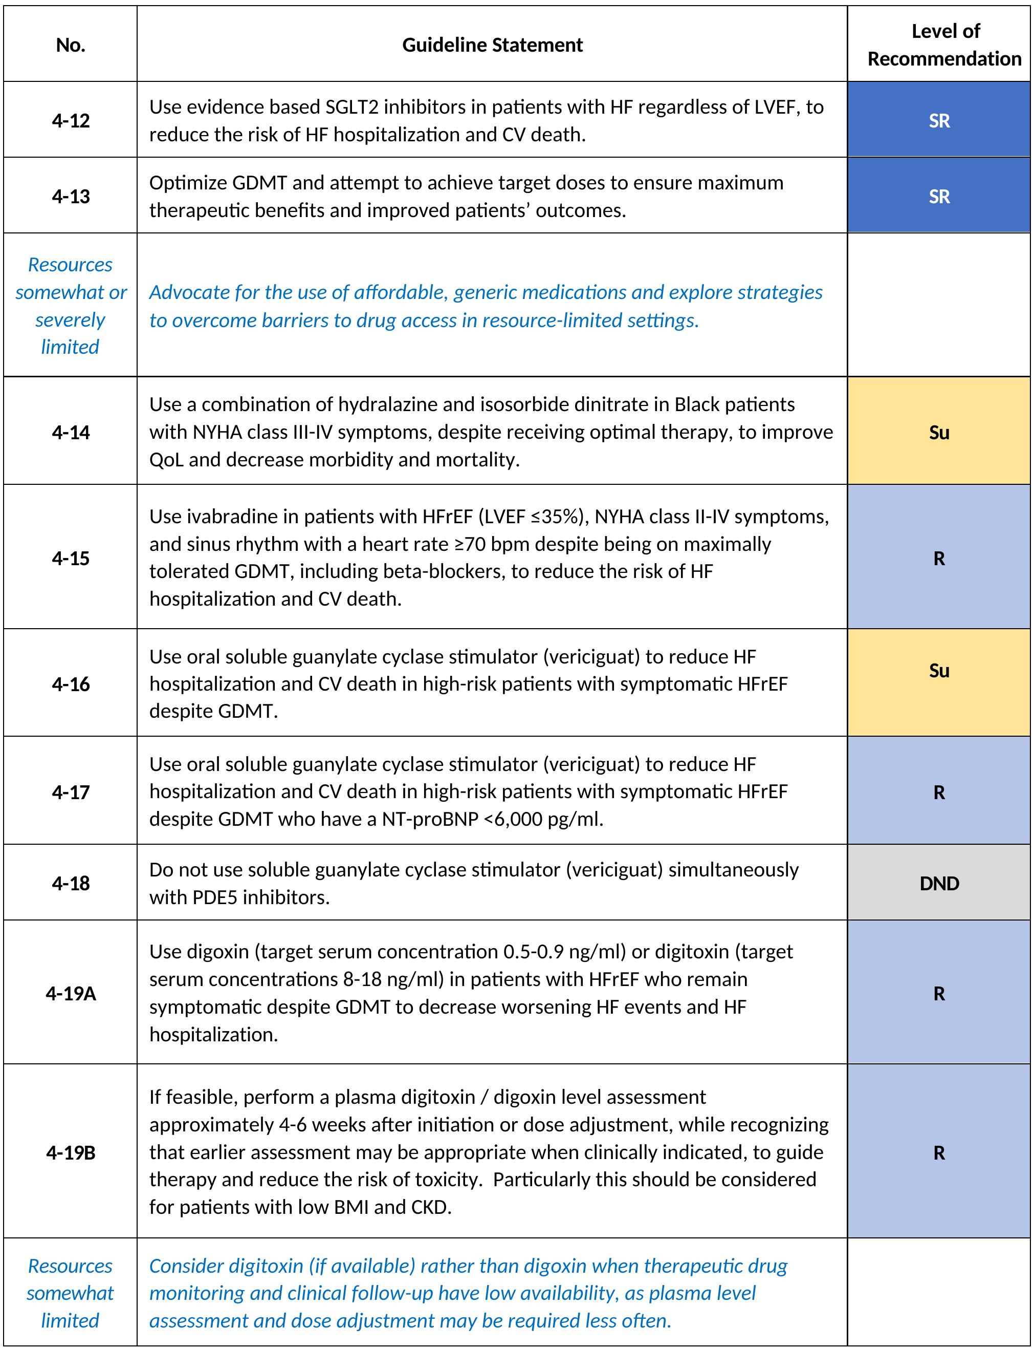
RECOMMENDATIONS
Recommendations for pharmacological therapies in patients with HF (1)
Chopra V et al. Global Cardiology 2026;4:165-196
Home - iCARDIO Alliance
Notes:
Pharmacological therapies, part 1.

Slide 17
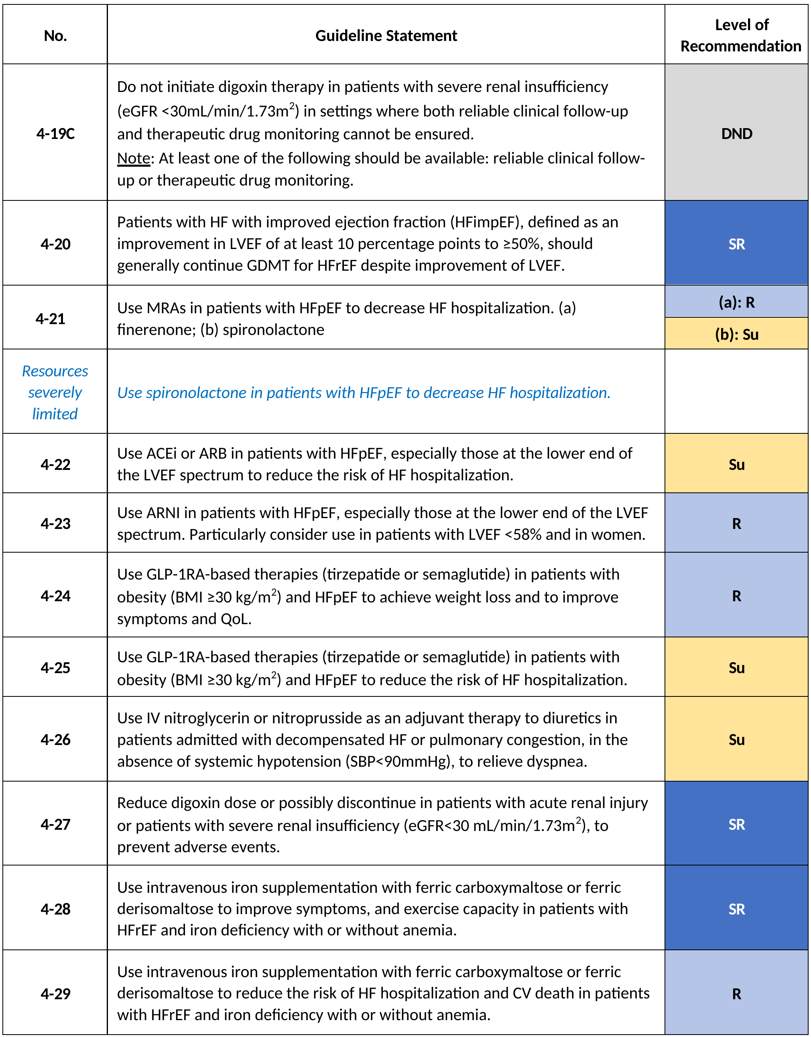
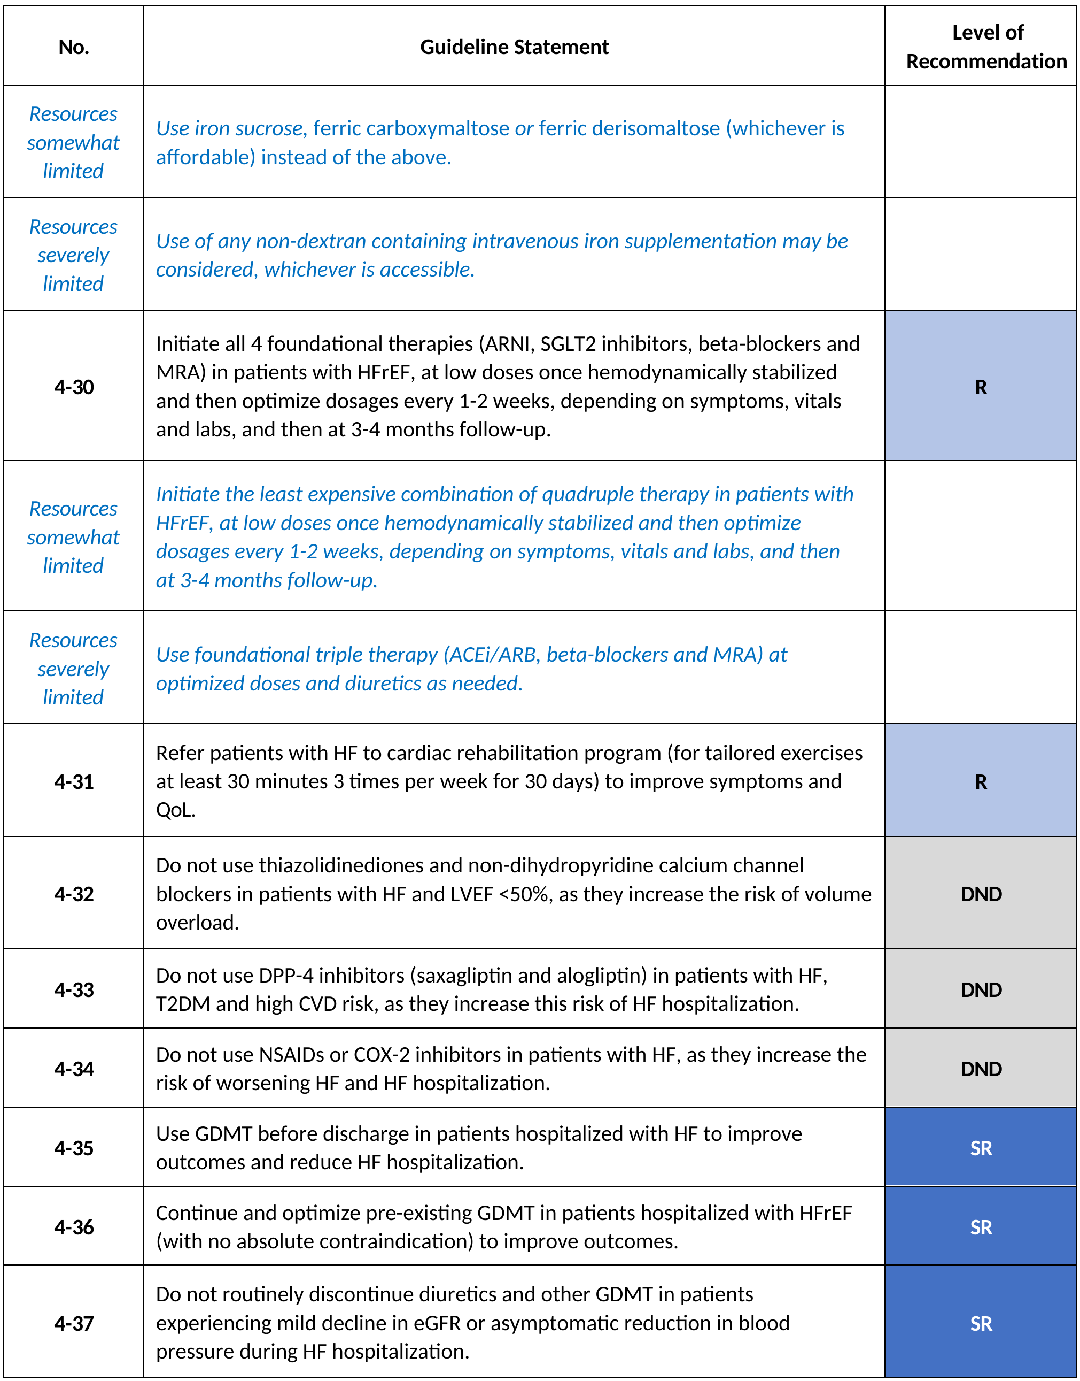
RECOMMENDATIONS
Recommendations for pharmacological therapies in patients with HF (2)
Chopra V et al. Global Cardiology 2026;4:165-196
Home - iCARDIO Alliance
Notes:
Pharmacological therapies, part 2.

Slide 18
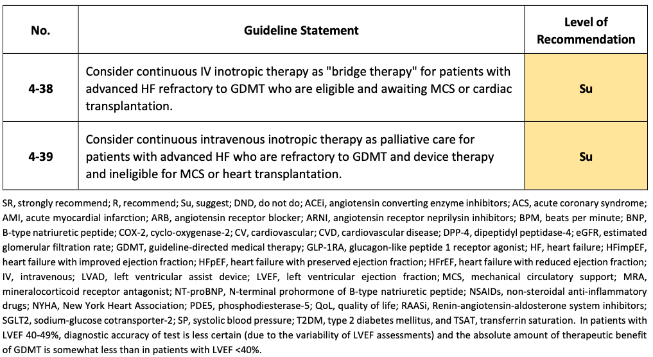
RECOMMENDATIONS
Recommendations for pharmacological therapies in patients with HF (2) (cont’d)
Chopra V et al. Global Cardiology 2026;4:165-196
Home - iCARDIO Alliance
Notes:
Pharmacological therapies, continued.

Slide 19
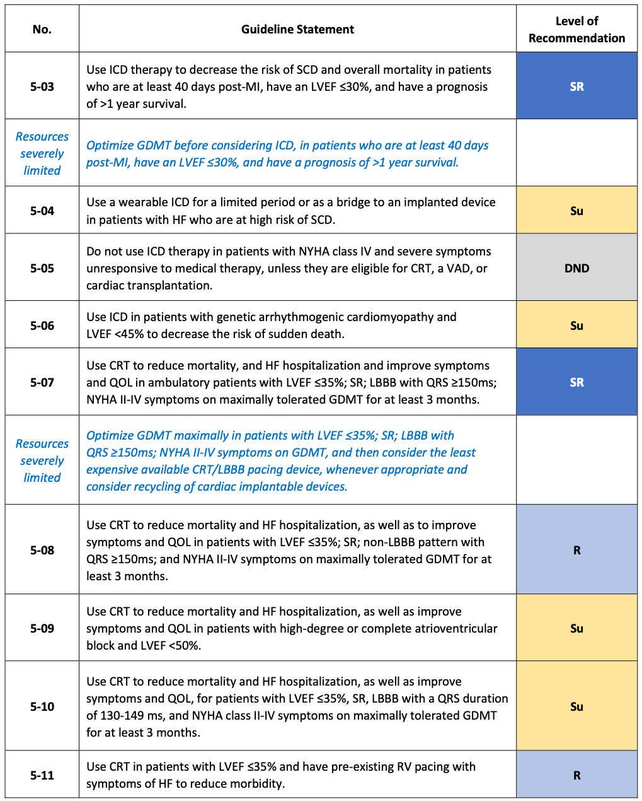
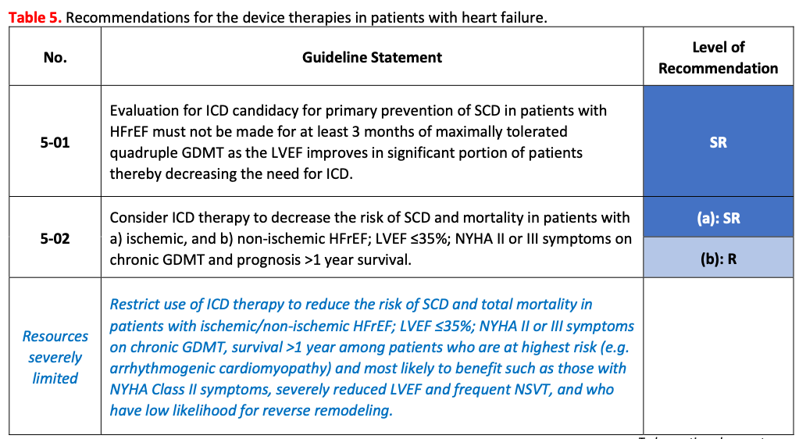
RECOMMENDATIONS
Recommendations for the device therapies in patients with HF
Chopra V et al. Global Cardiology 2026;4:165-196
Home - iCARDIO Alliance
Notes:
Device therapies in patients with HF.

Slide 20
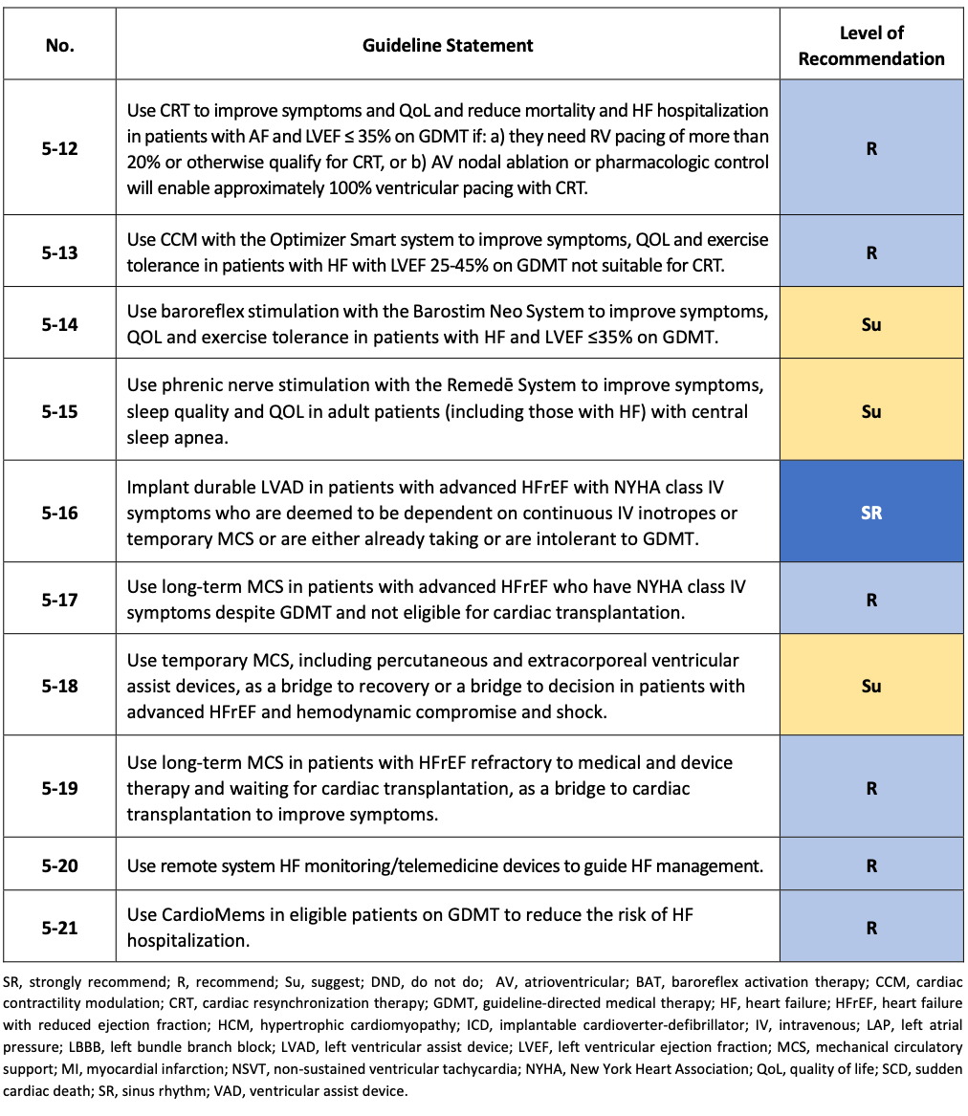
RECOMMENDATIONS
Recommendations for the device therapies in patients with HF (cont’d)
Chopra V et al. Global Cardiology 2026;4:165-196
Home - iCARDIO Alliance
Notes:
Device therapies, continued.

Slide 21
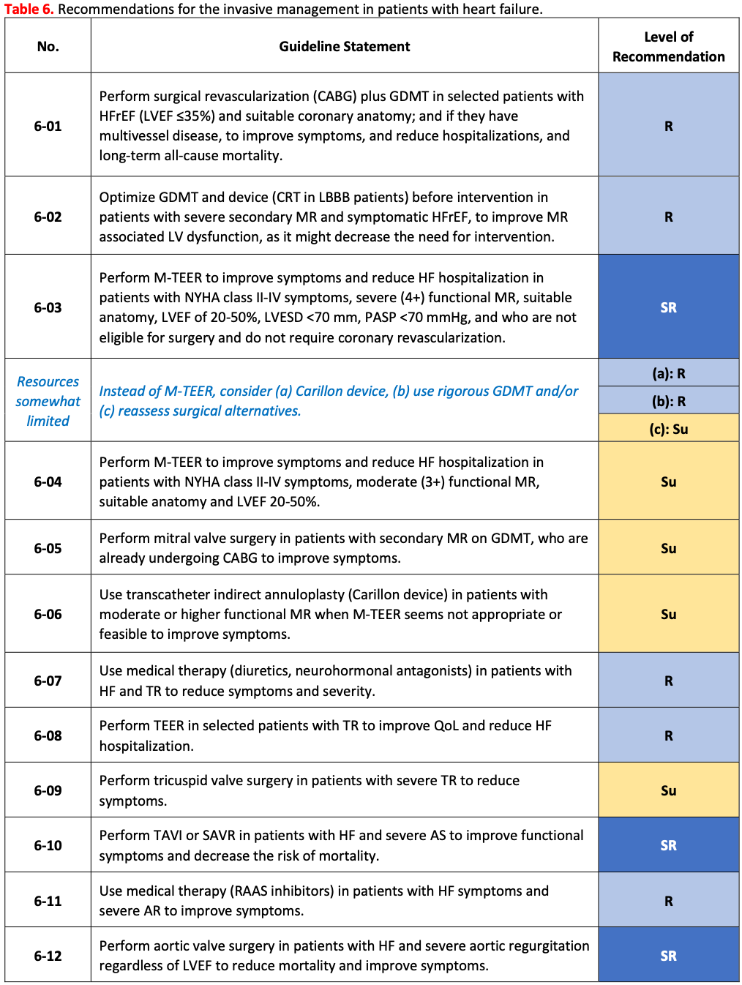
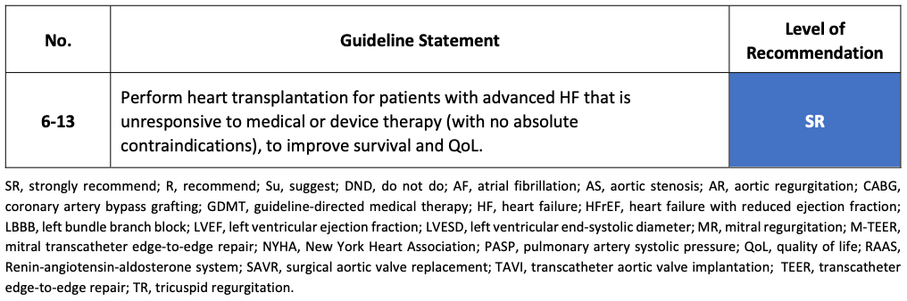
RECOMMENDATIONS
Recommendations for the invasive management in patients with HF
Chopra V et al. Global Cardiology 2026;4:165-196
Home - iCARDIO Alliance
Notes:
Invasive management in patients with HF.

Slide 22
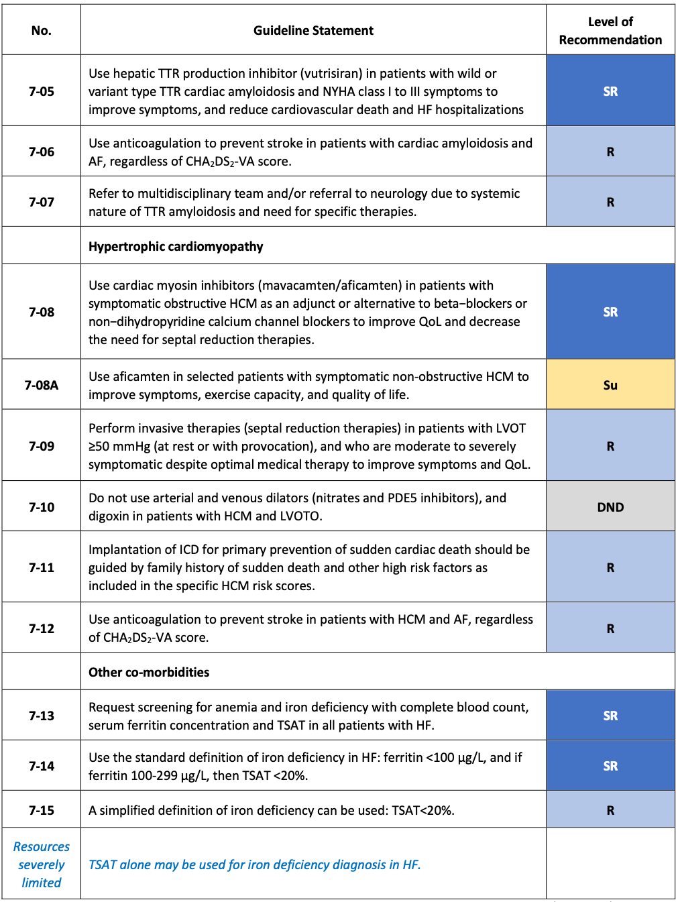
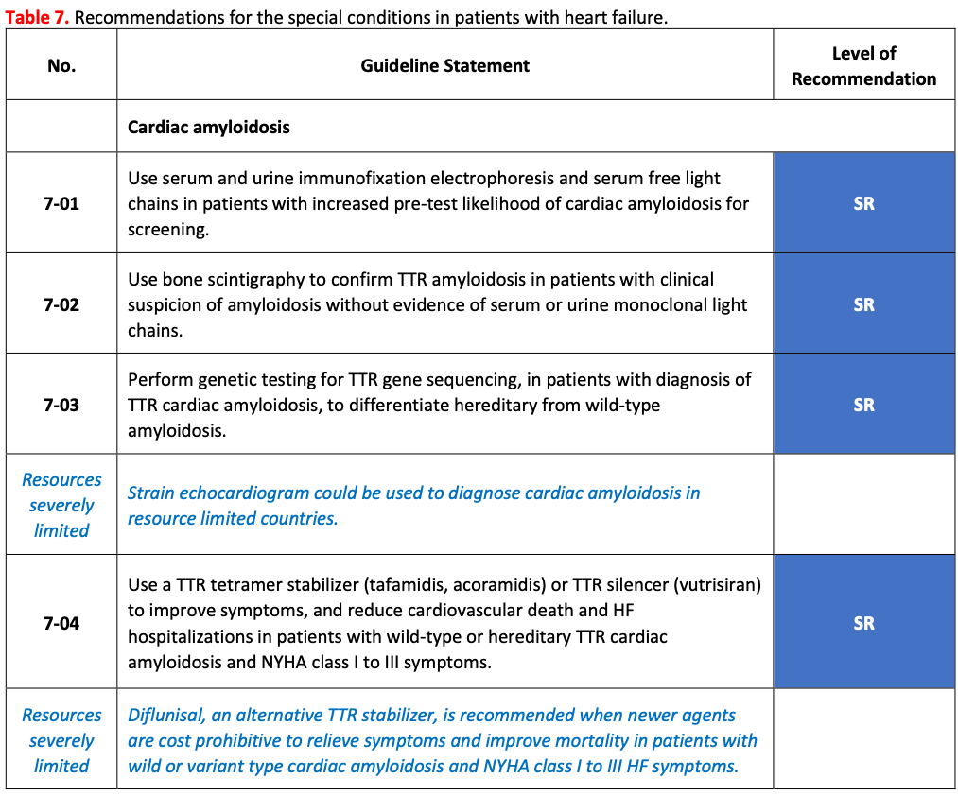
RECOMMENDATIONS
Recommendations for the special conditions in patients with HF (1)
Chopra V et al. Global Cardiology 2026;4:165-196
Home - iCARDIO Alliance
Notes:
Special conditions, part 1.

Slide 23
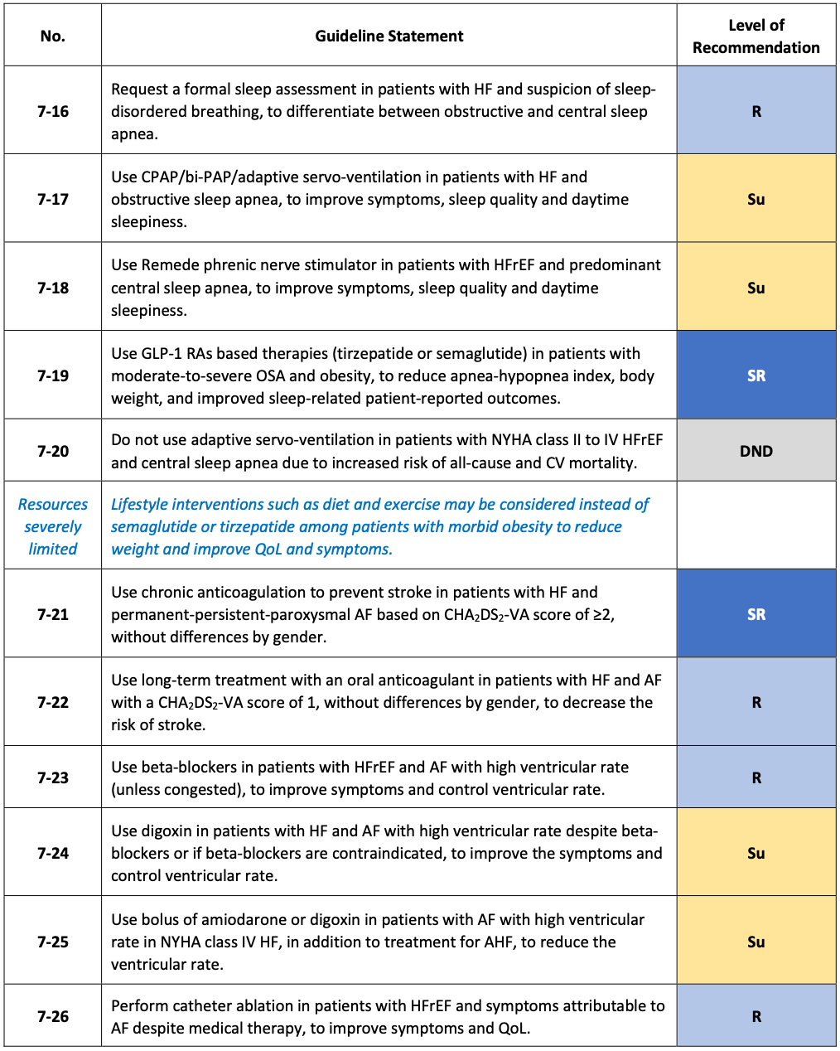
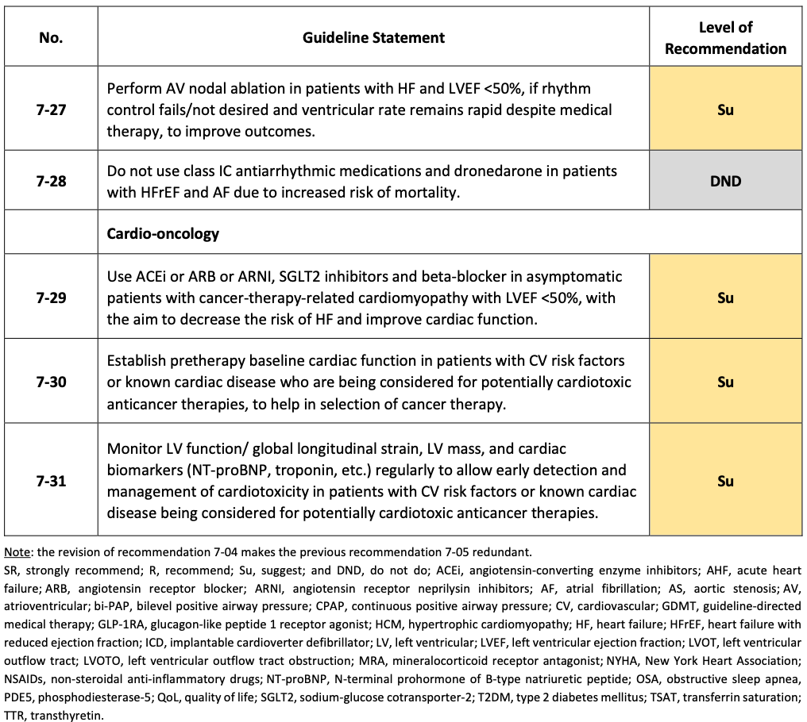
RECOMMENDATIONS
Recommendations for the special conditions in patients with HF (2)
Chopra V et al. Global Cardiology 2026;4:165-196
Home - iCARDIO Alliance
Notes:
Special conditions, part 2.

Slide 24
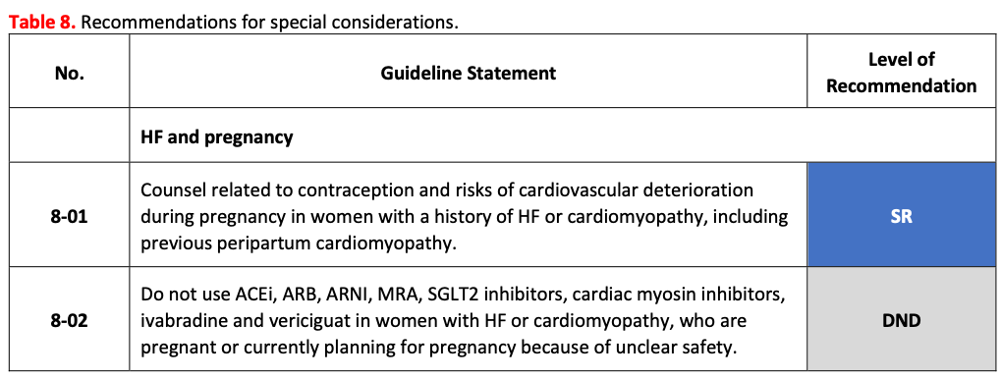
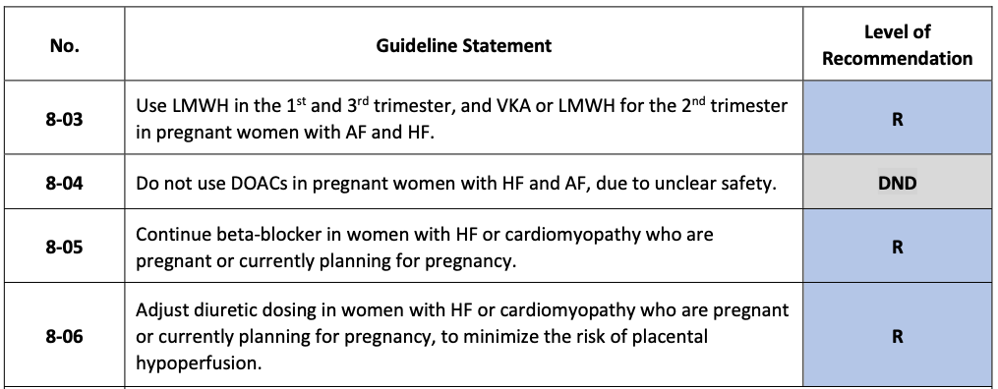
RECOMMENDATIONS
Recommendations for special conditions
Chopra V et al. Global Cardiology 2026;4:165-196
Home - iCARDIO Alliance
Notes:
Special conditions tables.

Slide 25
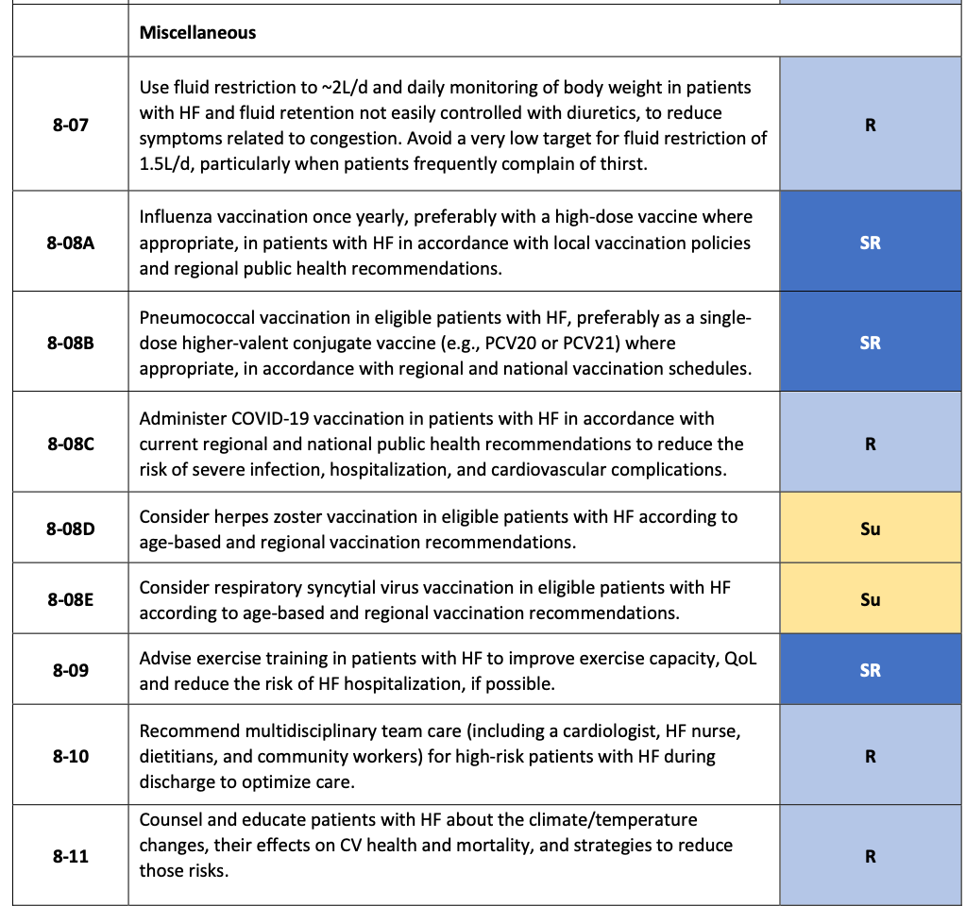
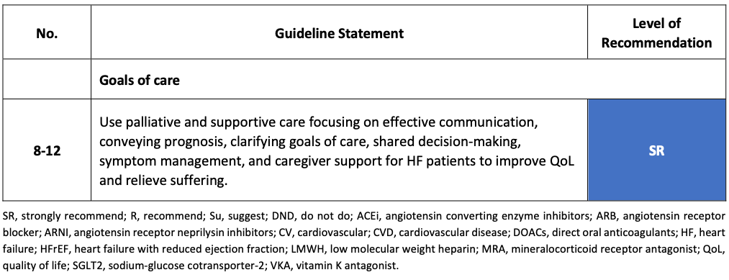
RECOMMENDATIONS
Recommendations for special conditions (cont’d)
Chopra V et al. Global Cardiology 2026;4:165-196
Home - iCARDIO Alliance
Notes:
Special conditions tables, continued.

Slide 26
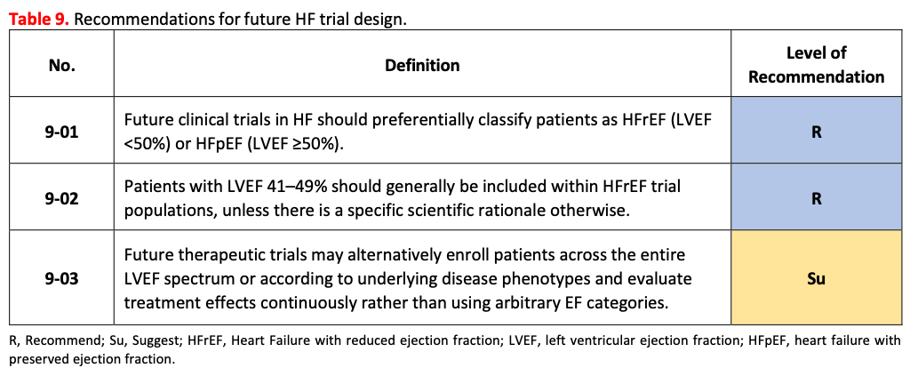
RECOMMENDATIONS
Recommendations for future HF trial design
Chopra V et al. Global Cardiology 2026;4:165-196
Home - iCARDIO Alliance
Notes:
Recommendations for future HF trial design.

Slide 27
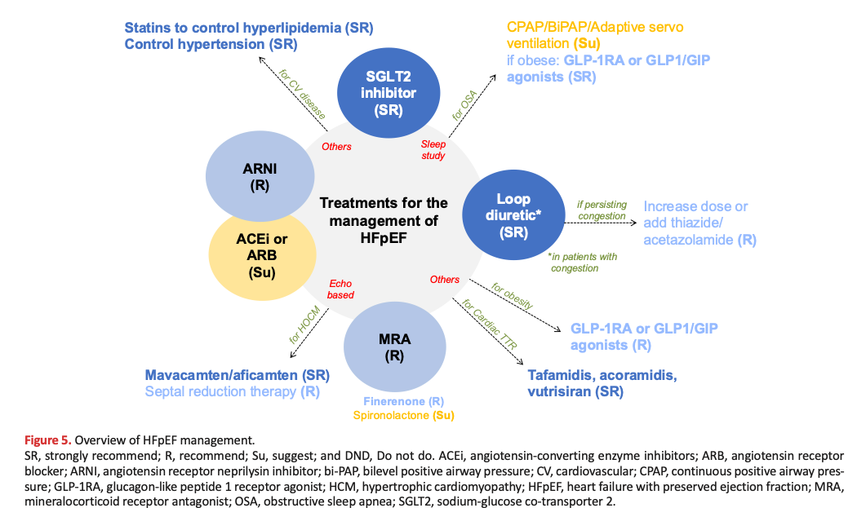
Overview of HFpEF
OVERVIEW
Chopra V et al. Global Cardiology 2026;4:165-196
Home - iCARDIO Alliance
Notes:
Overview of HFpEF.

Slide 28
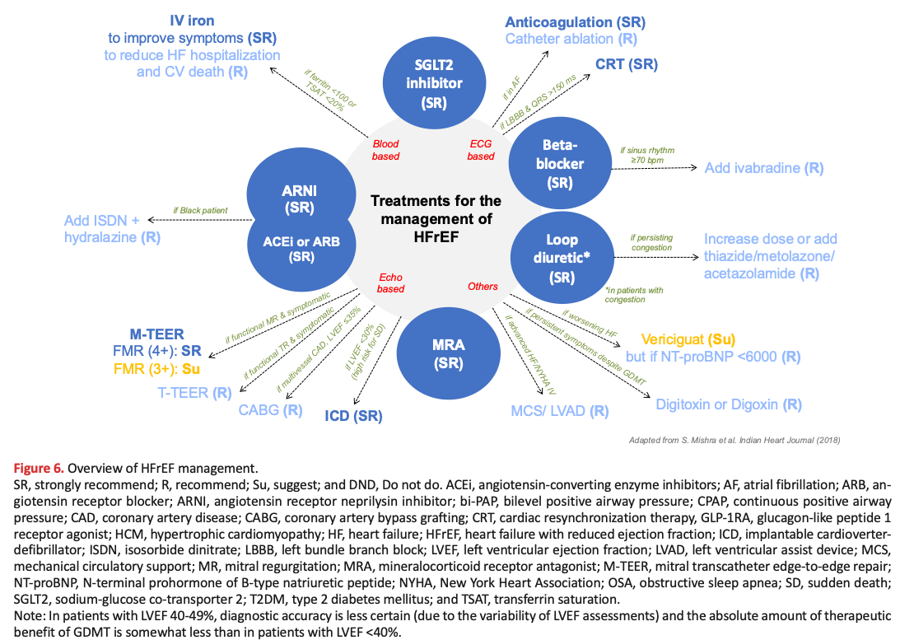
Overview of HFrEF management
OVERVIEW
Chopra V et al. Global Cardiology 2026;4:165-196
Home - iCARDIO Alliance
Notes:
Overview of HFrEF management.

Slide 29
2026 iCARDIO ALLIANCE GLOBAL GUIDELINES ON HEART FAILURE
What’s new in 2026
Chopra V et al. Global Cardiology 2026;4:165-196
Home - iCARDIO Alliance
Notes:
Title slide.

Slide 30
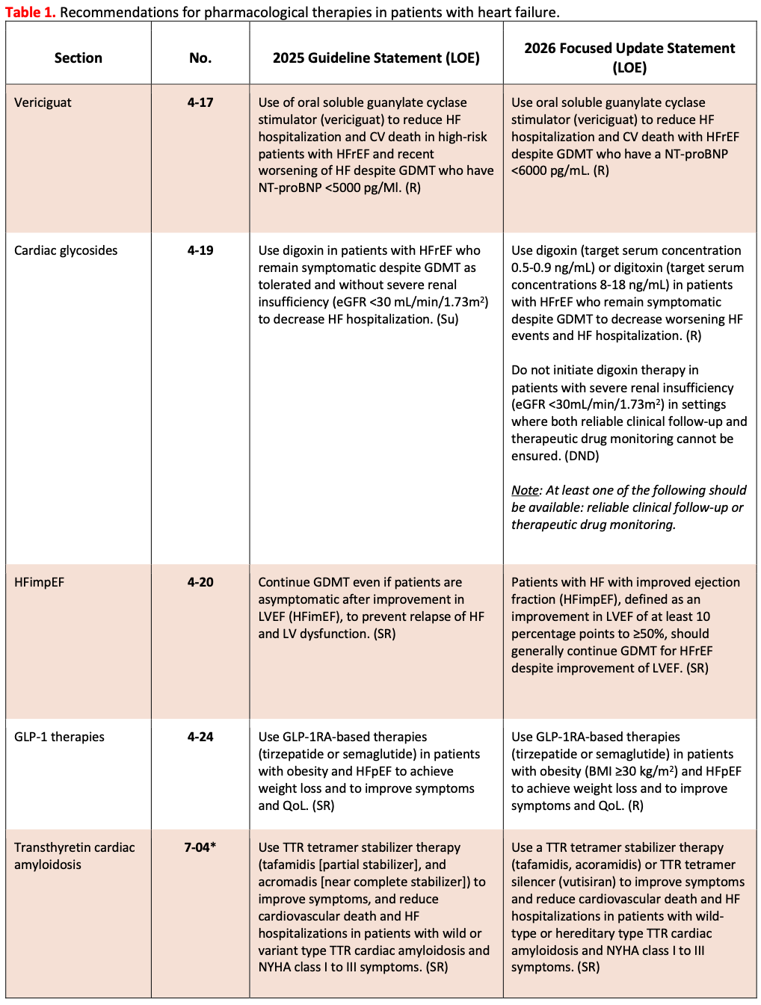
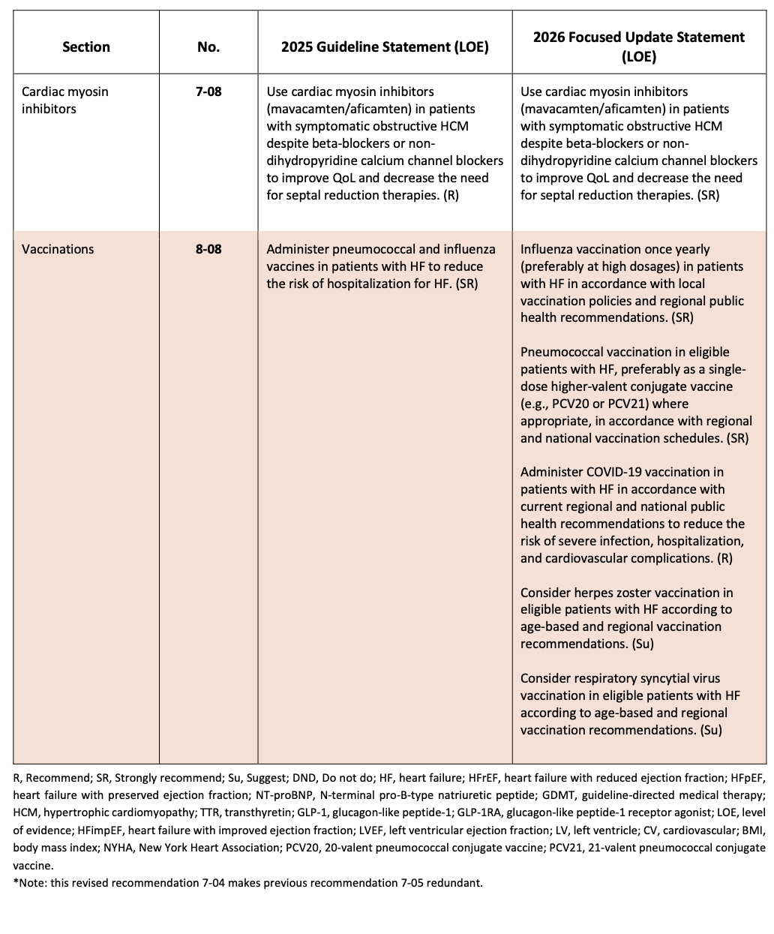
WHAT’S NEW IN 2026
iCARDIO HF management differences between 2026 and 2025 guidelines
Chopra V et al. Global Cardiology 2026;4:197-214
Home - iCARDIO Alliance
Notes:
Differences between the 2026 and 2025 guidelines.

Slide 31
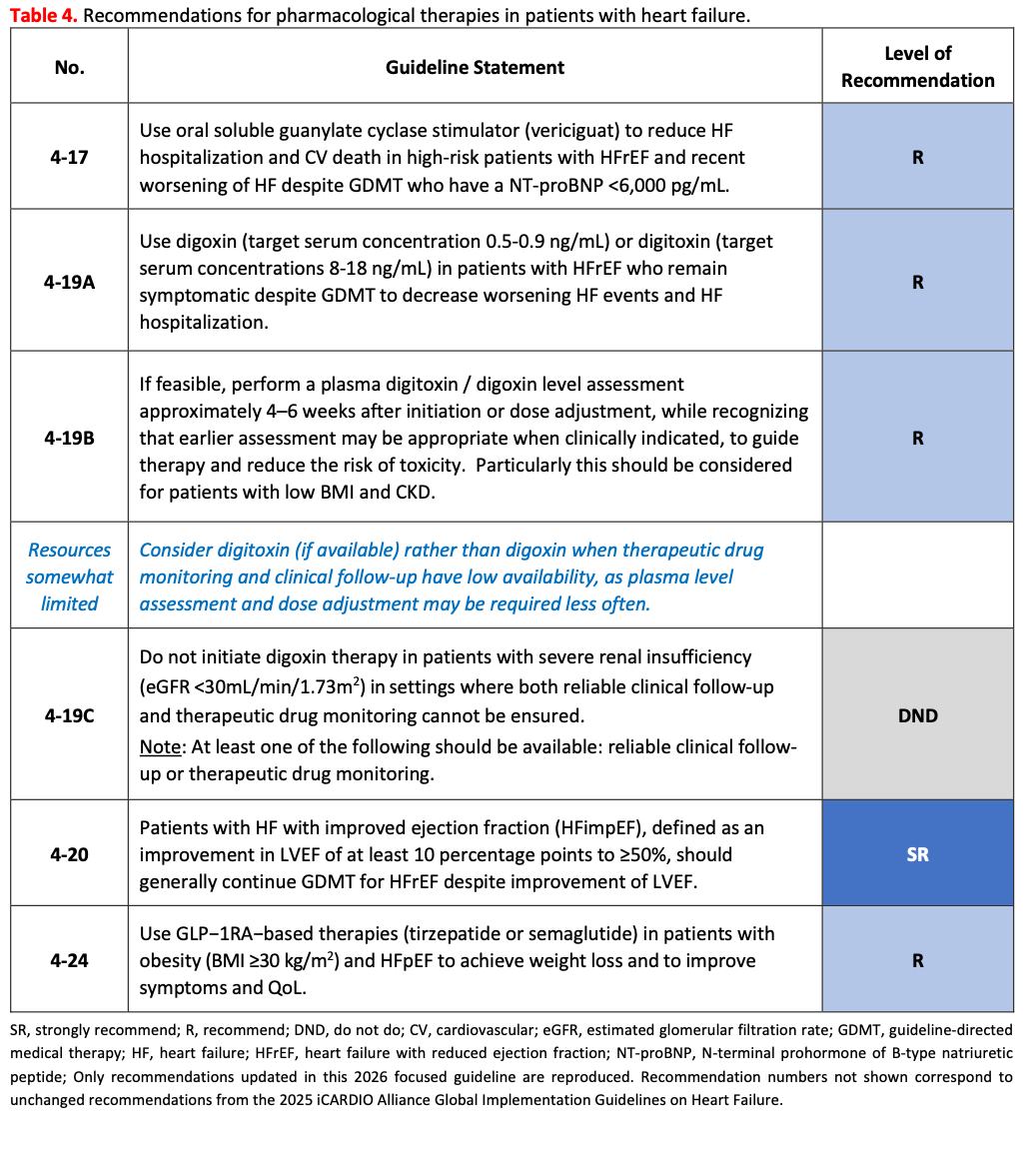
WHAT’S NEW IN 2026
iCARDIO HF management what’s new in 2026 for pharmacological therapies
Chopra V et al. Global Cardiology 2026;4:197-214
Home - iCARDIO Alliance
Notes:
What's new for pharmacological therapies.

Slide 32
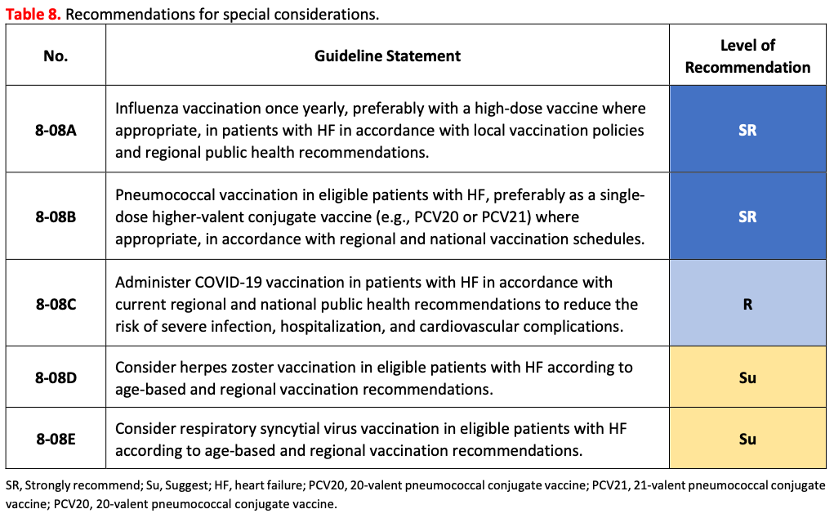
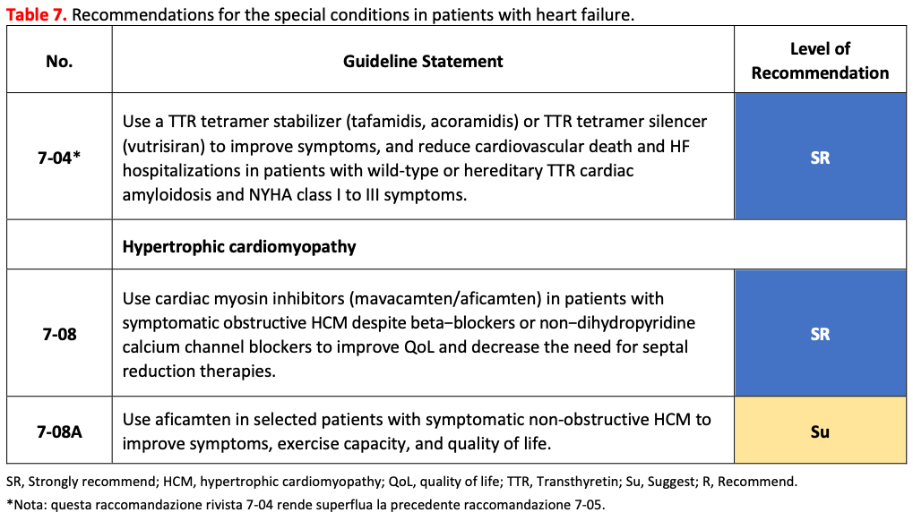
WHAT’S NEW IN 2026
iCARDIO HF management what’s new in 2026 for special conditions and considerations
Chopra V et al. Global Cardiology 2026;4:197-214
Home - iCARDIO Alliance
Notes:
What's new for special conditions and considerations.

Slide 33




iCARDIO ALLIANCE
Contacts
Veronica Dean
Christine Gans
Guidelines Development Manager
Administrative Officer
Phone : +33 685 543 219
Phone : +33 660 035 726
vdean@tmacademy.org
christine.gans@tmacademy.org
www.icardioalliance.org
www.icardioalliance.org
Translational Medicine Academy TMA Foundation - Headquarter: Picassoplatz 8, 4052 Basel, Switzerland
Notes:
Contacts.

