Slide 1


The iCARDIO Alliance
Global Implementation Guidelines
for the Management of Obesity 2025
Focus on Prevention and Treatment of Cardiometabolic Disease
Anker SD et al. Global Cardiology 2025;3:181-206
Home - iCARDIO Alliance

Slide 2
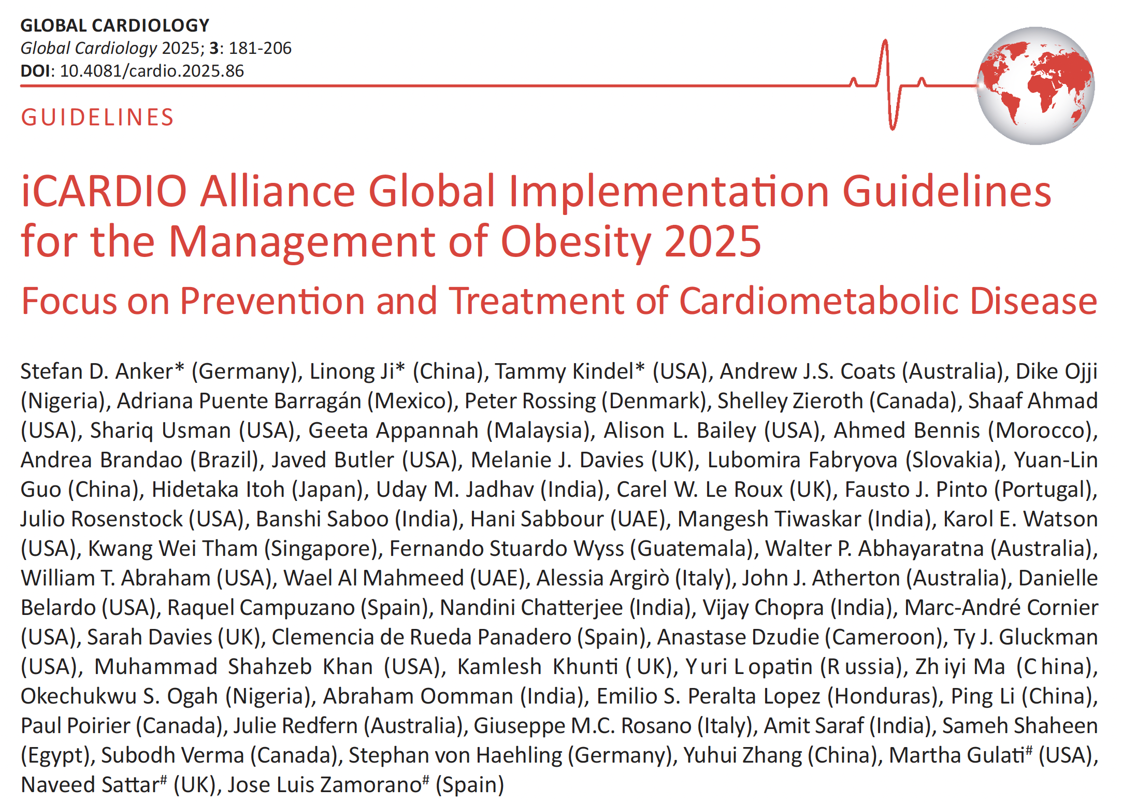
Home - iCARDIO Alliance

Slide 3
Aim of the global implementation guidelines
Build a truly global alliance by bringing together leading cardiovascular societies worldwide to improve the full continuum of care — from prevention and diagnosis to treatment.
Design guidelines for real-world use, producing concise, practical, and actionable recommendations applicable across diverse healthcare systems and clinical settings.
Ensure equity through resource-stratified guidance, with recommendations adapted to three levels of resource availability: with no economic consideration, resources somewhat limited, resources severely limited.
Guarantee global representation & credibility with writing panels composed of world-renowned experts (≥50% from outside Europe & North America), and an international peer-review. We also perform an open public review. All partner societies contribute to the process.
Open access & global reach: Guidelines are published open access in up to 4 to 5 international journals (lead: Global Cardiology), maximizing worldwide dissemination.
Home - iCARDIO Alliance

Slide 4
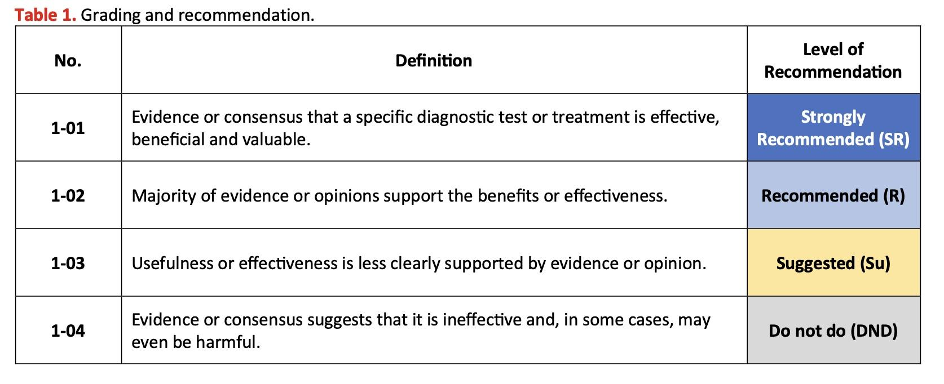
Grading of recommendations
Home - iCARDIO Alliance

Slide 5
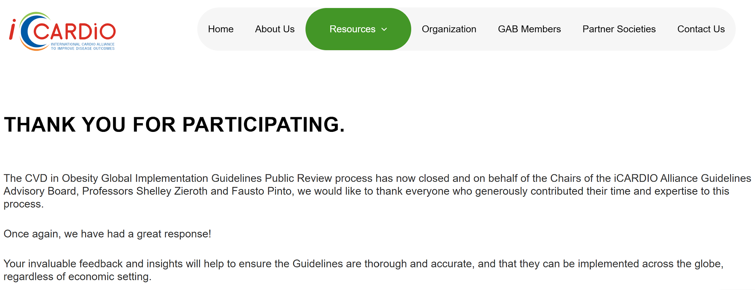
iCARDIO Alliance Global Guidelines
Public Consultation following the Peer Review
Open Public Review lasted one month May–June 2025
with comments from 63 spontaneous reviewers
Home - iCARDIO Alliance

Slide 6
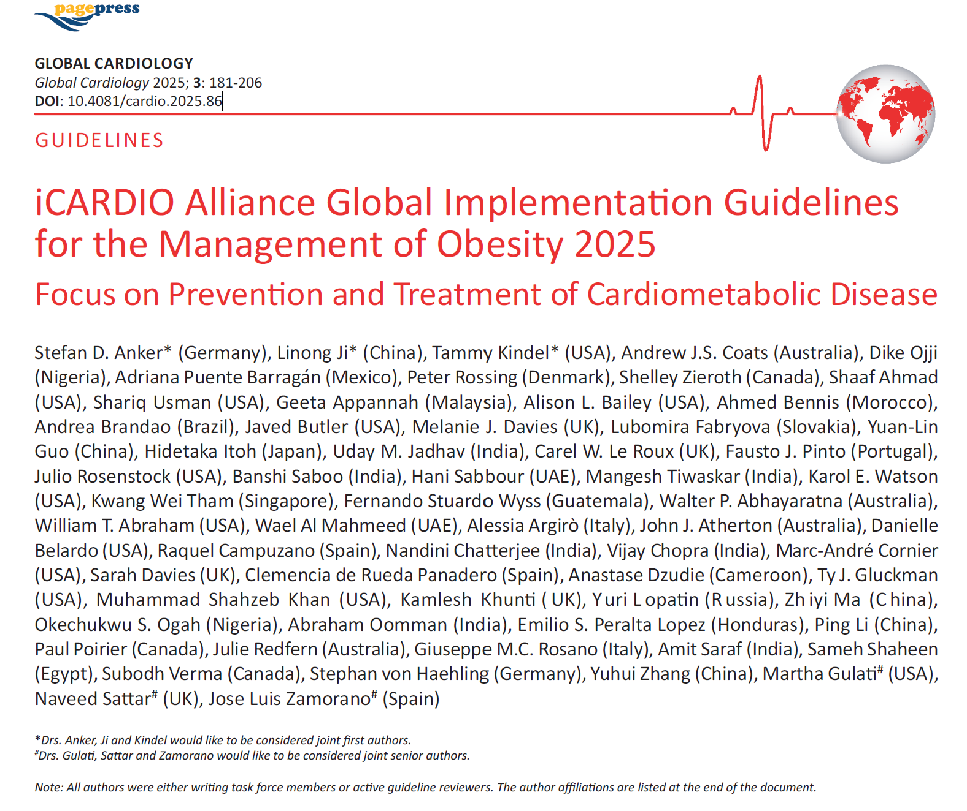

iCARDIO Alliance Global Guidelines
Final Obesity Document
Key Characteristics:
26 Pages
152 references
Authors are writing Task Force Members & Peer Reviewers
Authors from 22 countries from all continents
Published on 30th Sept, 2025
Anker SD et al. Global Cardiology 2025;3:181-206
Home - iCARDIO Alliance

Slide 7
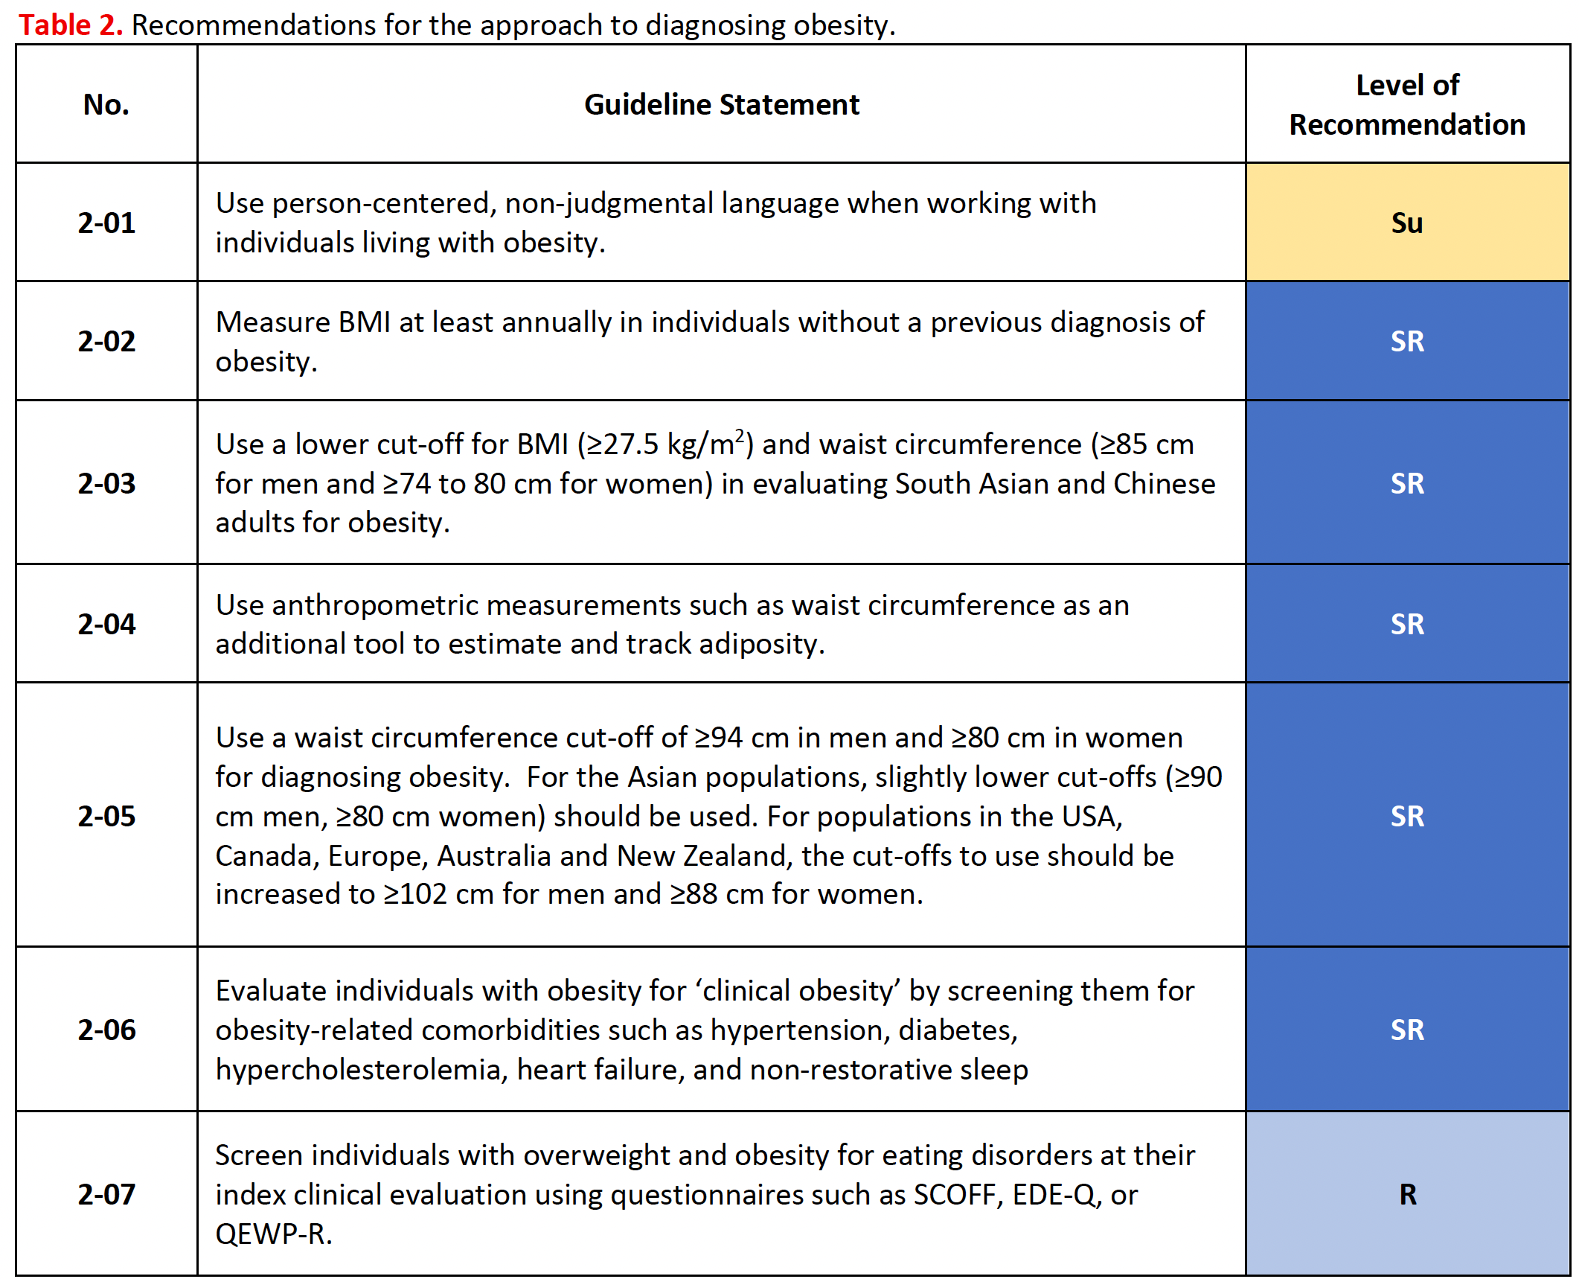
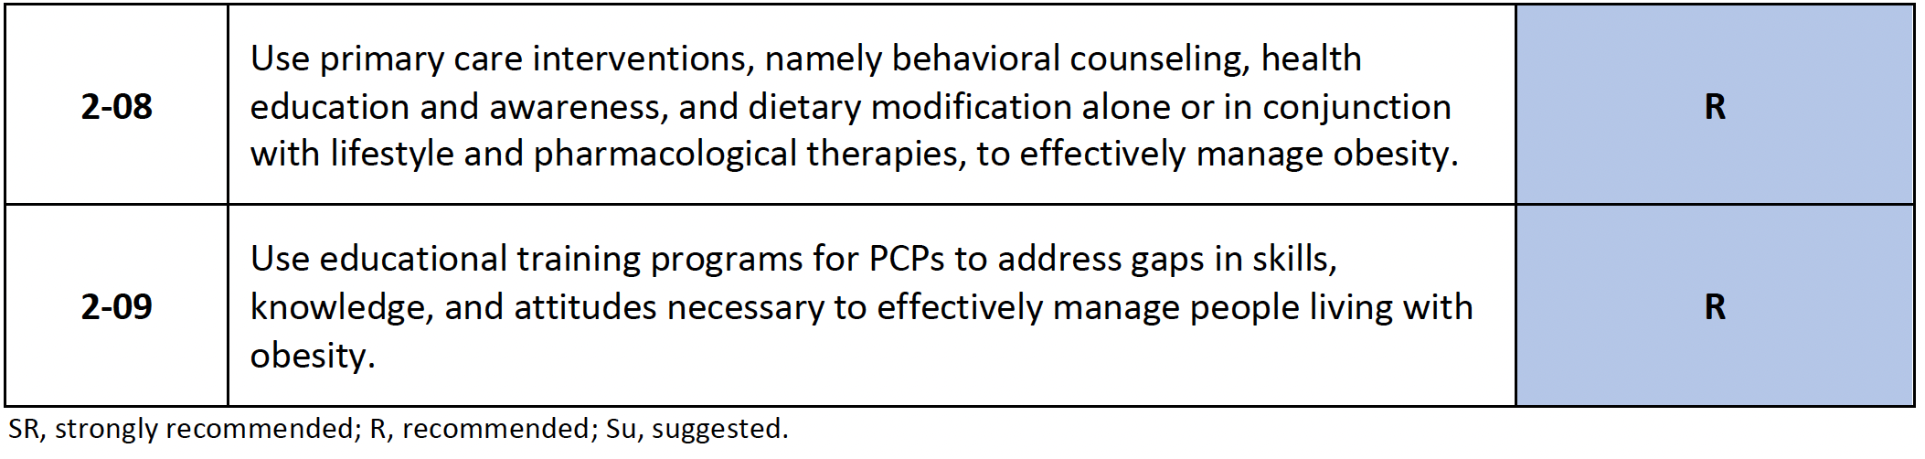
Recommendations for the approach to diagnosing obesity
Anker SD et al. Global Cardiology 2025;3:181-206
Home - iCARDIO Alliance

Slide 8
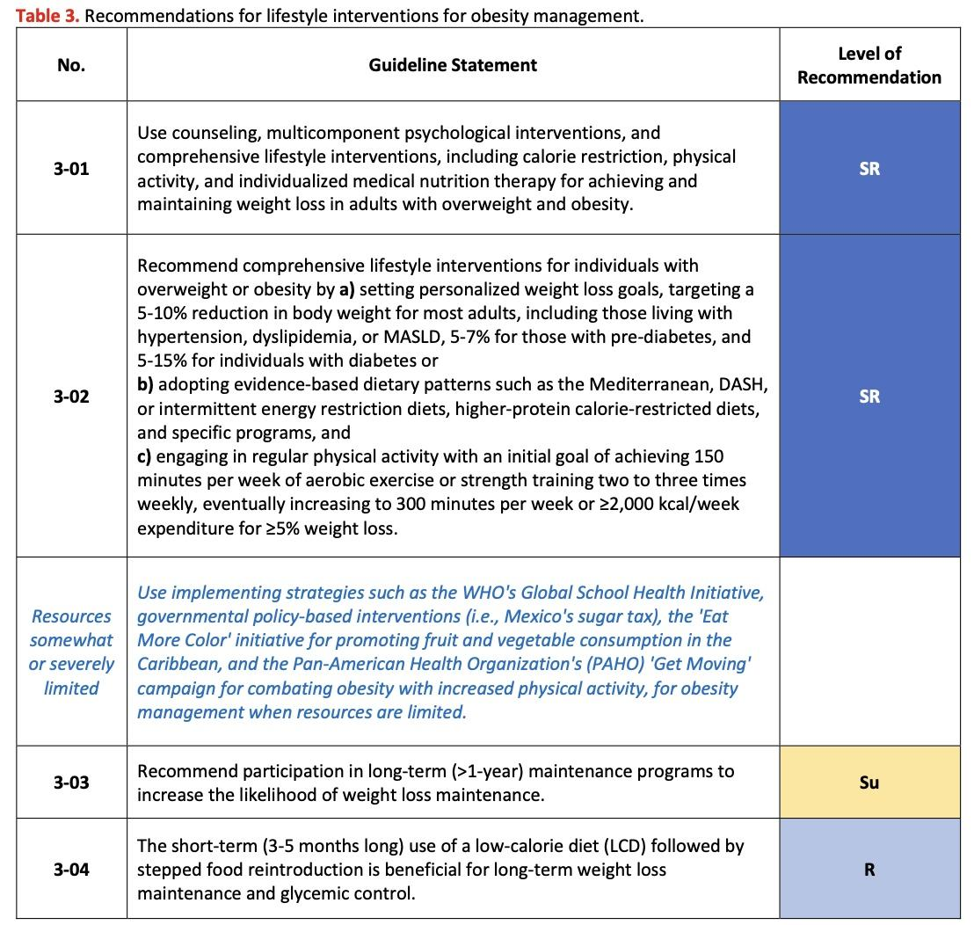
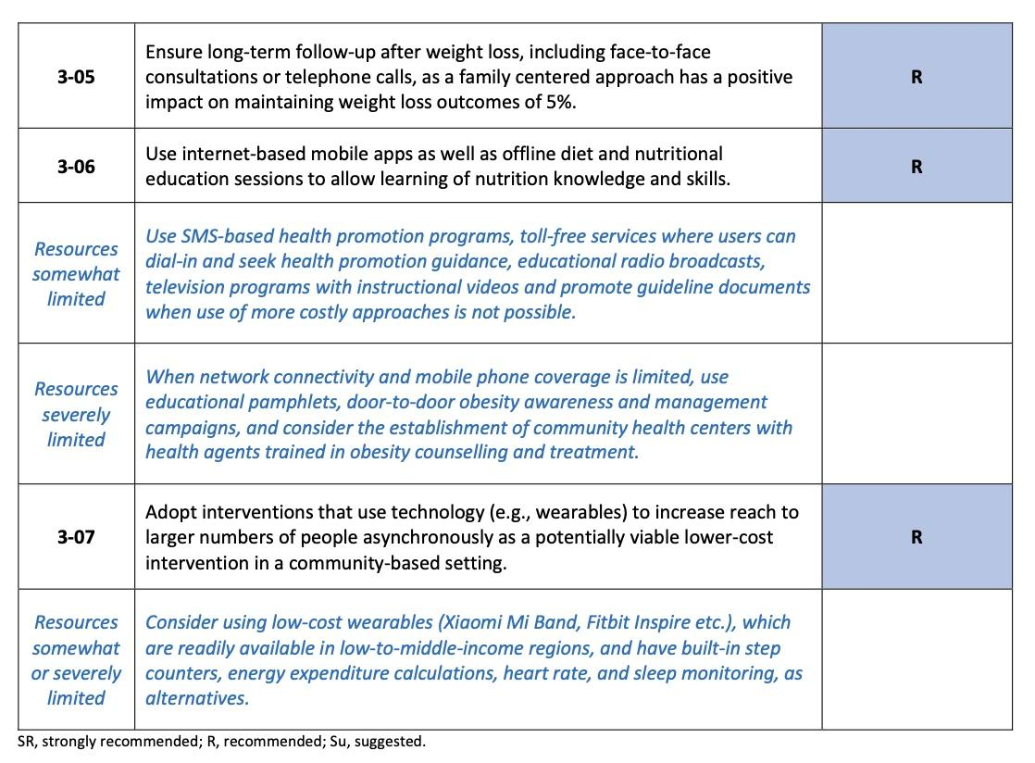
Recommendations for lifestyle interventions for obesity management
Anker SD et al. Global Cardiology 2025;3:181-206
Home - iCARDIO Alliance

Slide 9
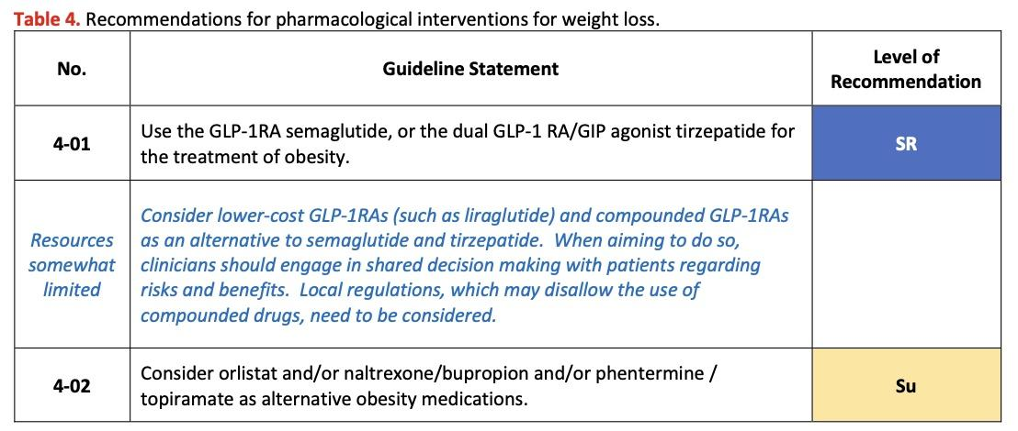
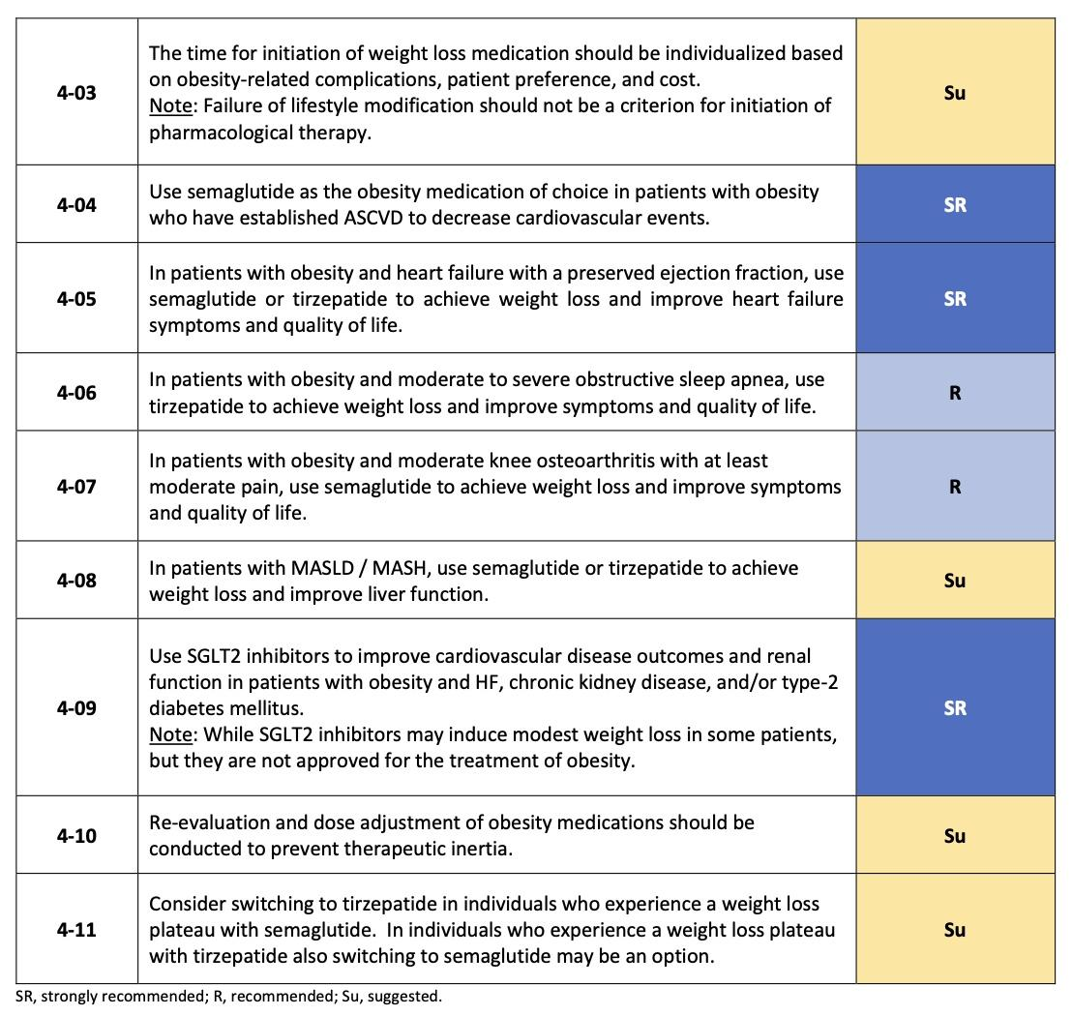
Recommendations for pharmacological interventions for weight loss
Anker SD et al. Global Cardiology 2025;3:181-206
Home - iCARDIO Alliance

Slide 10
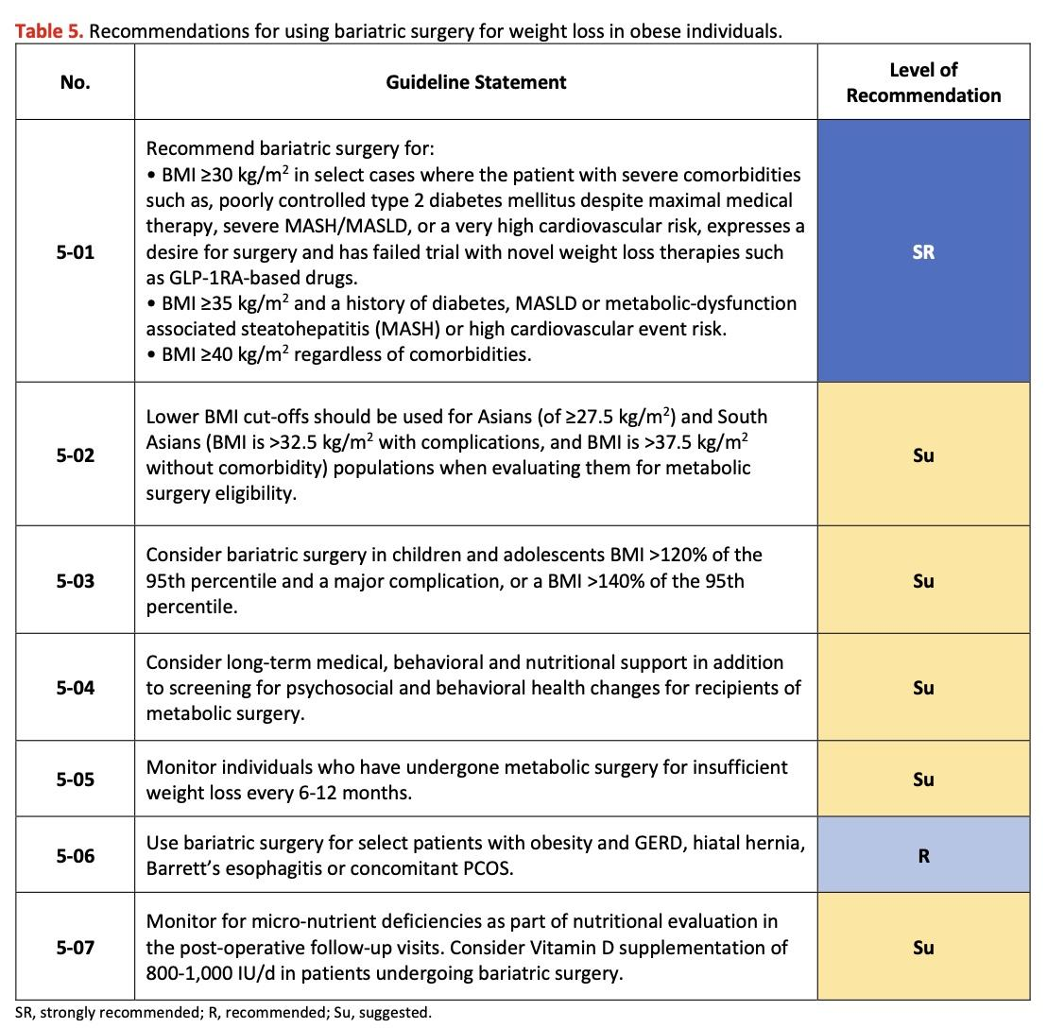
Recommendations for using bariatric surgery for weight loss in obese individuals
Anker SD et al. Global Cardiology 2025;3:181-206
Home - iCARDIO Alliance

Slide 11
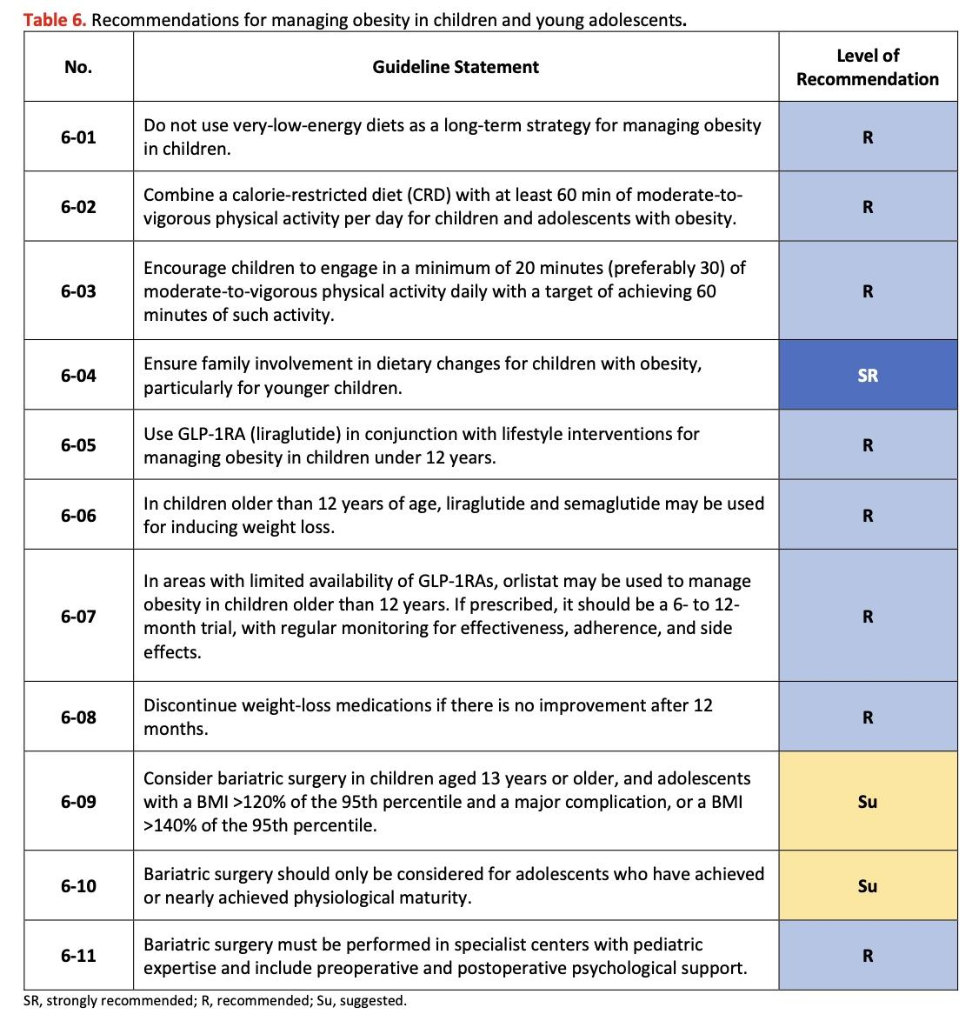
Recommendations for managing obesity in children and young adolescents
Anker SD et al. Global Cardiology 2025;3:181-206
Home - iCARDIO Alliance

Slide 12
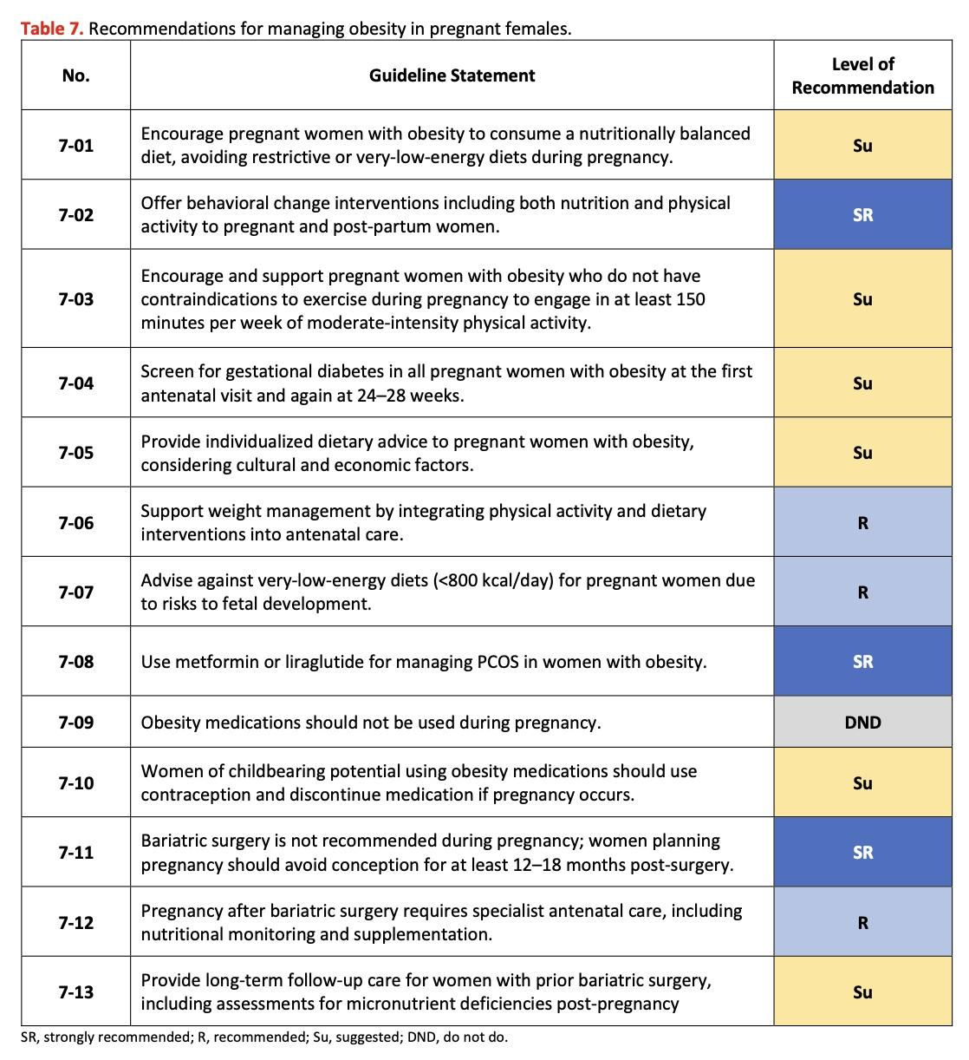
Recommendations for managing obesity in pregnant females
Anker SD et al. Global Cardiology 2025;3:181-206
Home - iCARDIO Alliance

Slide 13
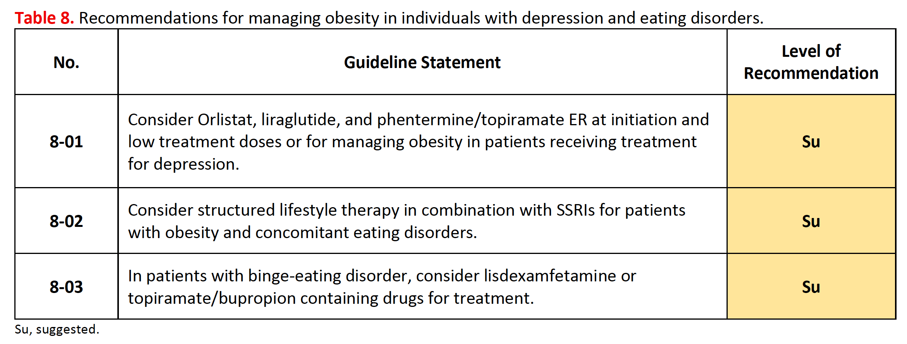
Recommendations for managing obesity in individuals with depression and eating disorders
Anker SD et al. Global Cardiology 2025;3:181-206
Home - iCARDIO Alliance

Slide 14
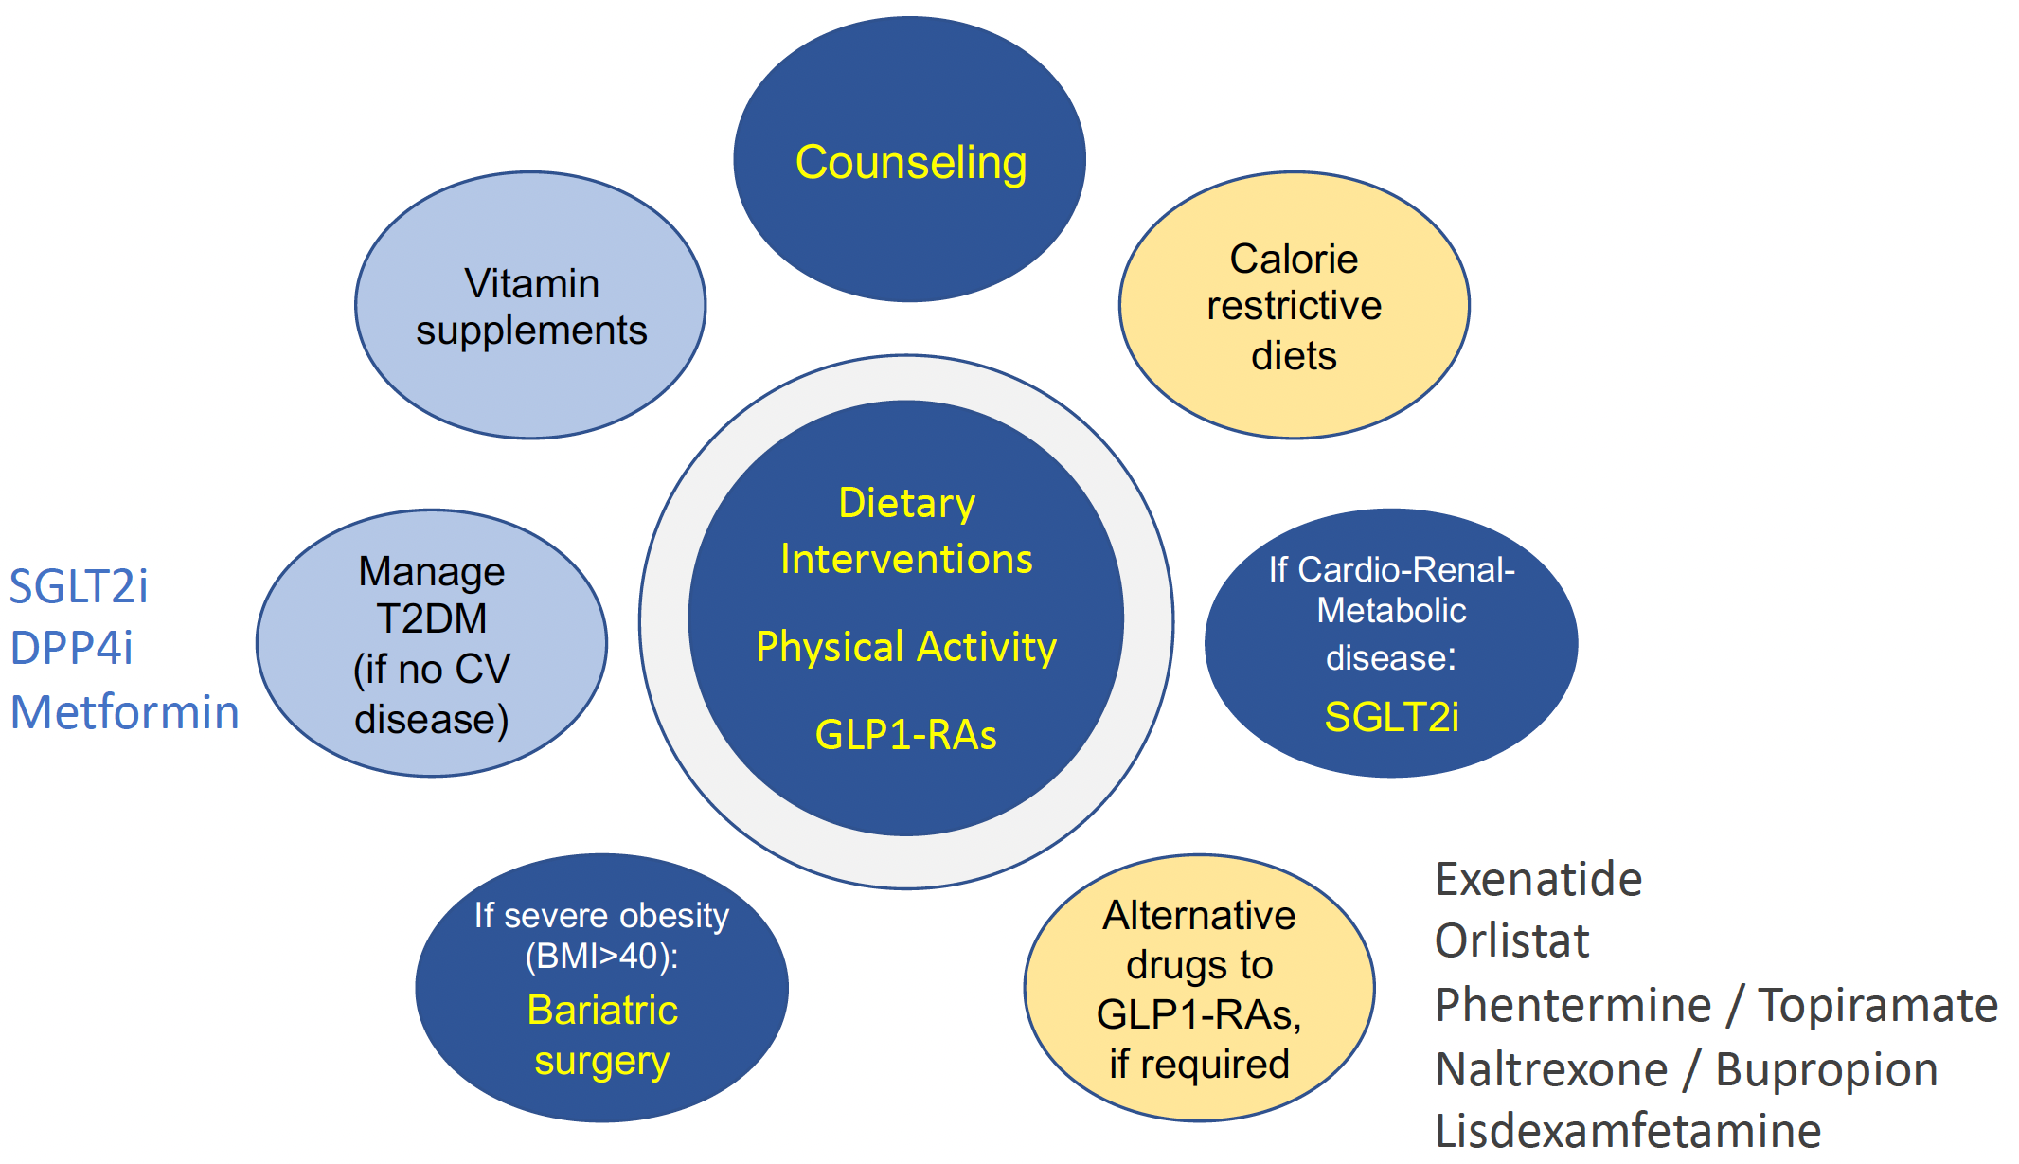
Treatment principles for obesity
Anker SD et al. Global Cardiology 2025;3:181-206
Home - iCARDIO Alliance

Slide 15
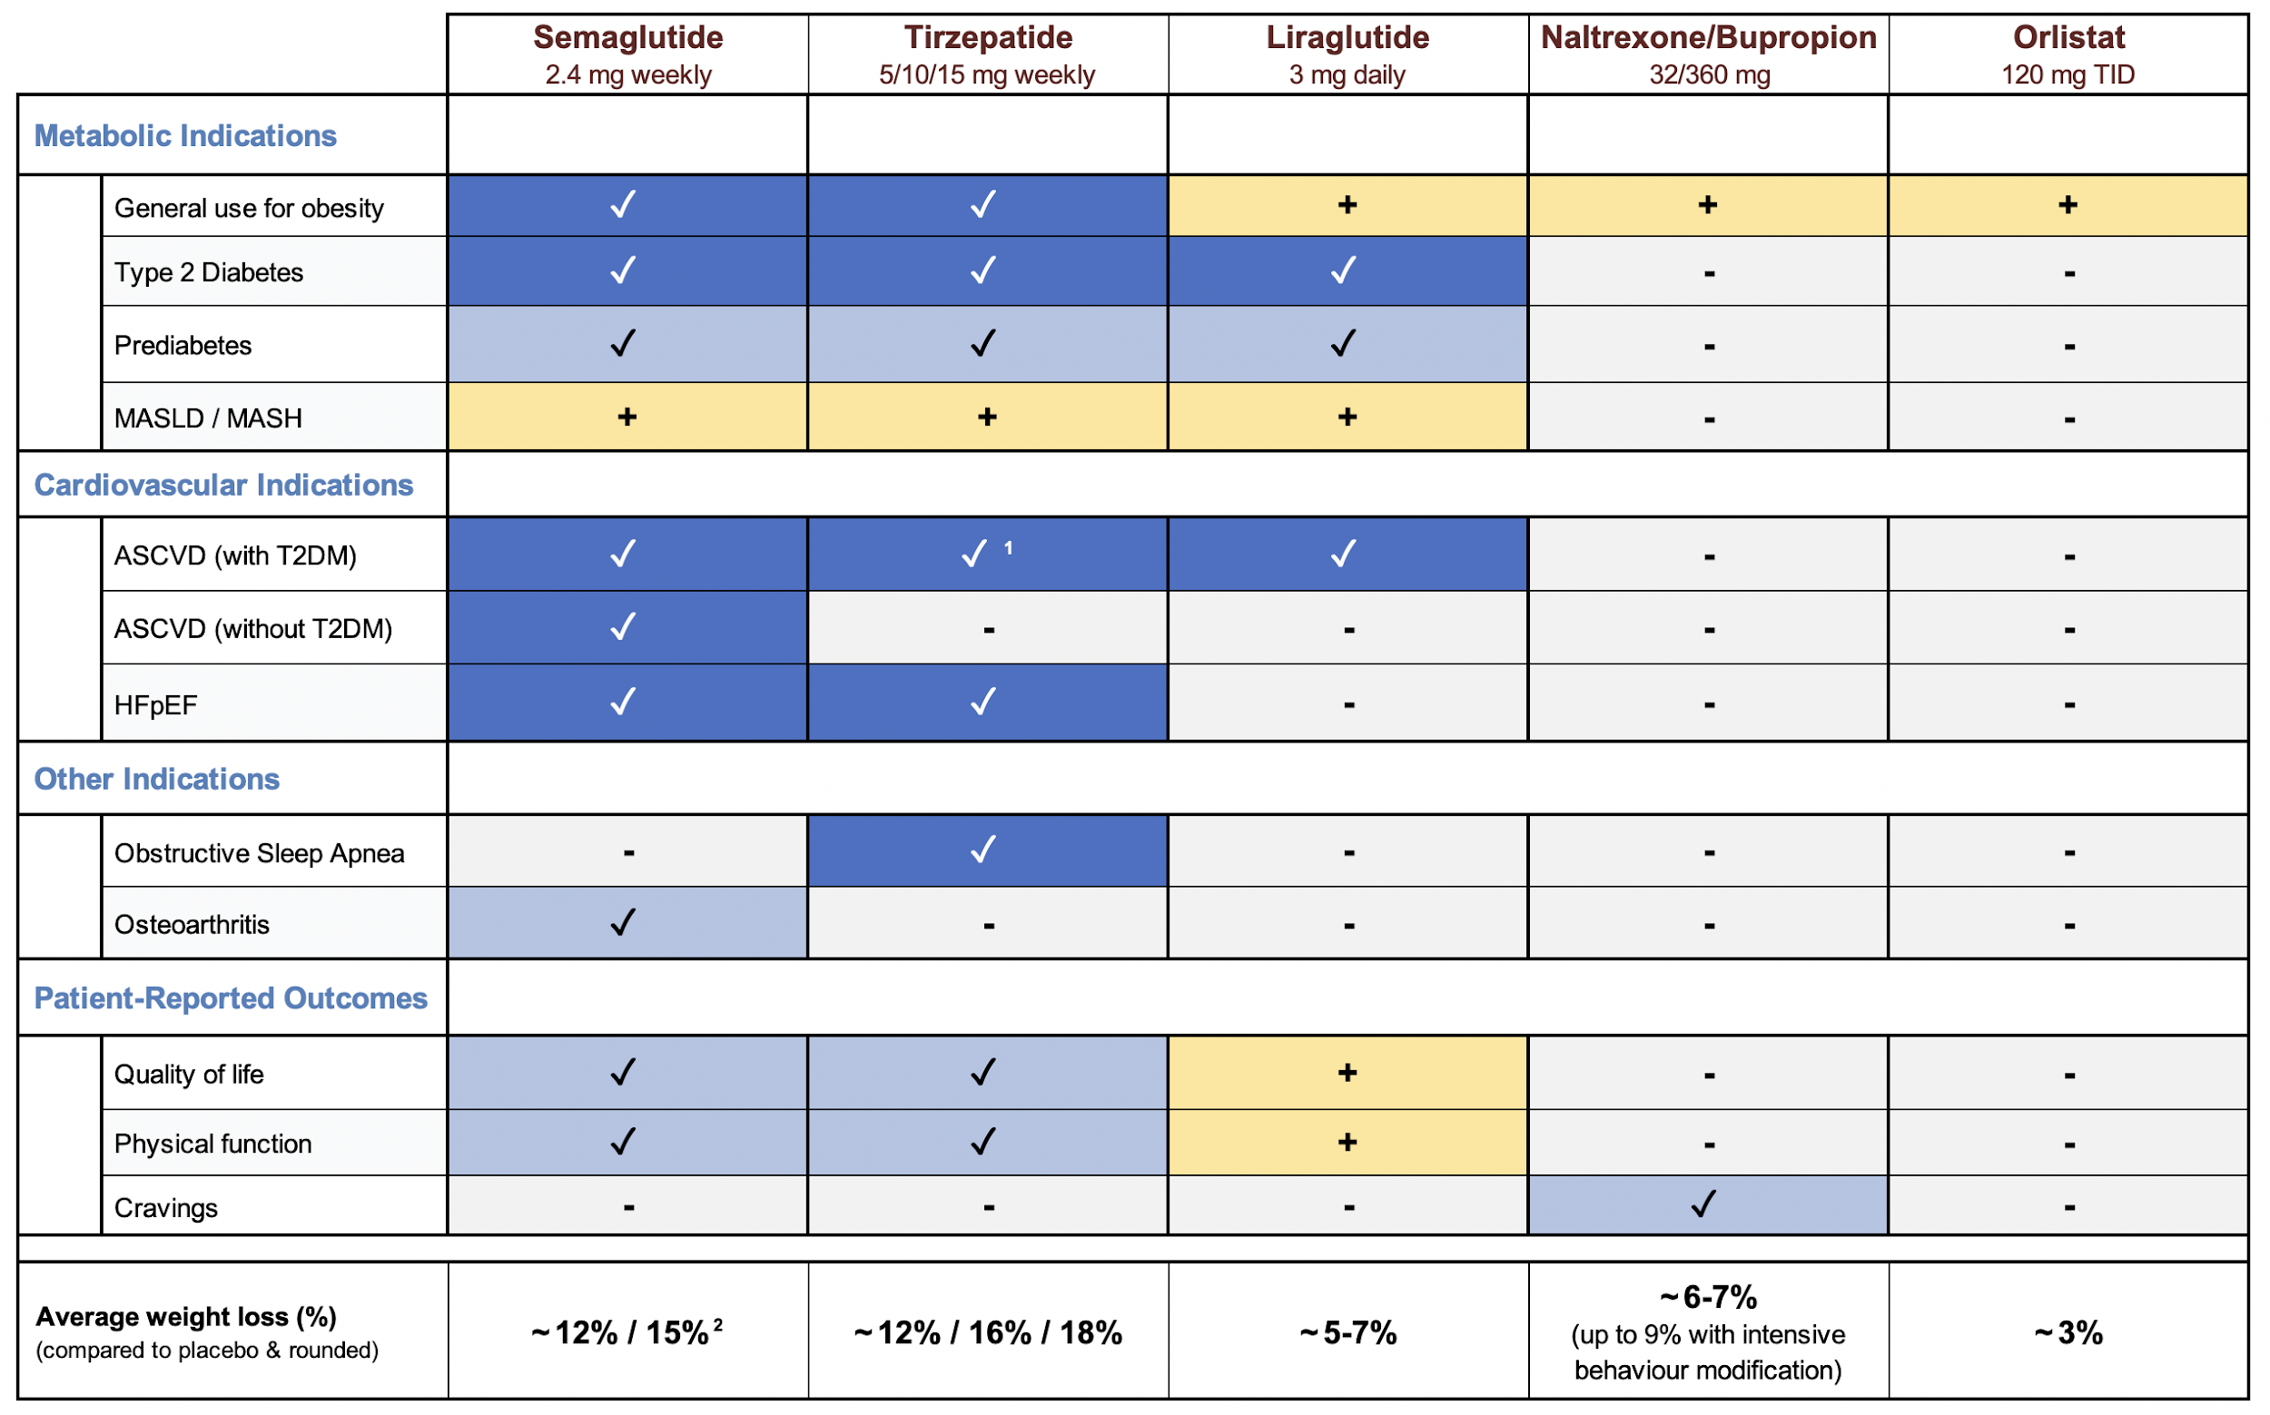
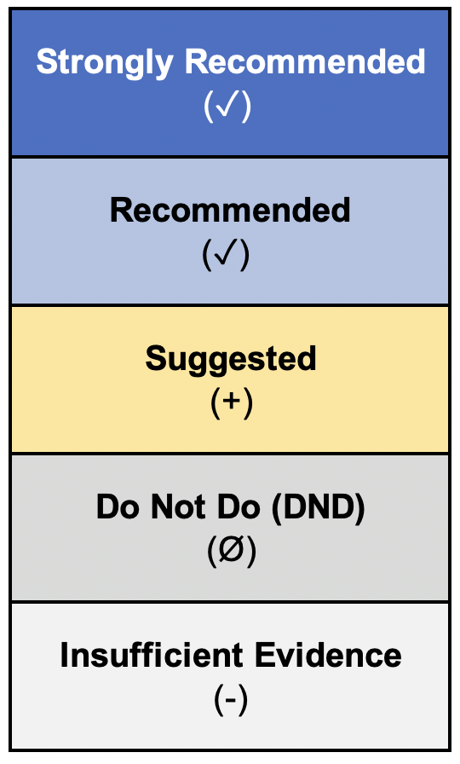
Weight loss medication recommendation chart for obesity in adults
¹ based on results of SURPASS-CVOT trial (EASD Congress 2025)
² based on results of STEP UP trial (Wharton S et al. Lancet Diabetes Endocrinol. 2025)
Anker SD et al. Global Cardiology 2025;3:181-206
Home - iCARDIO Alliance
Note: The format of this figure was informed by a table from the Pharmacotherapy for obesity
management in adults: 2025 Clinical Practice Guideline (CMAJ, 2025)

Slide 16





Contacts
Veronica Dean
Guidelines Development Manager
Phone : +33 685 543 219
vdean@tmacademy.org
www.icardioalliance.org
Christine Gans
Administrative Officer
Phone : +33 660 035 726
christine.gans@tmacademy.org
www.icardioalliance.org
Home - iCARDIO Alliance
Translational Medicine Academy
TMA Foundation - Headquarter: Picassoplatz 8, 4052 Basel, Switzerland

